Slide 1
The Affordable Care Act
Healthy Young America 2013: The Young Adult Perspective

Slide 2

Who are Young Invincibles?

Slide 3
Outline of Presentation
Overview of ACA provisions important to young adults
Methods of outreach
How to get involved

Slide 4


Who Doesn’t Have Insurance?
  17.1% of residents in Arizona lack insurance
27.6% of 18-34 year olds in Arizona lack insurance
15.7% of residents in the U.S. lack insurance
26.9% of 18-34 year olds in the U.S. lack insurance

Slide 5

The ACA: What Affects Young Adults
Provisions that most affect young adults 18-34:
  Women’s preventive services
  Student health plans
  Catastrophic plans
  Medicaid
  Navigators
  Tax credits
What to highlight about the ACA:
  Built-in assistance
  Affordable options
http://www.understandinghealthreform.com/uhr-v1/images/health-care-reform.png

Slide 6
What’s Already in Effect?
Young adults under 26 can stay on their parent’s plan
Those under 19 cannot be denied for pre-existing conditions
No co-pays for screenings, counseling, and well-woman visits
80 or 85% of premiums must be spent on health care service (depending on plan)

Slide 7

Women’s Preventive Services
Well-woman visits
Support for breastfeeding
Domestic violence screening and counseling
Mammograms and cancer screenings

Slide 8

Contraception
As of Aug 2012, new health plans cover contraception with no co-pay
Most plans saw this change in January 2013
Religious institutions exempt
Religiously-affiliated institutions have a delay until January 1, 2014
  Starting Jan. 1, employees and students get coverage directly from insurance companies

Slide 9

Student Health Plans (SHPs)
Serve 1-3 million young adults
Previously limited regulations
Now subject to standardized ACA requirements
  Must include preventive care benefits
  Ends pre-existing condition discrimination

Slide 10
Student Health Plans Update
Phased in Changes to Annual Limits:
  $100,000 minimum cap for 2012-2013 school year
  $500,000 minimum cap for 2013-2014 school year
  No limits for plans beginning on or after Jan. 1, 2014
Phased in Changes to Medical Loss Ratio:
  Approximately 70/30 MLR requirement for 2013 reporting year
  80/20 rule for all reporting years after Jan. 1, 2014

Slide 11

Catastrophic Plans
Available to:
  Young adults under 30 OR;
  Those unable to find a plan under 8% of income
What it covers:
  Three primary care visits a year
  Preventive services
  without co-pay or deductible
  Further services, but with high
  deductible
http://blog.themistrading.com/wp-content/uploads/2012/06/lucy.jpg

Slide 12

Catastrophic Plans
Caution!
  Very high
  deductible
  Tax Credits
  DO NOT apply
http://www.driversedguru.com/wp-content/gallery/becky-images/yellow-light.jpeg

Slide 13

Medicaid Eligibility and Enrollment
Currently Eligible:
  Mostly children and pregnant women
  Some very low-income parents, and disabled citizens
Newly Eligible:
  Everyone with income at or below 133% FPL (about $15,280 annually)
Up to 149,000 young adults in Arizona could become eligible for Medicaid

Slide 14
National update on Medicaid
States will receive 100% federal funding for newly enrolled Medicaid recipients for the first three years (2014, 2015, 2016) to support this expanded coverage.
  Steps down to 90% in 2020
Federal matching funds will not drop below 90% in subsequent years

Slide 15
Medicaid Expansion Population

Slide 16

Marketplaces
What is a marketplace?
  “Health Insurance Exchange”
  Offers plans for individuals and small businesses
  Determines eligibility for Medicaid and tax credits
  Tax credits applied directly
Will operate by:
  Website: HealthCare.Gov
  Telephone hotline: 1-800-318-2596
  In-person assistance
Open for business on October 1

Slide 17
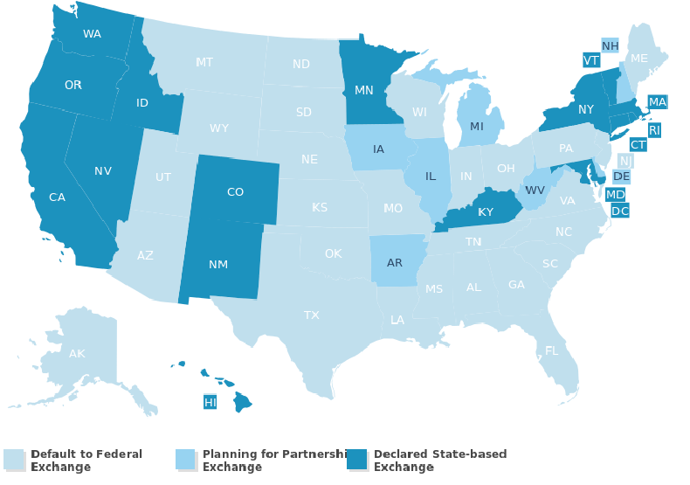
Marketplaces in the US
27 federally facilitated marketplaces
7 state-federal partnerships;
16 states (plus DC) state-based marketplaces
Picture Source: Kaiser Family Foundation

Slide 18

What is a Qualified Health Plan?
Certified by a marketplace
Have adequate provider networks
Utilize Navigators to conduct outreach and enrollment assistance
Streamlined application and coverage information
Provides Essential Health Benefits

Slide 19
10 Essential Health Benefits
Ambulatory patient services
Emergency services
Hospitalization
Maternity/newborn care
Mental health and substance use disorder services
Prescription drugs
Rehabilitative and habilitative services
Laboratory services
Preventive and wellness services/chronic disease management
Pediatric services
Notes:
Ambulatory: http://www.snhhs.org/Leaving-Hospital
Hospitalization: http://www.futurity.org/wp-content/uploads/2012/09/safety_hospital_1.jpg
Maternity/newborn care: http://babies-children.com/images/wallpaper/baby-2.jpg
Mental health and substance use disorder services : http://www.kaiserquotes.com/blog/wp-content/uploads/2012/01/Mental-Health-Insurance_XL.jpg
Prescription drugs: http://www.recyclemorewisconsin.org/wp-content/uploads/2013/01/Medications.jpg
Rehabilitative and habilitative services: http://www.siskinrehab.org/photos/3163-46.jpg
Laboratory services: http://or.ucsf.edu/ehs/11567-DSY/version/default/part/ImageData/data/Lab%20Glassware.jpg
Preventive and wellness services/chronic disease management: http://blackgirlsguidetoweightloss.com/wp-content/uploads/2012/02/gym.jpg
Pediatric services: http://thumbs.dreamstime.com/thumblarge_326/1224802955VoBt2h.jpg

Slide 20

Navigators and Assisters
Designed to assist customer
Outreach and enrollment
Arizona Navigators:
  Arizona Association of Community Health Centers
  Arizona Board of Regents, University of Arizona
  Greater Phoenix Urban League, Inc.
  Campesinos Sin Fronteras, Inc.

Slide 21

Tax Credits
Those making 134-400% FPL will qualify for tax credits (subsidies)
  134% of FPL for 1 person is $15,600
  400% of FPL for 1 person is $46,600
An advanceable tax credit allows a person to receive assistance at the time that they purchase insurance

Slide 22
How Much of a Tax Credit?
Four tiers of plans – Bronze, Silver, Gold, and Platinum
Tax credits are calculated based on Silver plan
Individuals can use tax credit for any plan
Tax credits will change with income
FPL | Income | Premium | Tax Credit | Actual Cost
134% | $1,301 | $252 | $212 | $40
250% | $2,427 | $252 | $56 | $195

Slide 23
How many young people in Arizona could get benefits?
Notes:
Data by CPS calculator

Slide 24

Individual Mandate and Penalties
Individuals must have qualifying health insurance
If not, penalties
  min. $95 the first year
  min. $695 by 2016
  Varies by income
Exemptions
  Native Americans
  Religious reasons
  Incarcerated individuals
  Those who can demonstrate “hardship”
  Those below the tax filing threshold
Picture Source: http://thepinkleague.com/2012/08/30/so-whats-the-lowdown-the-basics-of-football-part-2/

Slide 25

Other important parts of the ACA
No Annual Limits in 2014 (already phasing out)
Tax Credit for employers (already started)
Large employers (50+ FTEs) are required to provide health insurance
  Now beginning in 2015

Slide 26

Recap: The ACA Tailored for Young Adults
Young adults can stay on their parent’s insurance until 26
Student plans are now more comprehensive
Catastrophic plans are an option
Medicaid will reach new populations
Tax credits make plans affordable
Picture Source: http://wymancenter.org/the-importance-of-bulking-up-the-muscle-of-perseverance/

Slide 27
Outreach and Education for Young Adults
Young Invincibles @YI_Care
YoungInvincibles.org
facebook.com/together.invincible

Slide 28
There is an awareness gap
71% of uninsured 18-29 year olds don’t know of new options for insurance
83% of the Medicaid expansion population don’t know of new options for insurance
Research from Enroll America
Notes:
Reference: Informing Enroll America’s Campaign: Findings From a National Survey. Conducted by Lake Research Partners. November, 2012.

Slide 29
Overview
Messaging
Social Media
Traditional Outreach
Mobile Technology
Open Enrollment

Slide 30
Messages Can be Used to Motivate
You can see what your premium, deductibles, and out-of-pocket costs will be before you make a decision to enroll
You can find all the information you need about available health insurance plans in one place

Slide 31
Messages Can be Used to Motivate “Risk-Takers”
Getting covered will save you money
Getting covered now will help ensure financial security later
Individual Mandate will require you to purchase insurance

Slide 32
Use Language Cautiously
Be Careful | Here’s Why | Use This Instead
“Exchange” | People think “Exchange” is a place to trade or swap merchandise and don’t immediately associate it with health care. | “Marketplace”
Messages that only mention “your family” | Single and childless people have trouble identifying with messages exclusively about “family” | “Individuals”
“Financial Assistance Available” | The concept needs more exploration. Many consumers think “assistance” is for someone else, not them. | “You may be eligible for a $0 premium plan or a new type of tax credit that lowers your monthly payment”
Research from Centers for Medicare and Medicaid Services

Slide 33
Use Effective Methods of Interaction
Listen
Engage
Build Relationships
Google Alerts
RSS Readers
Ask questions
Respond in real time
Fun and informative posts
ID Influencers
Share info
Conversations
Shout outs

Slide 34


Use Social Media As an Outreach Tool
One in five Americans have reported using social media for health information
50% of Facebook users are in the 18-34 age group
Young adults value reviews through social media when considering goods and services
Notes:
“Latest News” National Research Corperation. http://hcmg.nationalresearch.com/public/News.aspx?ID=9
www.checkfacebook.com (2011)

Slide 35
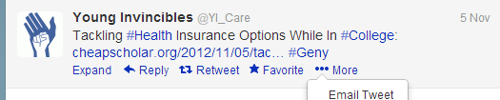
Twitter Anatomy 101
Twitter handle
#Hashtags
Embedded links
Retweet
Share via email
Favorite

Slide 36
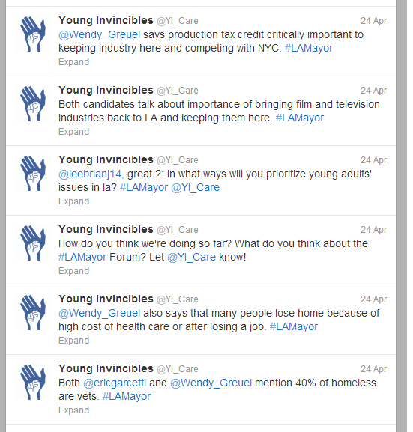
Twitter Chat
Twitter Chats
Twitter chats (aka forums or town halls) are a great way to engage with other activists or outreach targets
Set a specific time and date
Use a specific hashtag for questions and comments (YI used #LAMayor for this Twitter candidate’s forum)
Participants can submit questions ahead of time by tweeting at you, or they can ask questions in real time

Slide 37
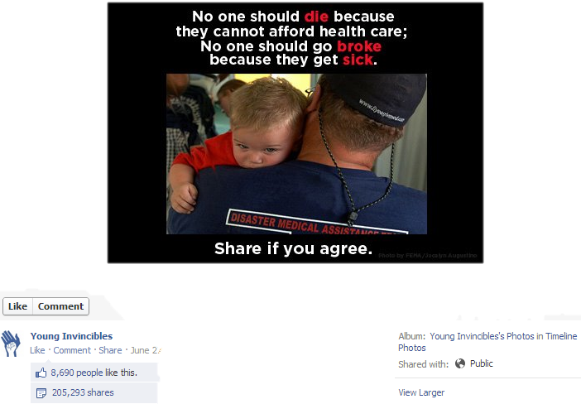
Going Viral

Slide 38
Traditional Outreach
Traditional Outreach
Group Presentations
Hosting Events
Tabling
Brochures and Newsletters

Slide 39
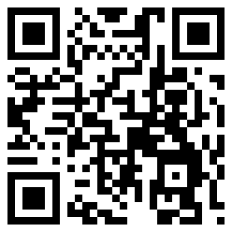
Mobile Technology
Mobile Technology
Text Message Services
QR Codes
Mobile App
Mobile Websites
Notes:
Mobile websites

Slide 40
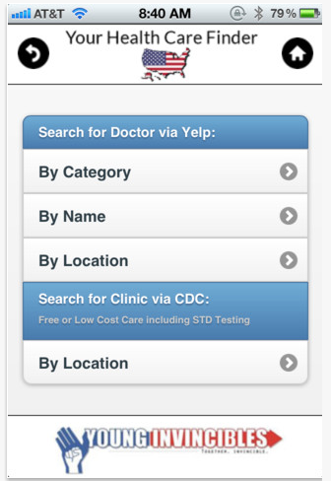
Find a Doctor
Find doctors and Community Health Centers in your area
Search by location with GPS or zip code
Search by name or category
Shows user ratings of doctors in the area

Slide 41
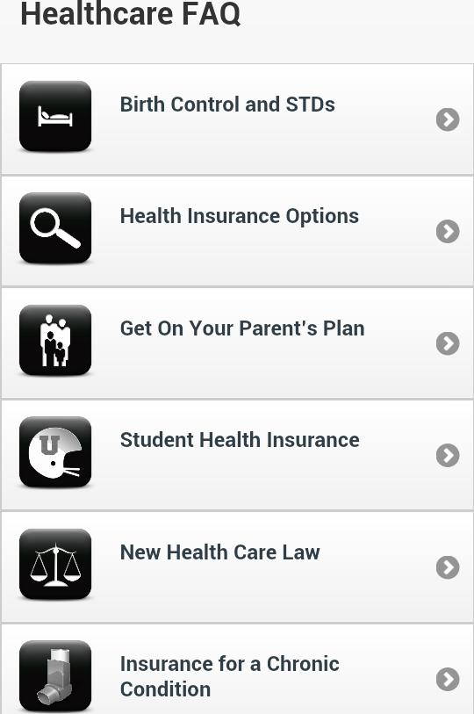
Mobile App Explains Common FAQs
How to find health insurance for different people
Explains the health care law
Defines common health insurance terms

Slide 42
Outreach Plans in Arizona
12 campuses targeted for broad outreach.
Tier 1
ASU-Tempe, Gateway Community College, Glendale Community College, Mesa Community College, Pima Community College, UA-Tucson
Tier 2
ASU-Downtown, Chandler-Gilbert Community College, Estrella Mountain Community College, Paradise Valley Community College, Scottsdale Community College, South Mountain Community College

Slide 43
Outreach Efforts in Arizona
Work with relevant entities on each campus (such as administrators, student life advisors, health center directors, faculty, student leaders, campus media).
Directly communicate with young adults (tabling, speaking in classrooms, presentations to student groups).
Provide opportunities for young adults to get more information through strategically placing materials (including Young Person’s Guide to Health Insurance, Fact Sheets, Top 10 Tips for Young Adults, FAQ, Posters, Social Media).

Slide 44
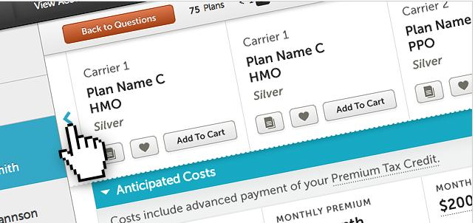
Open Enrollment Starts October 1

Slide 45
What Can You Do?
Visit and Direct Others to HealthCare.gov
Host YI on your campus/facility for a training
Spread the word
  Volunteer with Navigators
  Table
  Social Media
Commitments to spread the word and help others get enrolled

Slide 46

A National Campaign to Cover Young Adults
State-by-State Fact Sheets
Download our App: “Your Health Care Finder”
Outreach Materials
FAQs: Answers for Consumers and Advocates
Calendar of Upcoming Trainings
Follow-up Webinar

Slide 47

HYA Video Contest
Young Invincibles and the US Health & Human Services Dept. Present….
An innovative and unique way to reach young adults
Up to $30,000 in prizes and over 100 chances to win; a single person could win more than $6,500!
Submission period ends 9/23
The first round of public voting starts on 10/1
Three Themes
  You Are Not Invincible → a skit showing why young adults need health insurance
  Perform a Song → covers, parodies, or original songs about getting covered
  Animation → engaging way of informing people of critical facts of the ACA
Go to HealthyYoungAmerica.org to learn more and submit a video!

Slide 48

Keep in Touch
Like us on Facebook
Follow us @YI_Care
Our Contact Information:
Erin Hemlin
Erin.Hemlin@younginvincibles.org
(202) 534-3560 (713) 410-7241
Aurora Garcia
Aurora.Garcia@younginvincibles.org
(562) 519-3106

