Slide 1
Choosing and Using a Health Plan: What Consumers Need to Know
JoAnn Volk
Arizona Assister Training
September 2014

Slide 2
Selecting a Plan
Using Coverage
What to do when there’s a problem

Slide 3
Plan Selection: Understanding a Multi-Dimensional Product
Inside vs. Outside Marketplace
Premiums
Type of Plan (HMO, PPO, etc)
Benefits
Deductibles, other cost-sharing
HSA option?
Networks

Slide 4
Choosing the Optimal Health Plan: Inside vs. Outside the Marketplace
Why buy a Marketplace plan?
APTCs
CSRs
Certification process
On-line shopping tools
Access to future SEPs
Notes:
Plans all meet same minimum standards; no grandfathered plans, no excepted benefit plans – all rules for individual plans will apply and coverage will be MEC
Must enroll in marketplace plan to get APTCs and CSRs
Access to future SEPs: for change in eligibility for APTCs – for example, self-employed with income > 400% of poverty and loses major client and income drops to < 400% FPL

Slide 5
Choosing the Optimal Health Plan: Inside vs. Outside the Marketplace
Why buy outside the Marketplace?
Ineligible for APTCs, CSRs
Choice of insurer
Choice of provider
BUT: beware of non-MEC products
Not eligible for a SEP due to income change
Notes:
Outside HIX – may be right option for someone for whom provider is really important. Esp if in middle of course of treatment.
Non-MEC: short-term limited duration, discount plans, indemnity policies

Slide 6
Types of Insurers
Commercial Health
Insurers
CO-Ops
Former Medicaid MCOs
HMOs
Notes:
One of AZ’s plans, Meritus Health Partners is co-op plan – an plan option created by ACA to increase competition; member owned.
HMOs are integrated insurers – like a Kaiser Permanente – where physicians and hospitals work for the plan.

Slide 7
Health Insurance Basics: Types of Products
HMOs
Plus POS
PPOs
EPOs
MSPs
Excepted Benefit plans
Notes:
* Source: “How Private Insurance Works: A Primer” – prepared for the Kaiser Family Foundation by Georgetown University’s Institution for Health Care Research and Policy, April 2002
Note: a health insurance company can offer more than one type of product.
HMOs (health maintenance organizations)
In network only, with a couple of exceptions
Require participants to work closely with PCP who is responsible for managing and coordinating care
must get referrals from PCP to see a specialist or get additional like diagnostic tests, labs, etc)
If participants don’t get this referral, service generally not covered
The only charges patients have to deal with are copayments.
HMOs can be administratively simpler for patients because their provider deals with filing claims.
HMO’s, on average, tend to cost participants less than PPO and POS plans.
PPOs (preferred provider organizations)
Contract with providers to create a network of participating providers.
You pay less if you use providers that belong to the plan’s network.
You can use doctors, hospitals, and providers outside of the network for an additional cost.
Participants in this type of plan also do not need a referral from their PCP to see specialists, although the specialists themselves may require one.
EPO (Exclusive Provider Organization)
EPO contracts with providers and won’t reimburse for care received OON, but don’t need to be assigned to a PCP and don’t need referral to see a specialist
POS (point of service plan)
You pay less if you use doctors, hospitals, and other health care providers that belong to the plan’s network.
POS plans also require you to get a referral from your primary care doctor in order to see a specialist
MSP: another creation of the ACA to increase competition, but in states where they exist (not AZ) they are run by the Blues so no different from Blue regular offerings. Also not really multi-state, so can’t use them to see providers in more than one state
Excepted Benefit Plans
-- Not MEC
Includes hospital indemnity policies (that pay a fixed dollar amount per day when you are hospitalized), discount plans, short-term nonrenewable policies, or plans that provide coverage only for a specific disease (i.e., cancer-only policies).
- Companies that sell these products, also called “excepted benefits,” are required to notify you if they don’t qualify as MEC

Slide 8
Choosing the Optimal Health Plan: Understanding Cost-sharing
Deductibles
Embedded/not-embedded
The HSA option
Co-payments
Co-insurance
Maximum out-of-pocket protections
Notes:
Defining some terms:
Deductibles can be embedded or aggregate:
If embedded: If you are enrolled in single/individual coverage, you must meet the individual deductible before the plan pays claims for covered services. If you are enrolled in family coverage, the plan begins paying claims for an individual family member once he/she meets the individual deductible. Once the family has met the family deductible, the plan pays claims for all members of the family for covered services.
If aggregate: If you are enrolled in family coverage, once the family has met the family deductible ($ZZZZ), the plan pays claims for covered services. The individual deductible does not apply in family coverage.
The MOOP can be embedded or aggregate in same way:
If embedded: If you are enrolled in single/individual coverage, once you meet the individual OOP limit, the plan will pay 100% of covered services. If you are enrolled in family coverage, once an individual family member has met the individual OOP limit, the plan will pay 100% of covered services for that individual. Once the family meets the family out-of-pocket maximum, the plan will pay 100% of covered services for all members of the family.
If aggregate: If you are enrolled in family coverage, once the family meets the family OOP limit, the plan will pay 100% of covered services. The individual out of pocket maximum does not apply in family coverage.
Note that SBCs do not now have to tell you which type of deductible or MOOP you have in the plan, so if it’s important – for example, if one person in the family needs lots of costly care – it’s best to check, since the embedded approach may work best.
Note that often people tend to focus on a single nu
mber – i.e., annual deductible or MOOP, without realizing that this doesn’t necessarily represent the extent of possible cost-sharing liability. People should choose a plan in which total possible cost-sharing is less than their household liquid cash balance. See KFF: median liquid assets for people 100-250%: $670; 250-400%: $2740.
Also need to watch out for:
Treatment over 2 plan years (if scheduling elective surgery do it at beginning of year, not end)
3) Costs for OON care
On the plus side, per ACA all preventive care covered w/o cost-sharing (but must have “A” or “B” recommendation from USPSTF), and some plans cover certain services under the deductible, i.e., a primary care visit, certain # of drug refills for chronic care management, but watch for office visit charges with this

Slide 9
Choosing the Optimal Health Plan: Selecting a Network
Network adequacy: eye of the beholder
Use of provider directories
Policies and procedures
Tips for consumers
Notes:
QHPs – supposed to have networks that ensure “reasonable access” for policyholders. But what that means can be in eye of beholder
In all cases, ACA does require plans to cover emergency care at in-network rates even when received OON
Provider directories – notoriously out-of-date and inaccurate. Ex: physician retired 20 years who is still in Aetna’s provider directory
Important not just to know which providers are in network but also carrier’s policies and procedures – what happens if you need care that is covered under your policy but no in-network provider to deliver the service?
Particular wrinkle in Arizona, where HMOs required to offer coverage statewide but doesn’t require them to meet tough NA standards – result is plan might be available in a county but not offer providers. I know this was something Allen was working on. People really need to check that provider directory. JoAnn will talk momentarily about what someone should do if they’re enrolled in a plan and realize they’re not happy with the network.
Also, CCIIO has signaled that they may be beefing up their network adequacy review – and possibly imposing time/distance standards in an upcoming rulemaking. NAIC is also working on updating the NA model law.

Slide 10
Choosing the Optimal Health Plan: Using the Summary of Benefits and Coverage
What is the SBC?
What are the coverage scenarios?
Limitations of the SBC
Inaccuracies
Incomplete information
BUT: Big Improvement
Notes:
For people with chronic conditions or anticipated care needs, look carefully – especially at plan limits and exclusions. For example, while annual dollar limits prohibited, plans can still place per-visit limits, ie, on PT services. That should be reflected in the SBC.
Also important information about the NETWORK, like whether they need to go through PCP to see a specialist, and what OON network cost-share is for specific services
Also important information about drug coverage, and a link to the health plan’s formulary
And of course, SBC must clearly indicate whether coverage meets MEC. That will always be true for Marketplace plans, but not necessarily true off Marketplace.
Limitations – only a summary
Ex. Some don’t reflect fact that some issuers cover certain services under the deductible
Coverage scenarios – diabetes and having a baby. calculator inaccurate

Slide 11
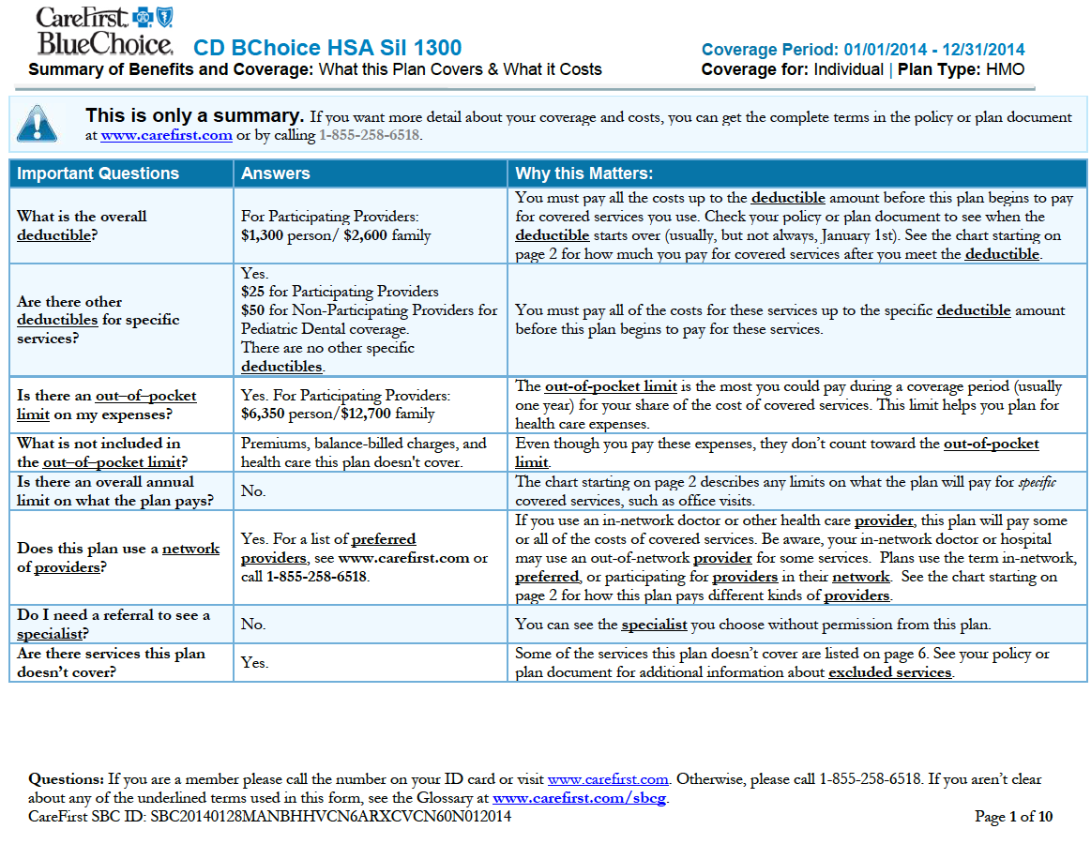

Slide 12
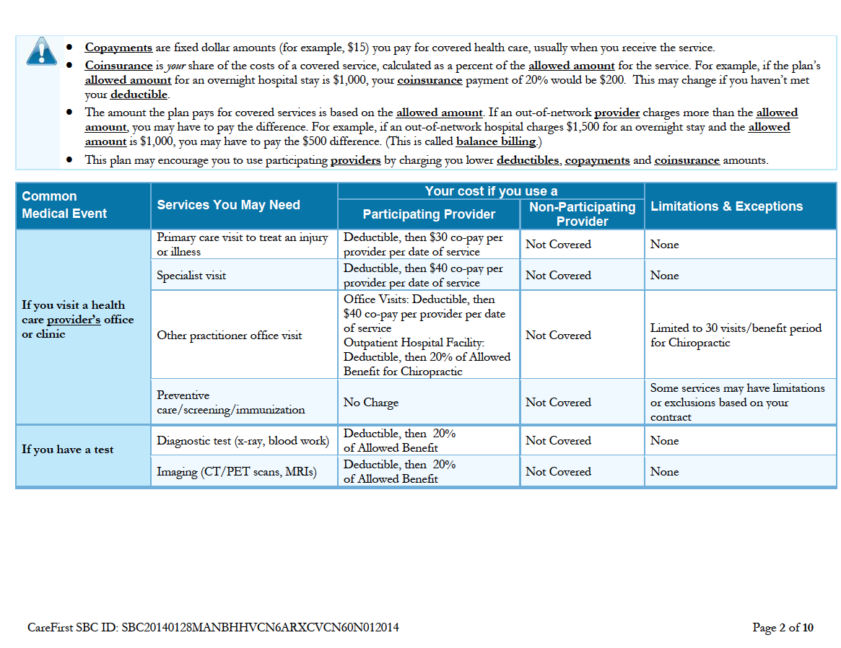

Slide 13
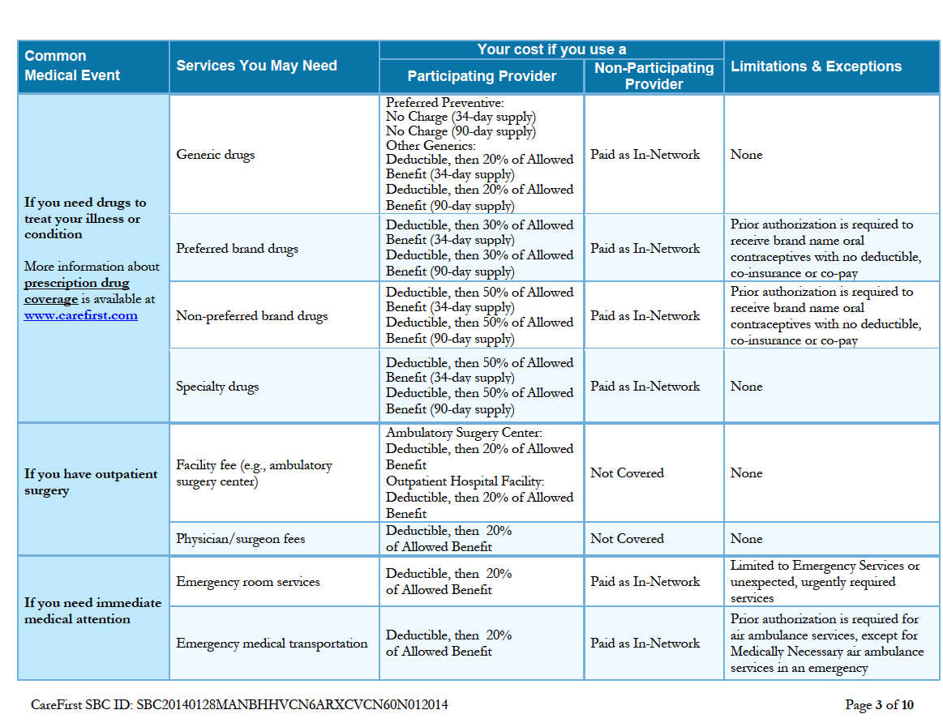

Slide 14
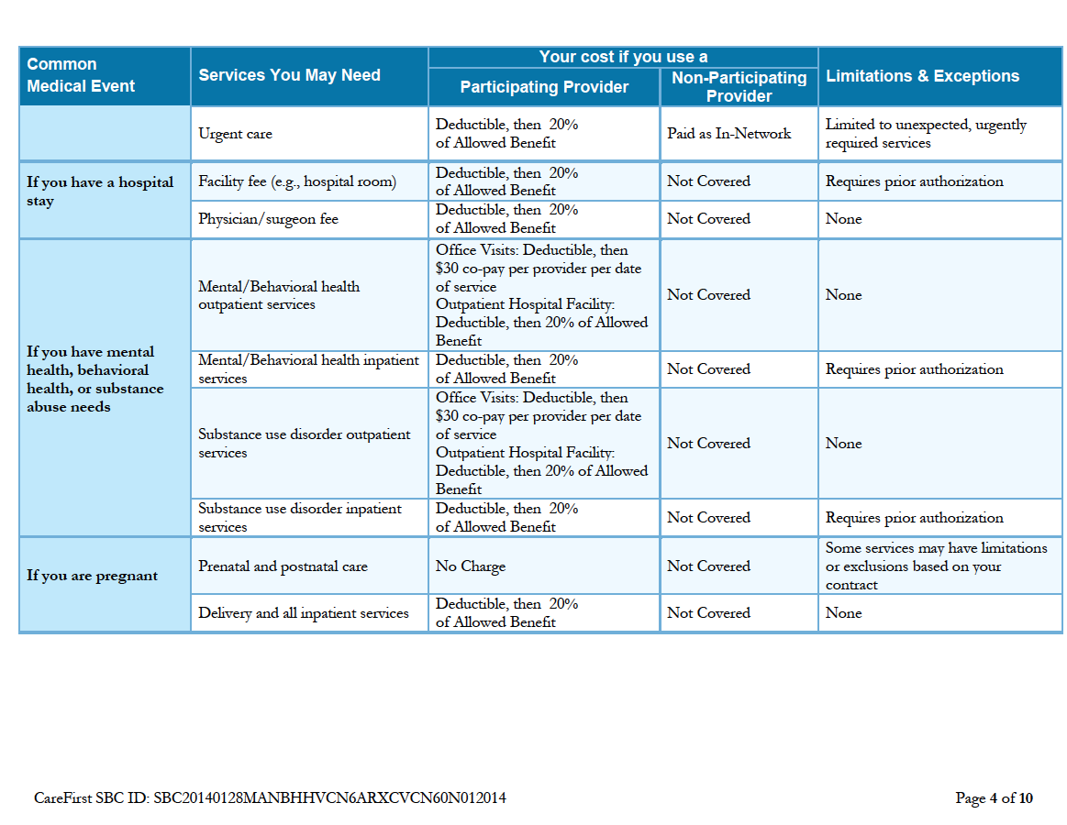

Slide 15
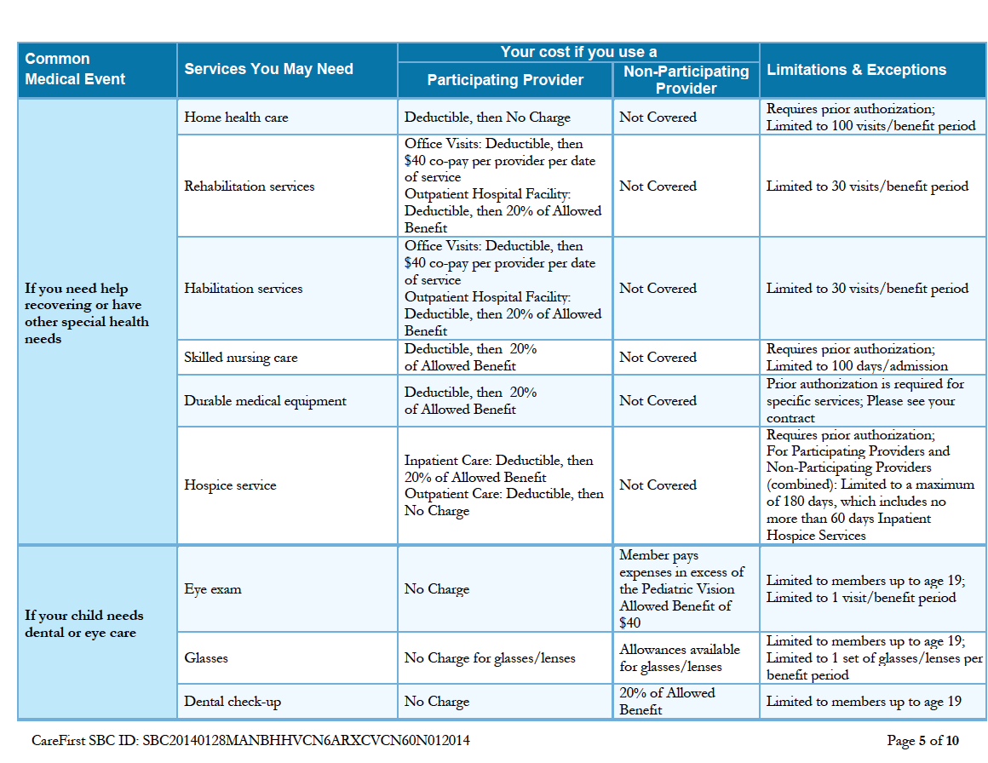

Slide 17
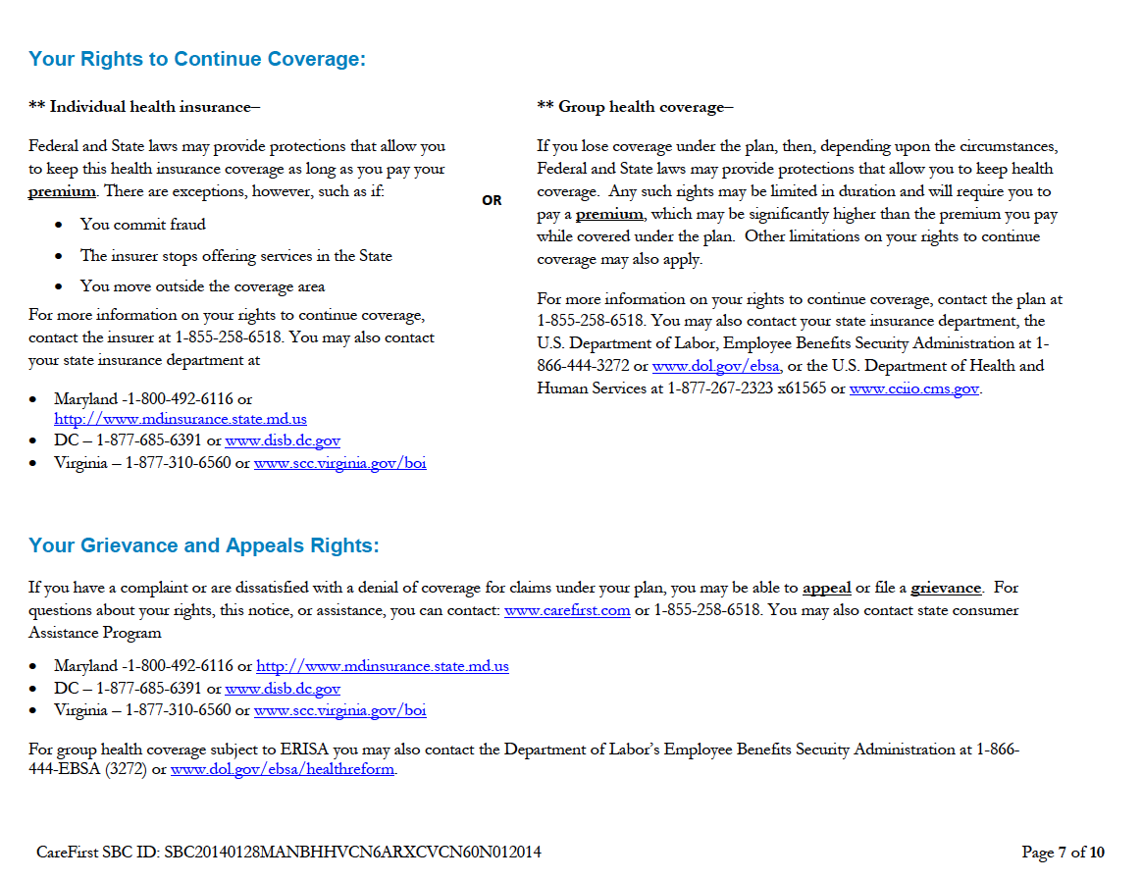

Slide 19
Oops: Changing Plans
Changing plans during open enrollment
Before effective date
After effective date, under certain circumstances; must meet all 4 criteria:
Change to plan with same insurer
Change to plan in same tier and with same cost sharing reduction, if applicable
Change is required to move to more inclusive network or for other limited circumstances identified by CMS
Still within Open Enrollment period
Changing plans outside open enrollment: special enrollment periods
Notes:
can change plans after effective date if meet all 4 criteria
SEP: largely the same inside and out, except for those that apply only in HIM - change in income
- contractual violation of QHP
- change in immigration status
Not in your JD to help with problems with plans, but may come to you
Direct to insurer – a lot can be resolved at plan level
Call DOI

Slide 20
Using Your Health Plan
Paying your premium
Effective Date
Selecting a PCP (if applicable)
In- vs. Out-of-network providers
Appropriate care settings
Referrals and pre-authorization
Deductibles
Other cost-sharing

Slide 21
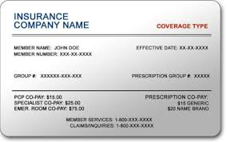
Using Your Health Plan: Paying Premiums and Effective Dates
Problems getting insurance card
Problems with effective dates?
Problems with payments
90-day grace period
Notes:
Card: Ex. Delays getting cards
Effective Date: Plan sets payment deadline; note effective date may or may not coincide with payment of 1st premium so be sure to check with plan
Payments:
Ex. Problem w/ data sent to insurer on APTC so insurer thought consumer should be paying higher premium
Often a data glitch and will require referral to casework
Rule on 90 day grace period

Slide 22
Using Your Health Plan: Provider Issues
Selection of PCP if applicable
Understanding implications of OON care
Tiered provider networks
Appropriate care settings
Continuity of Care
Notes:
PCP: may be required, depending on plan, but is recommended, even if not needed for referrals to specialists
OON care:
won’t apply to MOOP
Tiered networks: all considered “in network” so applies to MOOP
If care OON, will pay more and potentially be subject to balance billing
Also watch out for “inadvertent” OON care when hospitalized. Anesthesiologist, radiologist, ER doc.
Some health plans voluntarily undertake measures to limit the consumer’s cost exposure – by covering the non-network service at the in-network level, and/or by basing reimbursement levels on the provider’s billed charge to limit balance billing. The ACA does not require plans to adopt such measures, however.
Appropriate care settings: PCP for routine care, both when well and when sick. ER for emergencies. In addition to costing patient less, PCP better because:
-- will usually see same provider, but in ER will get whoever is working that day
-- will get check of other issues, general health with PCP, but in ER will focus on condition that brought you in
-- PCP wait time may be shorter than at ER
-- PCP will have access to complete medical record, but in ER that may not be the case
Continuity of care – can apply to both providers (docs, hospitals) and course of drug treatment.

Slide 23
Using Your Health Plan: Cost-sharing Issues
Free preventive services (with caveats)
“Deductible shock”
Some services covered pre-deductible
How does HSA work? (for those who have it)
Drug formulary issues
Non-discrimination
Maximum out-of-pocket
Notes:
Office visits and preventive services:
If office visit billed separately, can charge for it
If not separately billed office visit and primary purpose of visit was to obtain preventive service, can’t charge for office visit
If not separately billed office visit and primary purpose of visit is NOT to obtain preventive service, then can charge for it
Deductibles – note that some plans do cover some services, usually primary care, some urgent care, before the deductible (has been called donut hole coverage).Also, if haven’t figured out whether deductible is embedded or aggregate before choosing plan, will want to understand which applies when using coverage
HAS: tax preferred savings account only available with certain HDHP – minimum deductible of $1,250/$2,500, with limit on contribution allowed ($3,300/$6550)
Formulary: tiers with co-pay or co-insurance;
- AZ has rule that plans must provide 60 days notice to remove drug from formulary
Limits of MOOP: EHB only, in network only, may still be separate MOOPs for benefits in plan, as long as together they don’t exceed limit of $6,350/$12,700

Slide 24
What to do if something goes wrong: Appealing a plan denial
AZ Department of Insurance:
602-364-2499
www.azinsurance.gov
Law includes new protections for appealing a benefit denial from a plan
Internal appeal: consumer can ask plan for full and fair review of decision
External review: consumer can ask independent 3rd party to review plan’s decision
Notes:
No CAP in AZ

Slide 25
What to do if something goes wrong: Appealing a plan denial
Examples of denials that can be appealed:
Joe goes out of network to see a specialist
Plan said Mary’s procedure was not medically necessary
Plan said Alice’s treatment was experimental
Plan said service Bob received is not a covered service
Notes:
Drugs: Note that denials of coverage for a drug can go through an exceptions process, which is similar to this process – an internal review and external review – but is separate.
ACA requires plans to have exceptions process, but AZ has state-specific process that says non-formulary drug must be approved if formulary drug is ineffective in patient or would cause an adverse or harmful reaction
AZ also has requirement that plan provide 60 day notice to member that drug will be removed from formulary. If no notice, report to DOI

Slide 26
Internal Appeals Process
Appeals of Health Plan Denial
Plans must give notice of denial:
Prior Authorization – 15 days
Service Received – 30 days
Urgent Care – 72 hours
Consumer has 6 months to appeal
Plan must give decision on appeal:
Prior Authorization – 15 days
Service Received – 30 days
Urgent Care – As quickly as medical condition requires; no more than 4 business days
Consumer must request an external review within 60 days of plan’s notice of appeal decision.
External appeal decision by independent third party within 60 days of request for external review.
Plan must accept the independent party’s decision.
External Appeals Process
https://www.healthcare.gov/how-do-i-appeal-a-health-insurance-companys-decision/#part=1

Slide 27
Georgetown McCourt School of Public Policy Health Policy Institute Center for Children and Families Center on Health Insurance Reforms
JoAnn Volk
Joann.Volk@georgetown.edu
Website: http://chir.georgetown.edu/
CHIR Blog:
http://chirblog.org/
Tricia Brooks
Tricia.Brooks@georgetown.edu
Website: http://ccf.georgetown.edu/
Say Ahhh! a child health policy blog: http://ccf.georgetown.edu/blog/

