Slide 1
How to talk to consumers about health insurance
Health Literacy Missouri
Catina O’Leary, PhD
Notes:
Hello everyone, and thank you for joining me today.
[introduce self and why you are here]

Slide 2
Today we will discuss
What is Health Literacy Missouri?
What is health insurance literacy?
How do I give an effective group presentation?
How do I guide consumers through health insurance materials?
Notes:
Here’s a brief outline of what we are going to talk about today:
First, I will talk about who we are at Health Literacy Missouri, what we do, our current partnership with the Cover Missouri Coalition, and how we are helping Missouri adults get, use, and keep health insurance.
Next, we’ll explain health insurance literacy and the skills needed.
Then, we will discuss strategies for an effective group presentation.
And finally, we will go over how to guide consumers through health insurance materials to make sure they understand.

Slide 3
Before we begin
Health Literacy:
“The degree to which an individual has the capacity to obtain, communicate, process and understand health information and services in order to make appropriate health decisions.”
— Patient Protection and Affordable Care Act (Title V, Section 5002)
In other words, health literacy is the ability to make good health decisions every day.
Notes:
But before we do that, let’s review what health literacy is. I know many of you may have heard this term before and maybe have taken a training on it. It doesn’t hurt to go over it one more time.
This is the definition for health literacy that is in the Affordable Care Act (Read definition, or give participants time to read it)
This is a pretty good definition, though it’s written at a high reading level (12th grade), and puts the burden on the patient to decide what an “appropriate health decision” is.
We like to think about it more like this (click to bring up simplified definition)

Slide 4
Today we will discuss
What is Health Literacy Missouri?
What is health insurance literacy?
How do I give an effective group presentation?
How do I guide consumers through health insurance materials?
Notes:
Let’s start with who we are at Health Literacy Missouri, what we do, and why we’re here.

Slide 5
What is Health Literacy Missouri?
Health Literacy Missouri
A state-wide non-profit agency
We partner with health care providers, advocates, and organizations
Our goal is to help people make good health decisions every day
Notes:
Started in STL in 2009
We are a state-wide non-profit
The largest health literacy non-profit in the country
We partner with health care providers, advocates, and organizations who want patients to be healthier, systems to work and flow better, and materials to make more sense
Our goal is to help people make good health decisions every day

Slide 6
What is Health Literacy Missouri?
What we do
Health literacy trainings
Health environment assessments
Plain language review
Partnerships and coalitions
Notes:
HLM is a thought leader in the field of clear health communication. We specialize in tailoring evidence based approaches to spoken and written health communication to community members, health students, educators, and professions.
We do this in a variety of ways. We provide health literacy trainings to professionals that cover topics such as these:
How to speak with clients
How to write clearly
How to make easy-to-use materials
We also conduct health environment assessments of health care and public health facilities.
Our plain language team also reviews and revises documents and materials to ensure clear communication.
And finally, we partner with businesses and organizations to make a larger impact on health and health outcomes.

Slide 7
What is Health Literacy Missouri?
The State of Missouri
Missouri is not an expansion state
More than 300,000 Missouri adults fall in the Medicaid gap
The Missouri legislature is considering Medicaid expansion in the 2014 session
Notes:
Before we move on, I want to explain a little about our work in health insurance and health insurance literacy.
Let’s discuss the state of Missouri’s Medicaid situation and what we and other organizations in Missouri are doing about it.
Missouri Governor Jay Nixon has accepted the Medicaid expansion provision but the Republican-led legislature will not accept Medicaid expansion.
Because Missouri did not expand Medicaid, more than 300,000 Missouri adults will not qualify for Medicaid and will fall into the coverage gap, meaning they cannot afford health insurance and they cannot receive tax subsidies.
The Missouri legislature is considering Medicaid expansion but continues to table the discussion each session.
In 2014, Missouri will lose $2 billion in federal funding that could have been used to extend health insurance coverage to approximately 300,00 of the working-poor in Missouri.

Slide 8
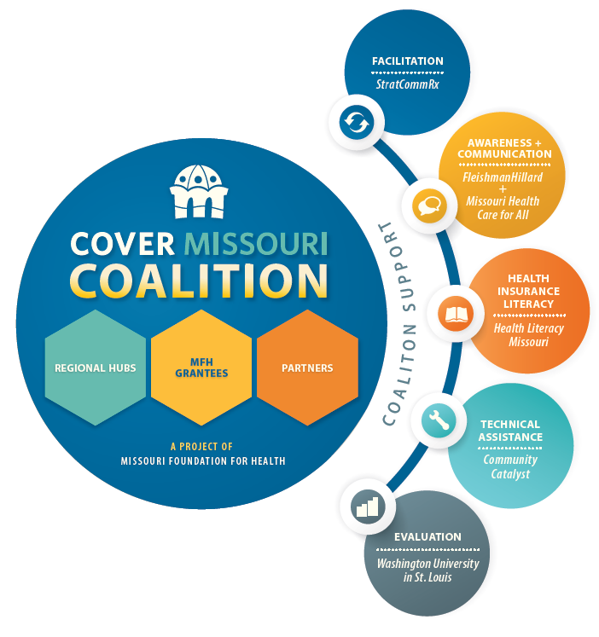
What is Health Literacy Missouri?
Cover Missouri Coalition
A project of the Missouri Foundation for Health (MFH)
Goal: to promote quality, affordable health coverage for every Missourian and to decrease the rate of uninsured to 5% in 5 years
Notes:
Because of the lack of Medicaid expansion and the lack of outreach to get Missourians to sign up for health insurance, the Cover Missouri Coalition was started in 2013 by the Missouri Foundation for Health.
It is made up of 450 agencies and organizations across the state of Missouri that share the vision of reducing the number of uninsured in Missouri.
The goal of the Cover Missouri Coalition is to promote quality, affordable health coverage for every Missourian and to reduce the rate of uninsured to 5% in 5 years.

Slide 9
What is Health Literacy Missouri?
Cover Missouri Coalition
Members work to build awareness, facilitate enrollment, increase health insurance literacy, and support Medicaid transformation
Total uninsured: 877,000 (2012)
2013 Enrollment Impact: 152,335 people
Almost 30% more than the federal goal
Notes:
The Cover Missouri Coalition reaches this goal by having its members work to build awareness, facilitate enrollment, increase health insurance literacy, and support Medicaid transformation.
When Cover Missouri started, Missouri had around 877,000 uninsured adults.
A CMS report issued in 2013 projected enrollment in Missouri to be 118,000, but with the help of the Cover Missouri Coalition, the enrollment number exceed that to 152,335 people. [CLICK] Or almost 30% more than the federal goal set for Missouri.

Slide 10
What is Health Literacy Missouri?
Health Literacy Missouri’s Role
We help coalition members:
Clearly communicate health insurance topics
Help consumers understand health insurance
Notes:
Health Literacy Missouri has been a part of Cover Missouri since the beginning. We were awarded a grant from the Missouri Foundation for Health to provide communication and health literacy expertise to the coalition and its members. We have 3 community partners:
Insurance expertise – The Mission Center
Cultural and linguistic expertise – The International Institute of St. Louis
Outreach and education - University of Missouri Extension Services
Our role is to partner with the coalition members and work together to help clients understand and use health insurance.

Slide 11
What is Health Literacy Missouri?
Health Literacy Missouri’s Role
Health Insurance Literacy project:
Videos, self-guided eLearnings, print materials
Plain language review
Translations
Notes:
To accomplish this, we at HLM will present health insurance literacy topics of interest in videos, eLearnings, and print materials over the next year.
We also give brief presentations on different health insurance literacy topics during webinars and summits.
Health Literacy Missouri also coordinates social media outreach about health insurance literacy.
HLM’s plain language team reviews and revises documents to help make them clear and works with project partners to translate health insurance materials into different languages.

Slide 12
Today we will discuss
What is Health Literacy Missouri?
What is health insurance literacy?
How do I give an effective group presentation?
How do I guide consumers through health insurance materials?
Notes:
What is health insurance literacy? You may have heard these words before, but we’re going to take a closer look at how health literacy and health insurance literacy is a fundamental component of our work in helping people get, use, and keep health insurance.

Slide 13
What is health insurance literacy?
Health Insurance Literacy:
“A person’s ability to find and evaluate information about health plans, select and use the best plan for their financial and health circumstances, and use the plan once enrolled.”
— Consumers Union, 2012
In other words, health insurance literacy is the ability to choose, use, and keep health insurance.
Notes:
So what is health insurance literacy? Here is a definition from the Consumer’s Union. This definition covers the full scope of health insurance literacy – simply put,
(Click to bring up simplified definition)
Health Insurance Literacy is about empowering consumers so that they can choose and use their health insurance in ways that improve their health.

Slide 14
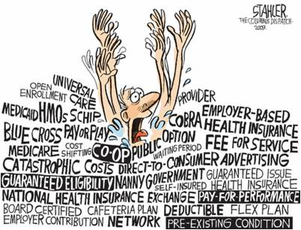
What is health insurance literacy?
Low health insurance literacy
At some point, everyone has difficulty:
Understanding health insurance information
Using health insurance once they have it
Notes:
Health insurance information can be very difficult to understand, as you know from your work. It involves legal jargon and industry jargon that most people don’t use in their daily lives. (Offer personal example, if you have one). I’m sure most of you could describe a time where you or someone you know had trouble understanding health insurance information.
We know that the populations we are working to enroll are especially vulnerable to low health insurance literacy. Many have never had health insurance before, and are hearing health insurance terms and having to perform complicated tasks for the first time.
Even when someone has health insurance, whether they’ve had it for a while or are just getting it for the first time, it’s challenging. Let’s take a look at some of the high-level tasks needed to be a patient with health insurance.

Slide 15
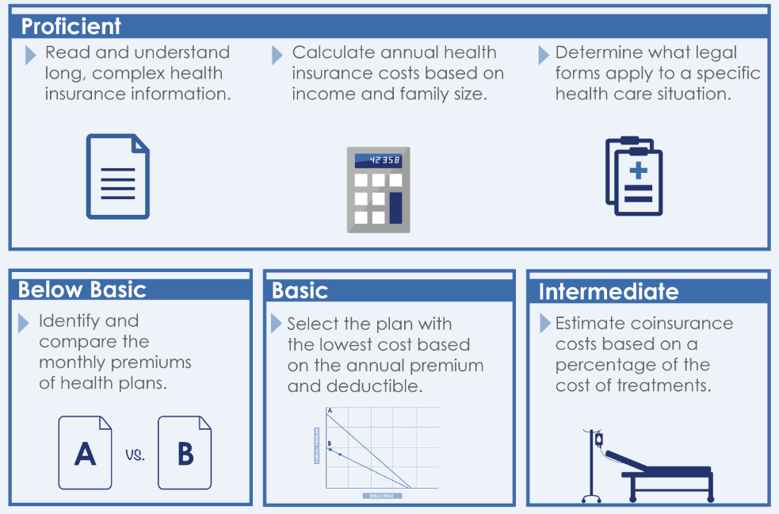
What is health insurance literacy?
Health literacy in the US
-National Assessment of Adult Literacy (NAAL), The Health Literacy of America’s Adults, 2003
Notes:
The National Assessment of Adult Literacy or NAAL for short conducted the first-ever national assessment designed to measure health literacy in 2003.
These are the 4 categories that U.S. adults fall in. A person can only complete tasks at and below their skill level. For example, a person who has basic level skills can not complete tasks in the Intermediate or Proficient categories.
The assessment shows that only 12 percent of U.S. adults had proficient health literacy. More than 1 in 3 U.S. adults would have difficulty with common health tasks such as following directions on a prescription drug label or understanding how to follow a childhood immunization schedule. That’s 77 million people, or 12 times the population of Arizona.
If we think about all of the skills necessary to make informed decisions about health insurance, they’re quite complex and would fit around these higher skill levels.
-calculating costs
-comparing plans
-understanding complex terms
What this tells us is that clients need a broad range of skills to get, use and keep health insurance. What kind of skills do they need?

Slide 16
What is health insurance literacy?
Consumers need a broad range of skills
Reading, understanding, and acting on written information
Using complex tools to make choices
Performing numeracy tasks
Navigating and using online technology
Notes:
Consumers need a broad range of skills
First, consumers need to read, understand and act on written information. This means understanding new words like premium, copay, explanation of benefits, and out-of-pocket maximum.
They will also need to understand how to read medication information, and then use their medicine correctly.
People also need to use complex tools like the online Marketplace, an insurance company website, or a company phone tree. For example, they may need to use a website to find an in-network provider.
People also need to use numbers. For example, to understand, calculate and compare costs of different plans. Managing health insurance also means managing personal finances. Some consumers might struggle with financial literacy even if they understand how to use their health insurance. Do they understand the trade-offs of having a low premium and high deductible versus a high premium and a low deductible?
Clients will also need some level of computer and technology literacy. They will need to remember a variety of logins and passwords, understand how to fill out online forms, and, maybe most important, trust computers and websites that need confidential information.
.

Slide 17
Today we will discuss
What is Health Literacy Missouri?
What is health insurance literacy?
How do I give an effective group presentation?
How do I guide consumers through health insurance materials?
Notes:
Now let’s talk about ways to give an effective group presentation.

Slide 18
How do I give an effective group presentation?
Today’s realities
Communicating effectively is more important and challenging than ever
People are distracted
People “self-select” what they want to hear
Attention spans are shorter
Notes:
Talking with consumers about health insurance is an important part of our job. But today, communicating effectively is harder than ever.
People are distracted. Our cell phones are always beeping at us.
People choose what to pay attention to. We are competing with a lot of other demands.
Attention spans are shorter. We have a limited amount of time to get our messages across.

Slide 19
How do I give an effective group presentation?
Why communicate?
Every communication has the potential to …
Help achieve organizational objectives
Tell your story to key audiences
Build reputation
Have an impact
Preparation is key for communicating with any audience
Notes:
Communication is more important than ever. Each communication has the potential to make an impact.
We need to be prepared to communicate and get our messages across.

Slide 20
How do I give an effective group presentation?
What makes this difficult?
Health care is …
Emotionally charged
Intensely personal
Insurance is …
Impacted by personal finances
Confusing and difficult to understand
The Marketplace is …
Polarizing to some people
An unknown
Confusing!
Notes:
Communicating about health insurance can be difficult.
Health care is emotional. People may be sick or scared of finding out if they are sick, adding stress to the situation.
Insurance is also impacted by personal finance. How many people here like talking about money or how much money they make. Insurance is also difficult to understand – something we just talked about.
The Marketplace is also confusing. People may not know what it is, where to go to find it, or how to use it.

Slide 21
How do I give an effective group presentation?
Audiences have different and conflicting:
Backgrounds
Levels of understanding
Priorities
Interests
Questions
Still, the messages need to be consistent
Notes:
We also need to consider that audiences have different levels of understanding, priorities, interests and questions.
This is why messages need to be consistent. I’m sure we’ve all been in a situation where instructions are given, and we know what to do. Then someone asks a question, and the instructions are given a little bit differently, and then we have no clue what we are supposed to do.
At Cover Missouri, we have some key messages.

Slide 22
How do I give an effective group presentation?
Key Messages
Most people are required to have health insurance or pay a penalty
If you can’t get affordable health insurance from work, you can buy it through the Arizona Health Insurance Marketplace
The Marketplace is a website where you and your family can compare and buy the insurance plan that fits your budget and health care needs
Notes:
Here are some of the key messages that the research indicates are important to communicate to consumers.
Last year, research showed that people were scared about the penalty – they didn’t know how it would affect them. This year, people are more familiar, so Cover MO is using this message to motivate people to get health insurance.
People also need to know who can buy insurance through the Marketplace, and what the Marketplace is.

Slide 23
How do I give an effective group presentation?
Key Messages
You can get help paying for insurance if you can’t afford it. If you meet certain income requirements, you may be able to lower coverage costs in one or two ways:
A new tax credit that lowers your monthly premium (or payment)
A cost-sharing reduction that lowers what you pay out-of-pocket
You can get in-person help from trained assisters To find one near you, visit www.healthearizonaplus.gov or you can speak to someone by calling 1-855-432-7587
Notes:
Financial help is another key message. The message that you can get help paying for insurance.
Last, the message that in-person help is available.

Slide 24
How do I give an effective group presentation?
Know your audience
Tailor your presentation
Notes:
You may be asked to give presentations to groups about health insurance. Let’s look at some things to keep in mind as you build a presentation.
One of the first things you should ask yourself when presenting is: who is this presentation for? The presentation will be most effective when targeted to a specific audience.
Tailor your presentation content and style to your audience. Consider culture, age, gender, and geographic location.
Put yourself in their shoes, and ask yourself:
What does my audience need to know?
What does my audience already know?
What questions will my audience have?

Slide 25
How do I give an effective group presentation?
Front load information
Present the most important information first
Most important
Specific information
Background information
Notes:
Organize your presentation.
Front load your information, meaning:
[click] Put the most important information at the beginning of the presentation.
Then move you can start to fill in with specific information and then background information, if needed.
At the end of the presentation, repeat your most important information and tell them what they need to do next.

Slide 26
How do I give an effective group presentation?
Break content into “chunks”
Keep related information together
How do I get health insurance?
How do I use health insurance?
How do I keep health insurance?
Notes:
Use what we call “advanced organizers” – a table of contents and slide titles – to cue the audience for what's to come.
Break your content into meaningful “chunks.” Each chunk should only have one idea or purpose.
Keep related information together as a way to keep the presentation organized.
Here is an example of how to break health insurance down into chunks:
[click] How do I get health insurance?
[click] How do I use health insurance?
[click] How do I keep health insurance?

Slide 27
How do I give an effective group presentation?
Use visuals
Attract attention
Replace words
Show steps in a process
Act out or draw
Notes:
Visuals make your presentation more appealing. Graphics attract attention, reduce words for low literate readers, and can help explain steps in a process or different options someone can take.
People have different learning styles: some learn better by seeing pictures, some by listening, some by writing, and others learn by doing. Besides using visuals, you can act out or draw what you are describing.
Visuals are great for showing steps to take an action. For example, this Cover MO graphic uses visuals to show the steps to finding an insurance plan that’s right for you.
A word of caution: don’t overload your slides with text or visuals. You can see that this slide is filled with text. We recommend that you have 30% to 50% white space on each slide.

Slide 28
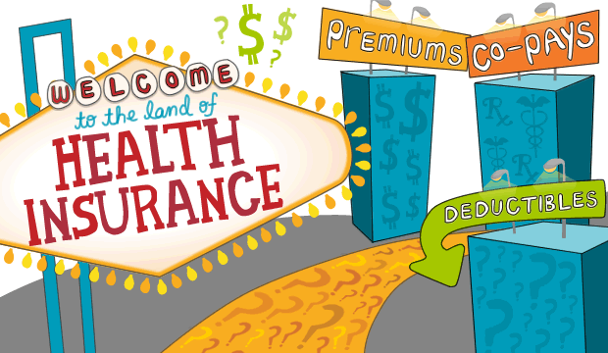
How do I give an effective group presentation?
Avoid jargon
Use short, common words
Explain technical words
Describe health insurance terms with every day language
Notes:
Lastly, let’s talk about using simple language.
Avoid jargon whenever possible. Jargon is special words or expressions used by a profession that are difficult for others to understand.
Use shorter, more common words that are easier to understand
Even words that seem common to us because we use them frequently, like the word “eligible,” may be confusing for clients.
Explain technical words
As we already talked about, stop and explain technical terms the first time you use them in your presentation. If you use an acronym, like FPL, give the full name – “Federal Poverty Level” the first time you use it, with the acronym “FPL” in parentheses, then you can use the acronym for the rest of the presentation.

Slide 29
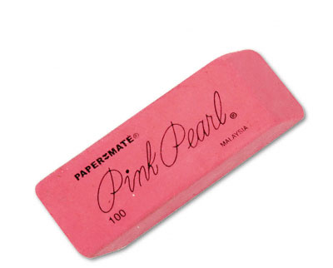
How do I give an effective group presentation?
Cubic containment system
Misapplication elimination device
Follicle redistribution mechanism
Vermin de-infestation apparatus
Notes:
ACTIVITY
Know what these are? [Have them guess each one. Click to bring up the text, pause, then click again for its picture. Do this 4 times]

Slide 30
How do I give an effective group presentation?
Takeaways
Know your audience
Put the most important information first
Break information into chunks
Use visuals
Avoid jargon and technical words
Notes:
Here are the main takeaways for presenting to groups:
Know your audience – tailor your presentation to your audience.
Put the most important information first – go from “most important” to “specific information” to “background information”
Break information into chunks – each chunk should have 1 main idea or point
Use visuals – graphics attract attention and reduce words for low literate readers
Avoid jargon and technical words – use short, common words to describe terms in every day language

Slide 31
Today we will discuss
What is Health Literacy Missouri?
What is health insurance literacy?
How do I give an effective group presentation?
How do I guide consumers through health insurance materials?
Notes:
Finally, let’s go over guiding clients through health insurance materials.

Slide 32
How do I guide consumers through health insurance materials?
Prepare for tough questions
Think through possible questions
Work with colleagues to prepare
Have answers prepared
Disagreement with ACA Law of the land
Previous denial New consumer protections
Cost Tax credits
Be prepared to repeat the answer
Notes:
As I already mentioned, preparation is key for communicating. It’s important to be prepared for questions your client will ask you. While you may not know every question that could be asked, there are common questions that I’m sure all of you have been asked.
Would anyone like to share some common questions they’ve heard? [let audience answer]
You can work with your colleagues to prepare how you will answer these questions.
To prepare for tough questions, it can be helpful to already have answers ready for the client. For example, if they have questions about the ACA, you can tell them that it’s the law of the land or if they have questions about being denied in the past, you can explain that there are new consumer protection laws for them (example: You cannot be denied for a previous condition).
And be prepared to repeat the answer or reword your answer for the consumer.

Slide 33
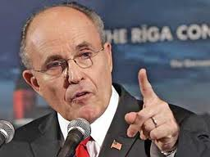
How do I guide consumers through health insurance materials?
Universal Precautions for Communication
“Using clear and simple communication with all individuals.”
- DeWalt et. al. (2010)
Notes:
Is anyone here familiar with universal precautions? In medicine, it usually means using protections, like wearing gloves, because you can’t tell who is sick and who’s not.
[click] In communication, it means using clear and simple communication with everyone.
You might recognize this picture of NY mayor Rudy Giuliani. He thought he was cancer free when his doctor told him several years ago that his prostate biopsy was “positive”. When he found out he said, “Oh wow. Positive. Positive is good right?” Really, positive indicates the presence of cancer. I shared this story as an example that you can’t tell by looking at someone, if they will understand information.
When talking to consumers about health insurance, the best practice is to assume that everyone has a hard time understanding health insurance.

Slide 34
How do I guide consumers through health insurance materials?
Use Universal Precautions for communication
Speak slowly
Use a friendly tone of voice
Match your wording to the culture of your client
Notes:
How can you use Universal Precautions when talking about health insurance?
First, remember to speak slowly. We all know that health insurance information is difficult to understand. An easy way to check yourself is, if you’re speaking like you do with someone who understands what you’re talking about or knows you, try to slow down. And remember, speaking slower is not the same as speaking louder.
Use a friendly tone to make the client more receptive to your information – I’m sure you all do this!
Try to use words and phrases that match your client – their age, culture, or background.

Slide 35
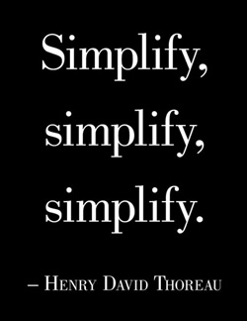
How do I guide consumers through health insurance materials?
Use plain language
Use short, direct sentences
Use common words
Explain technical terms
Notes:
Use plain language when you speak and write. Again:
Use short, direct sentences that are clear and easy to understand.
Use common words whenever possible.
If you do have to use a technical word or jargon, like “deductible” or “premium,” explain the term.

Slide 36
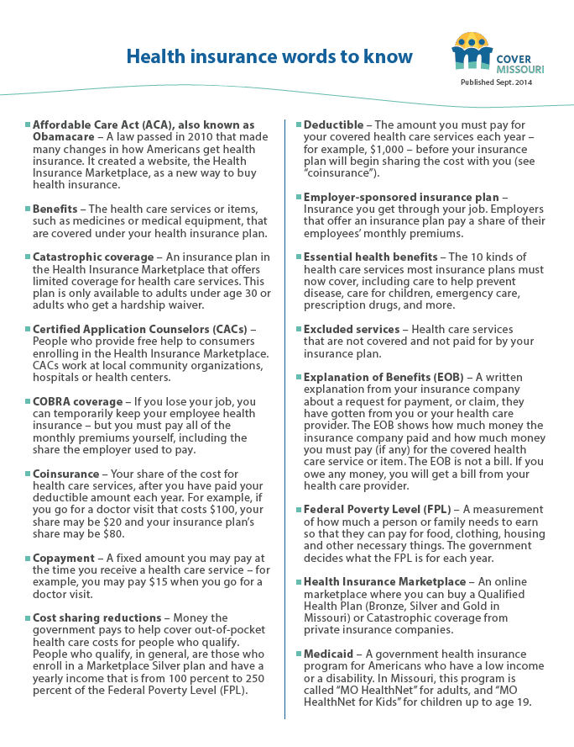
How do I guide consumers through health insurance materials?
Notes:
We created a glossary of health insurance words to know with simple explanations. We recommend using these to explain insurance terms.
For example, when you use a word like copayment, pause, and provide the simple explanation.
[click for copayment definition]
And the same for premium.
[click for premium definition]
A longer version of this glossary will be available on the Cover Missouri website.

Slide 37
How do I guide consumers through health insurance materials?
Jargon | Common Word
alternative
comprehensive
insufficient
register
maximum
annually
reimburse
option, another choice
covers everything
not enough, too little
sign up
the most you will have to pay
yearly
pay back, refund
Notes:
Let’s look at some words used with health insurance that we consider jargon. Tell me what common words you would use instead of these jargon words. [click – 7 times total]

Slide 38
How do I guide consumers through health insurance materials?
Use only essential numbers
Do the math
Don’t make the consumer calculate numbers
Family size | Yearly* | Monthly* | Hourly*
1 | $11,490 – $45,960 | $958 – $3,832 | $5.52 – $22.10
2 | $15,510 – $62,040 | $1,293 – $5,172 | $7.46 – $29.83
3 | $19,530 – $78,120 | $1,628 – $6,510 | $9.39 – $37.56
4 | $23,550 – $94,200 | $1,963 – $7,850 | $11.32 – $45.29
5 | $27,570 – $110,280 | $2,298 – $9,190 | $13.25 – $53.02
6 | $31,590 – $126,360 | $2,633 – $10,530 | $15.19 – $60.75
*Before-tax household income
U.S. Department of Health and Human Services (2013)
Notes:
Let's talk about numbers for a minute. Numbers are very important in health insurance.
You all deal with lots of numbers when explaining health insurance to consumers, such as premiums, tax credits, and cost sharing.
Numbers are important because, if you can explain them effectively, consumers will be able to make their own choices about health insurance and health costs in the future.
One tip is to only use the most important numbers – don’t give numbers that aren’t essential to helping your client understand. For example, costs of premiums and deductibles are important numbers, but percentages of people purchasing other health insurance plans is not an important number.
We all may recognize this chart or numbers that show up to 400% of the Federal Poverty Level. It is intended to show consumers whether or not they can qualify for financial help in the Marketplace, and does the math to show the income for hourly and monthly wages – this way consumers don’t need to calculate. Cover Missouri members found this chart very useful when working with consumers.

Slide 39
How do I guide consumers through health insurance materials?
Notes:
You can help explain numbers by using pictures, graphs, or pie charts, as in this illustration.
Here, this helps explain 25.7 by showing 25 stick figures, plus part of another figure as the “point 7”
People have trouble getting meaning from numbers. Translate numbers into something that the client can relate to in every day life. For example, you can use analogies or comparisons, like “That’s about the cost of buying a cup of coffee every day.”

Slide 40
How do I guide consumers through health insurance materials?
Notes:
This is a tool to help consumers understand cost-sharing and estimate what they will pay for health care. You can use this worksheet to help consumers compare plans. For example, they can fill out 3 of these worksheets to compare 3 different plans. This will help the consumer see all of their options so they can decide what plan will work best for them.
Help the consumer fill in page 1 of this sheet with the numbers from healthcare.gov. Then have the consumer think about their health care needs – the number of times they think they will go to the doctor or fill prescriptions. Use that to estimate the cost of copays.
Have the consumer copy these numbers to the other side of the worksheet.
This follows several plain language principles:
It explains technical terms. For each insurance term there is a simple explanation.
It doesn’t make consumers calculate. Do all the math for them. Be sure to write out each step.

Slide 41
How do I guide consumers through health insurance materials?
Notes:
Page 2 of the worksheet uses a visual to aid understanding.
Remember, don’t make the consumer calculate. Do all the math and show each step.
The bottom of the worksheet helps estimate the cost the consumer might pay in 2015, and the most they would need to pay (their premium plus the out-of-pocket maximum).

Slide 42
How do I guide consumers through health insurance materials?
Empower consumers
Ask open-ended questions: “What” or “Why”
Notes:
Empowerment is giving someone the confidence and ability to make his or her own choices.
Encourage consumers to ask questions. This is one way you can check to make sure he or she understands.
Ask open-ended questions, like “What questions do you have for me?” as opposed to a closed question that invites a “yes” or “no” answer.
Open-ended questions encourage detailed responses, and usually begin with “What” or “Why.”

Slide 43
How do I guide consumers through health insurance materials?
Give additional handouts and materials
List resources for more information
Place contact information in bold or circle
Notes:
Giving the right information empowers consumers to make health and health insurance decisions on their own.
To give the right information:
Have clear materials and resources for the consumer to take home and use.
Studies show that people can absorb information when they can re-read it at home, at their convenience, when they’re not under stress. Studies also show that a high percentage of information is forgotten the moment a person leaves an appointment or meeting. This will help them remember what they forgot.
Highlight or bold contact information
[click] This is taken from the glossary of health insurance terms we helped create for the Cover Missouri Coalition. As you can see, all important contact information is bold and easy to find so they can call if they have questions. If the information is not bold, you can also circle it or highlight it for them.

Slide 44
How do I guide consumers through health insurance material?
Summarize
Repeat your 3 main points
Give specific next steps
Notes:
At the end of your visit, summarize the key points of the materials. Focus on the 3 most important points in the material that the consumer needs to know or do when he or she leaves.
Focus on action items. Give clear instructions on what the consumer should do when he or she gets home, like such as scheduling an appointment or putting all of their health insurance information in a folder.

Slide 45
How do I guide consumers through health insurance material?
Takeaways
Assume everyone has difficulty understanding health insurance
Use plain language and explain health insurance terms
Explain what numbers mean
Empower consumers
Open ended-questions
Provide materials
Summarize
Notes:
To recap, giving consumers the right information will empower them to make health and health insurance decisions.
Remember to do these 4 things when communicating with a consumer:
Focus on need to know information
Use plain language and explain health insurance terms.
Explain what the numbers mean.
Empower consumers with handouts and instructions for next steps by giving information so they can make their own decisions.

Slide 46
Questions?
Contact:
Diane Whitson, MPH
dwhitson@healthliteracymissouri.org
314-361-9400
Notes:
What questions do you have for me?
If you do have questions later, please contact Diane Whitson. Diane is our program coordinator for our health insurance literacy project with Cover Missouri.
[mention the 1 page takeaway they will receive or have]

