Slide 1
Affordable Care Act Marketplace:Step by Steps to Apply
Cover Lemay
www.CoverLemay.com
(314) 691-7469
CoverLemay@gmail.com

Slide 2
Table of Contents
Step One: Creating a Marketplace Account
Step Two: Starting a Marketplace Application
Step Three: Entering Household Information
Step Four: Entering Income Information
Step Five: Entering Additional Information
Step Six: Reviewing and Signing
Step Seven: Reviewing Eligibility Notice
Step Eight: Comparing and Choosing a Health Plan
Step Nine: Comparing and Choosing a Dental Plan
Step Ten: Making a Premium Payment
Other: Navigating Your Profile and Application
When to Contact Cover Lemay: Unique Situations

Slide 3
Creating a Marketplace Account
Step One:

Slide 4
Click “Log in” and then click the “Create Account” button to get started
Visit HealthCare.gov or call 1-800-318-2596 for Marketplace Assistance.
HealthCare.gov is the secure, federally run Marketplace for Missouri.

Slide 5
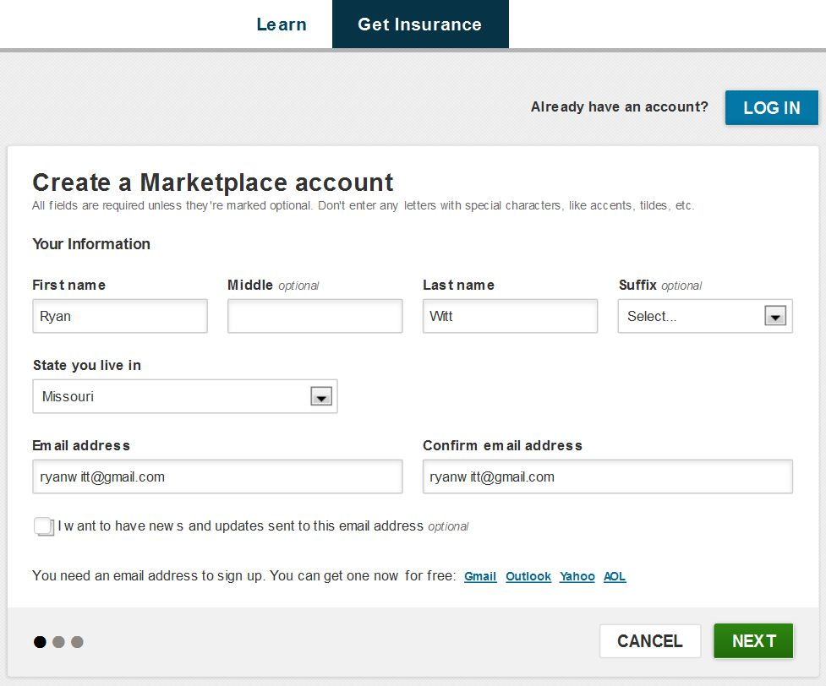
Click this box if you would like info
emailed to you
Create an email if you do not have one
Enter your information as it appears on your Social Security card. Enter an email address that you can immediately access to verify the creation of a Marketplace Account.

Slide 6
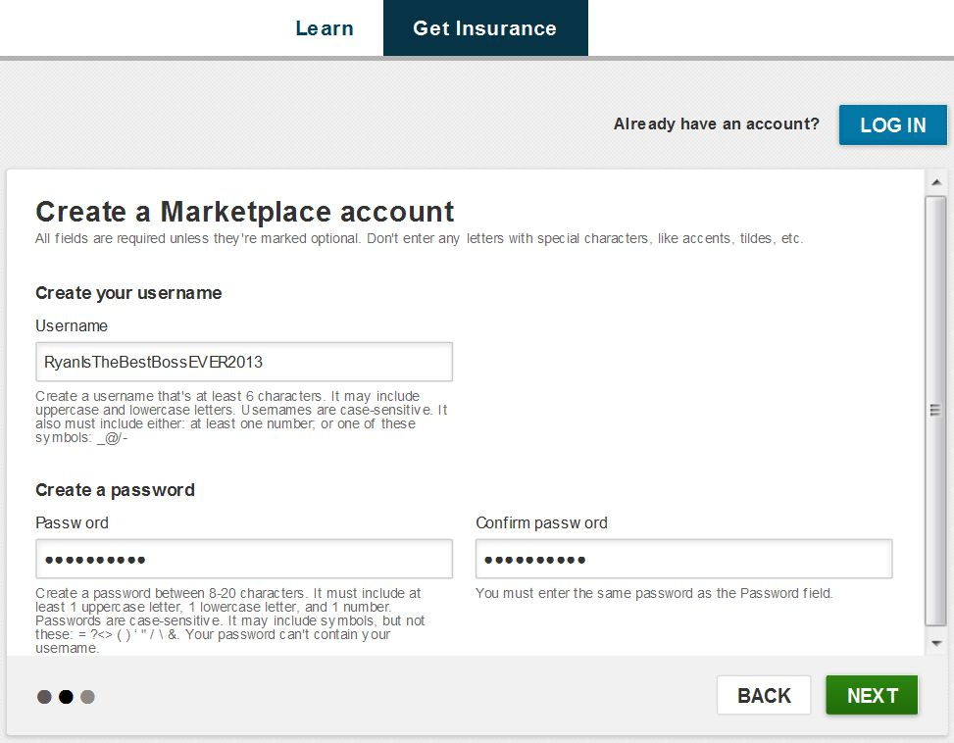
Read the instructions on the username and password closely.
Avoid common names such as JohnSmith1.
Enter a unique username and password. We suggest using your email user ID. Record this information in a safe location for future reference. Remember, this information is case sensitive.

Slide 7
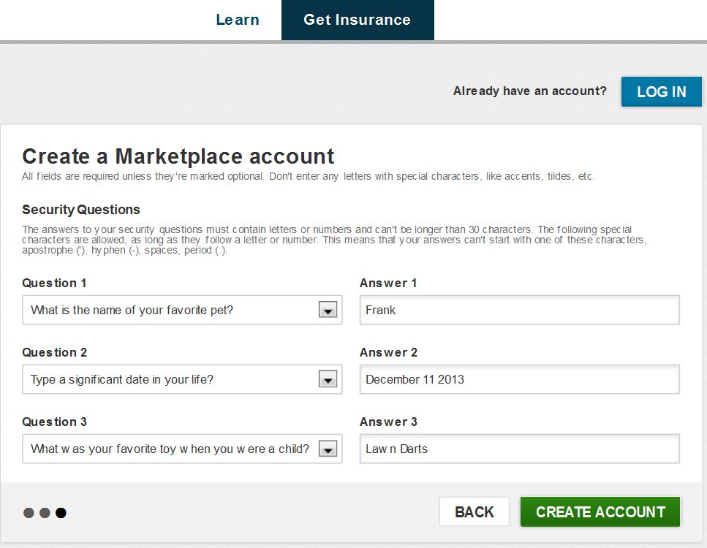
For security reasons, you will be required to choose three questions and type in three answers. Remember, answers are case sensitive so record if you chose to capitalize an answer. Dates must written out in full and CANNOT have slashes like this MM/DD/YYYY.

Slide 8
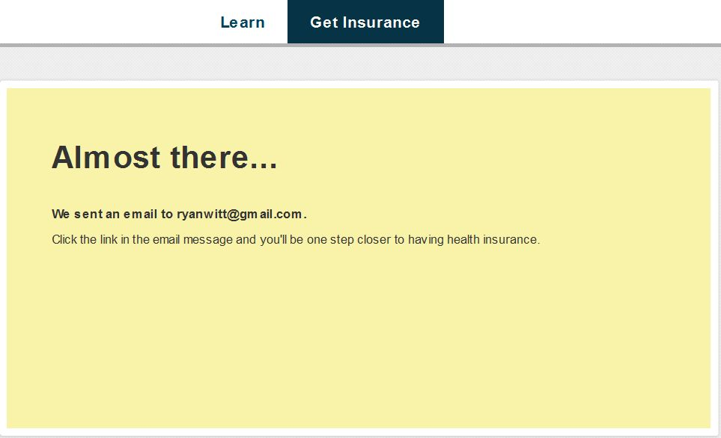
If your username, password, and security questions were approved, you will see this screen. Log into your email and look for the Account Creation Verification email.

Slide 9
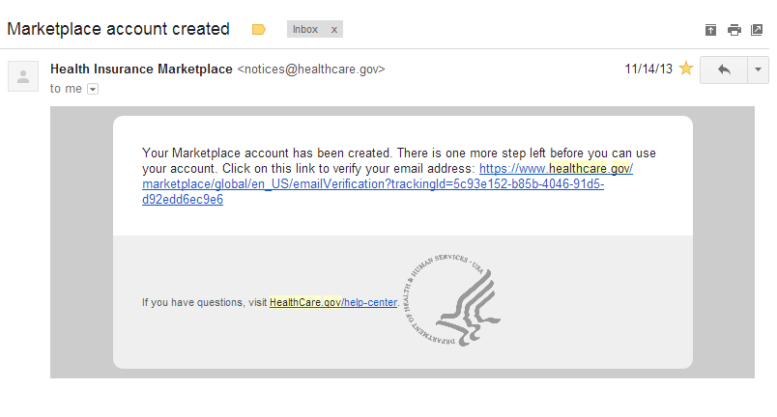
Click this link to complete the “Creating an Account” step
Look for an email from notices@healthcare.gov with the Subject “Marketplace account created”. Click on the blue hyperlink to verify your email address. The link will bring you back to healthcare.gov and invite you to sign into your new account.

Slide 10
Table of Contents
Step One: Creating a Marketplace Account
Step Two: Starting a Marketplace Application *next
Step Three: Entering Household Information
Step Four: Entering Income Information
Step Five: Entering Additional Information
Step Six: Reviewing and Signing
Step Seven: Reviewing Eligibility Notice
Step Eight: Comparing and Choosing a Health Plan
Step Nine: Comparing and Choosing a Dental Plan
Step Ten: Making a Premium Payment
Other: Navigating Your Profile and Application
When to Contact Cover Lemay: Unique Situations

Slide 11
Starting a Marketplace Application
Step Two:

Slide 12
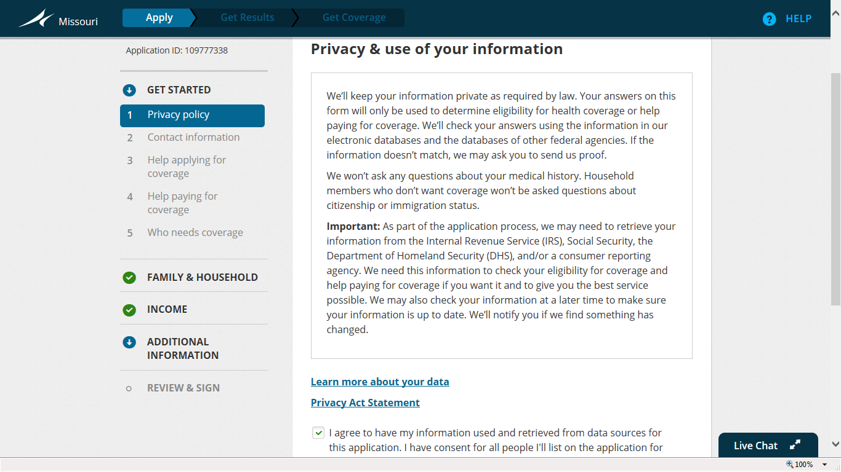
If you have basic questions, use the “Live Chat” option. “Live Chat” will not ask for personal information.
Otherwise, call the Marketplace Assistance Hotline at 1-800-318-2596. The hotline may ask for personal information to verify your identity.
HealthCare.gov will keep your information secure. You can learn more about how your privacy is protected at this step.

Slide 13
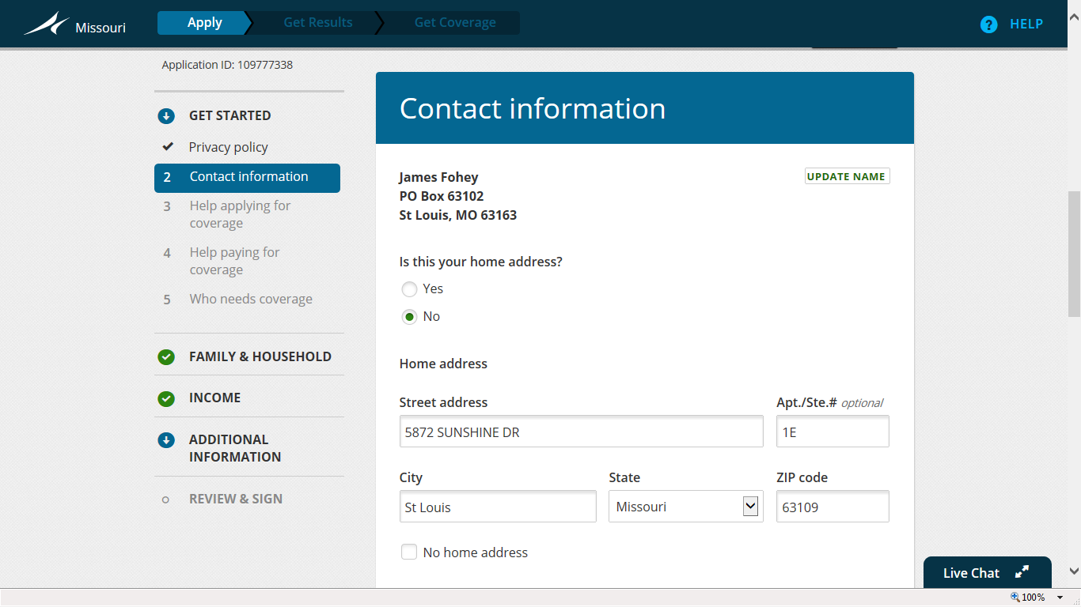
Name and address
You enter the city without abbreviations. This should be “Saint Louis”
Enter in your contact information without abbreviations. The application will verify your address in the next steps.

Slide 14
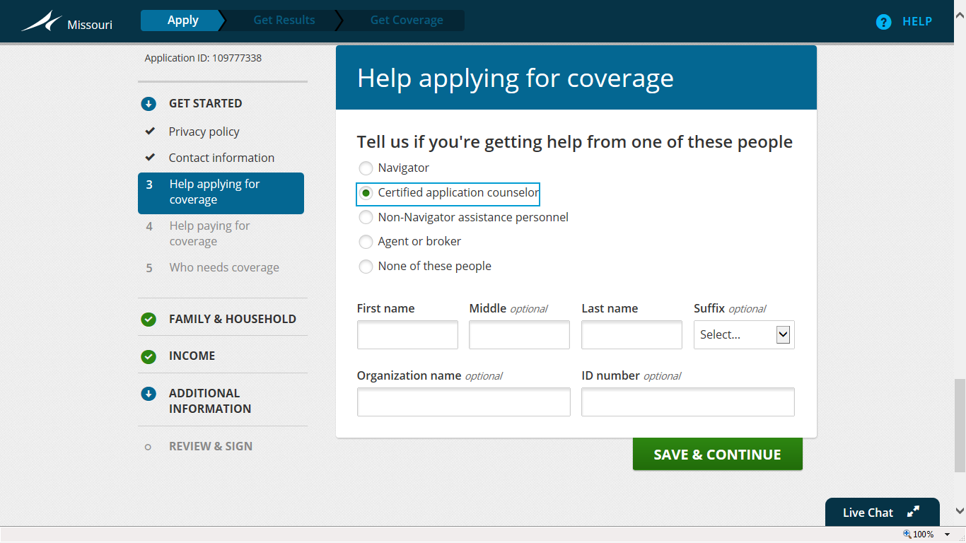
If you are receiving assistance, allow the individual to enter their ID number at this time.

Slide 15
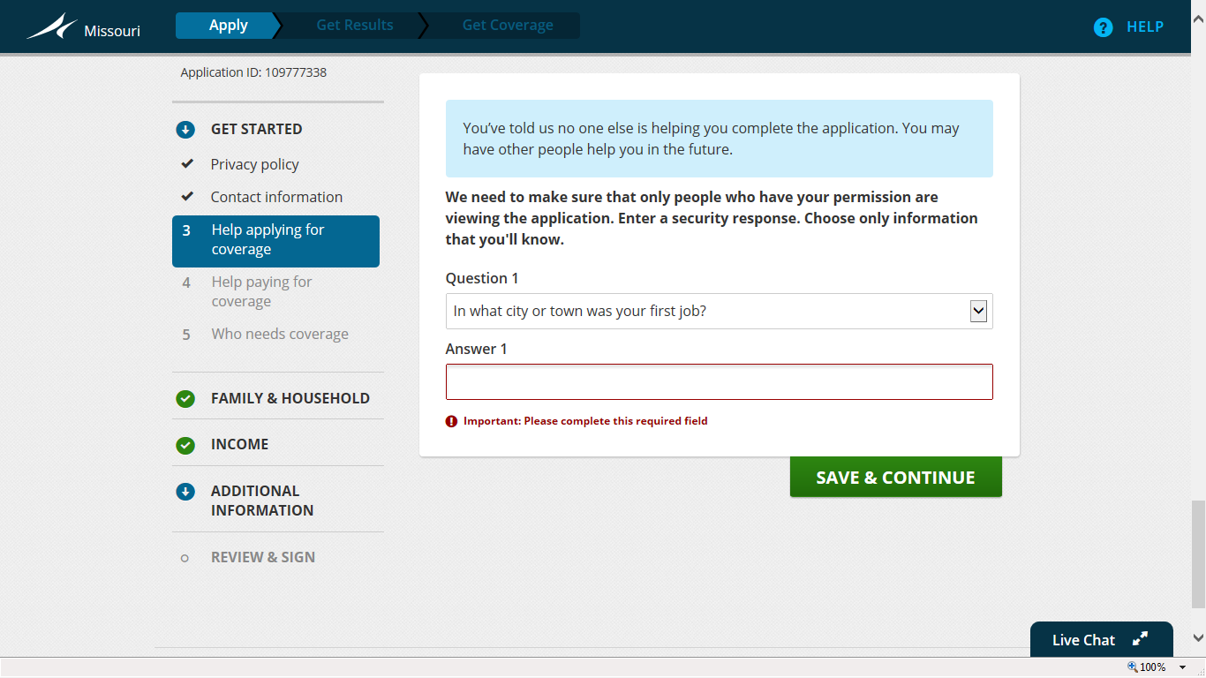
This step will only appear if you have stated you are receiving assistance with your application.

Slide 16
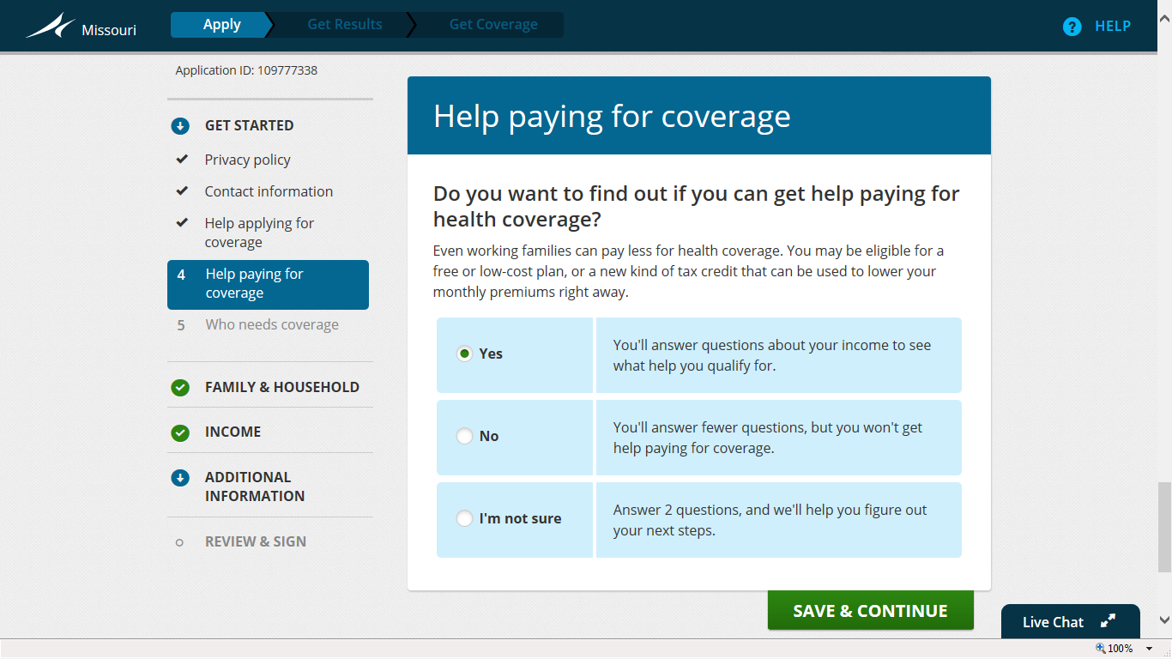
Answer “yes” if interested in being determined for premium tax credits and cost sharing reductions.

Slide 17
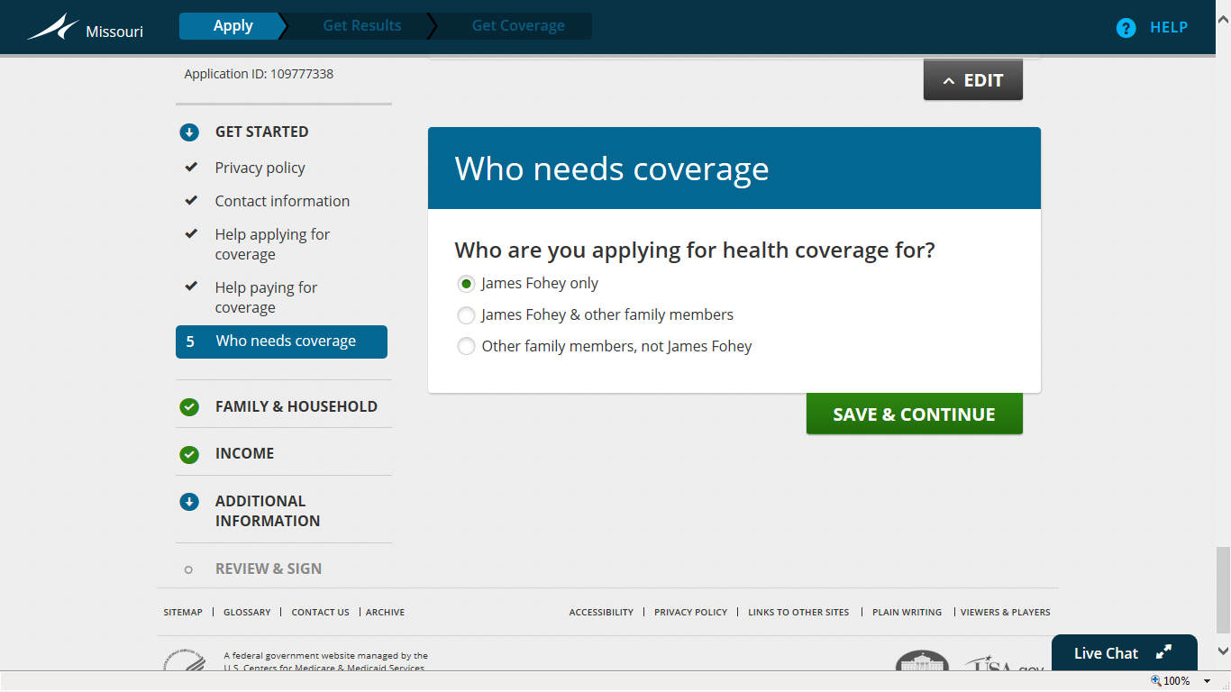
Choose the most appropriate statement: applying for self, applying for self and other family members, or applying for other family members and not self. If family members already have health coverage, you are NOT applying for health coverage for them.

Slide 18
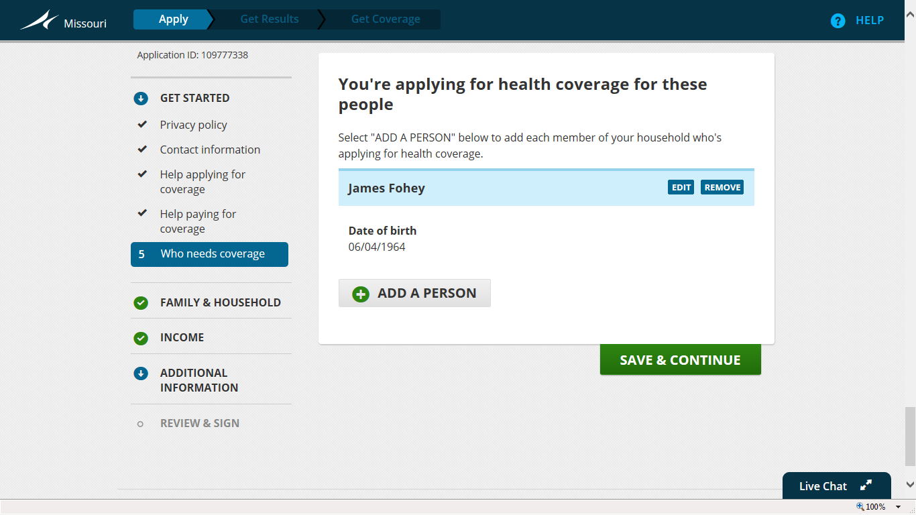
Add additional individuals needing coverage if applicable. Make sure the name matches what is printed on the Social Security card.

Slide 19
Table of Contents
Step One: Creating a Marketplace Account
Step Two: Starting a Marketplace Application
Step Three: Entering Household Information *next
Step Four: Entering Income Information
Step Five: Entering Additional Information
Step Six: Reviewing and Signing
Step Seven: Reviewing Eligibility Notice
Step Eight: Comparing and Choosing a Health Plan
Step Nine: Comparing and Choosing a Dental Plan
Step Ten: Making a Premium Payment
Other: Navigating Your Profile and Application
When to Contact Cover Lemay: Unique Situations

Slide 20
Entering Household Information
Step Three:

Slide 21
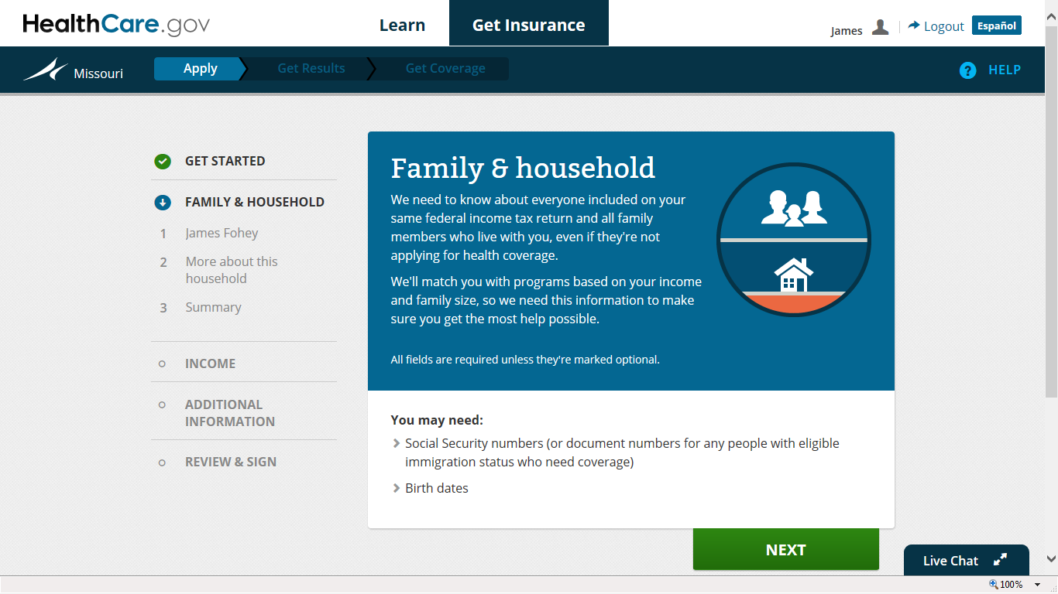
Next step in the application: complete family and household information. You will whether you plan on filing taxes, anyone you may claim, and how you are related to other family members applying for coverage or claimed on taxes.

Slide 22
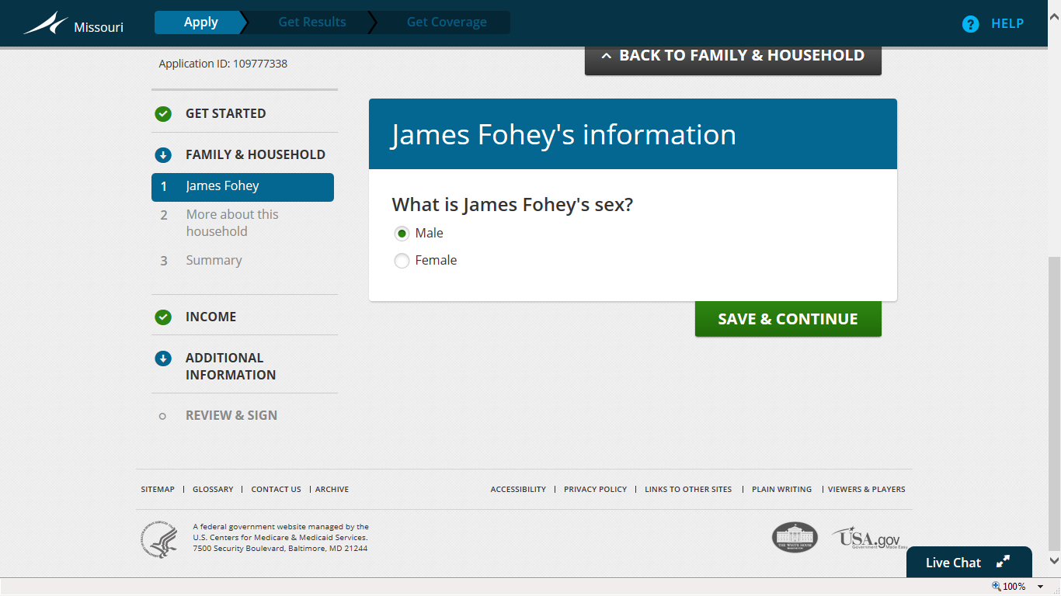
Enter in basic information about each individual.

Slide 23
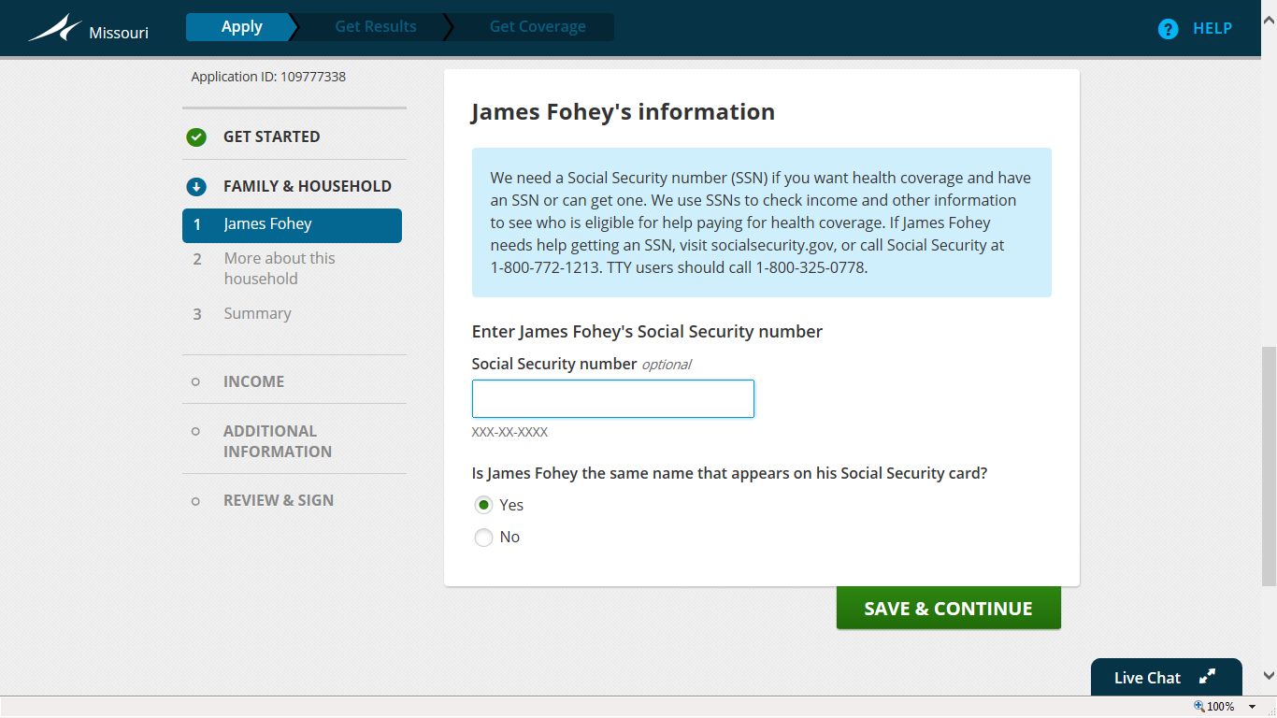
Social Security number is optional but will help make it easier for the Marketplace to verify your identity

Slide 24
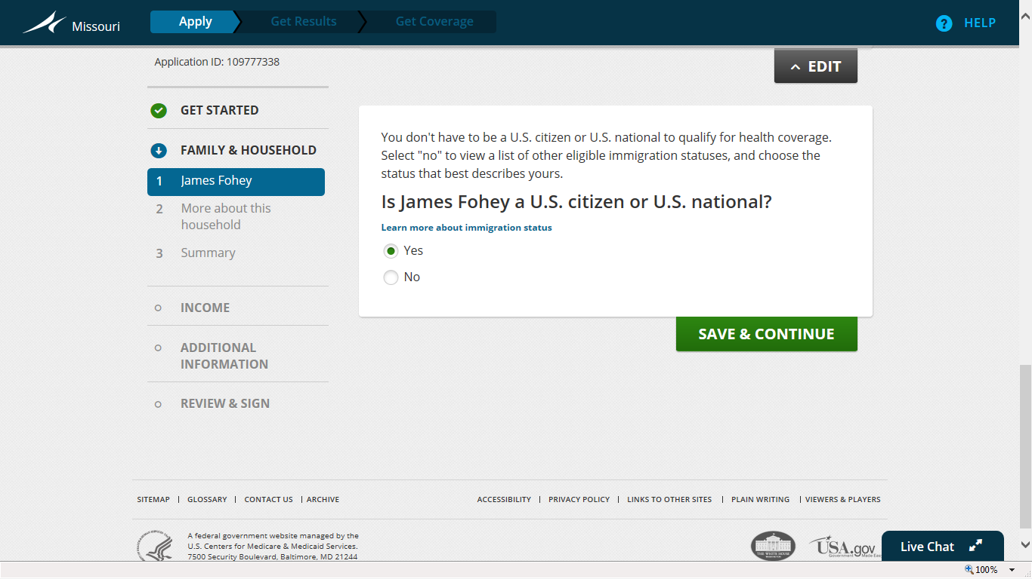
Individuals that are green card holders, refugees, asylees, and many others are permitted to apply. Follow this link for additional eligible statuses: https://www.healthcare.gov/immigration-status-and-the-marketplace/

Slide 25
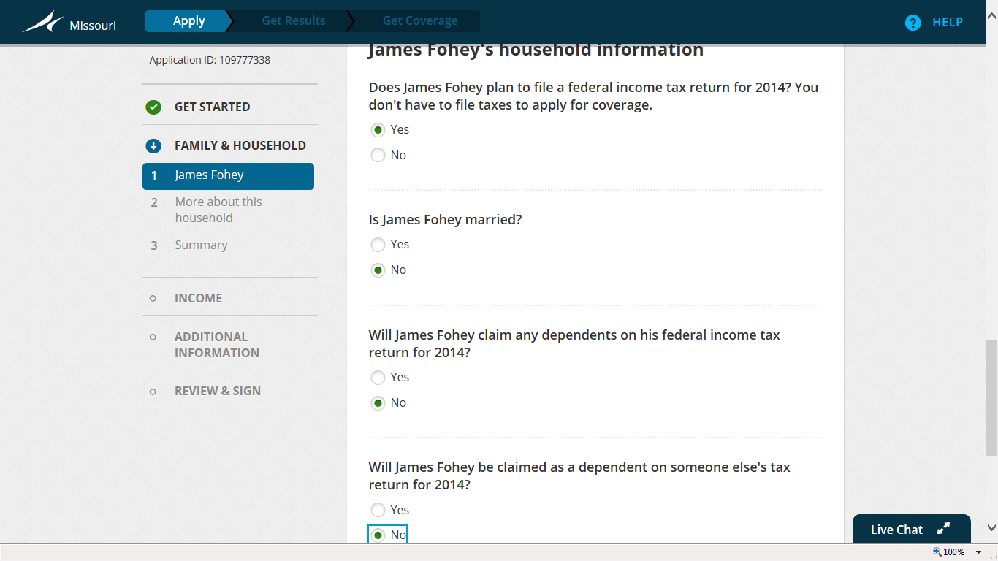
State yes if interested in consideration for subsidies
You must file taxes for 2014 to be eligible for subsidies. If you are married, you must file jointly with your spouse. If you are claimed as a dependent under an individual and that individual has affordable family health insurance, you are not eligible for subsidies.

Slide 26
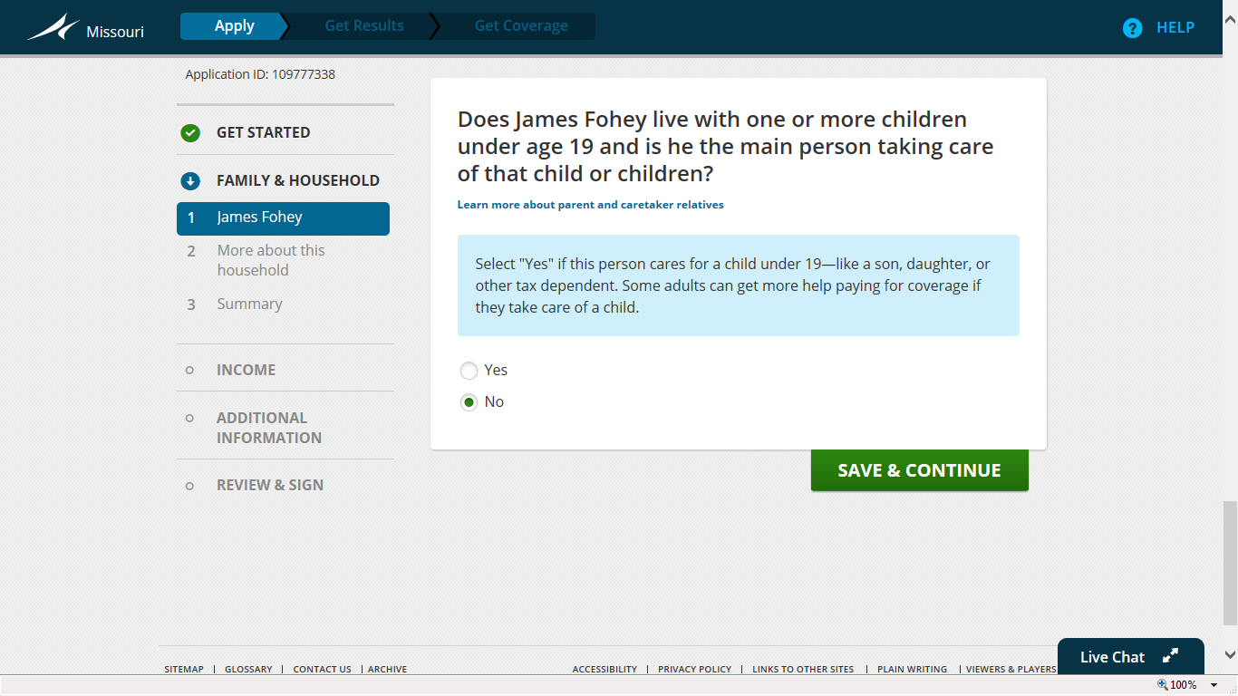
State “yes” even if the child already has health insurance coverage and you are not currently applying for the child (this includes Medicaid)

Slide 27
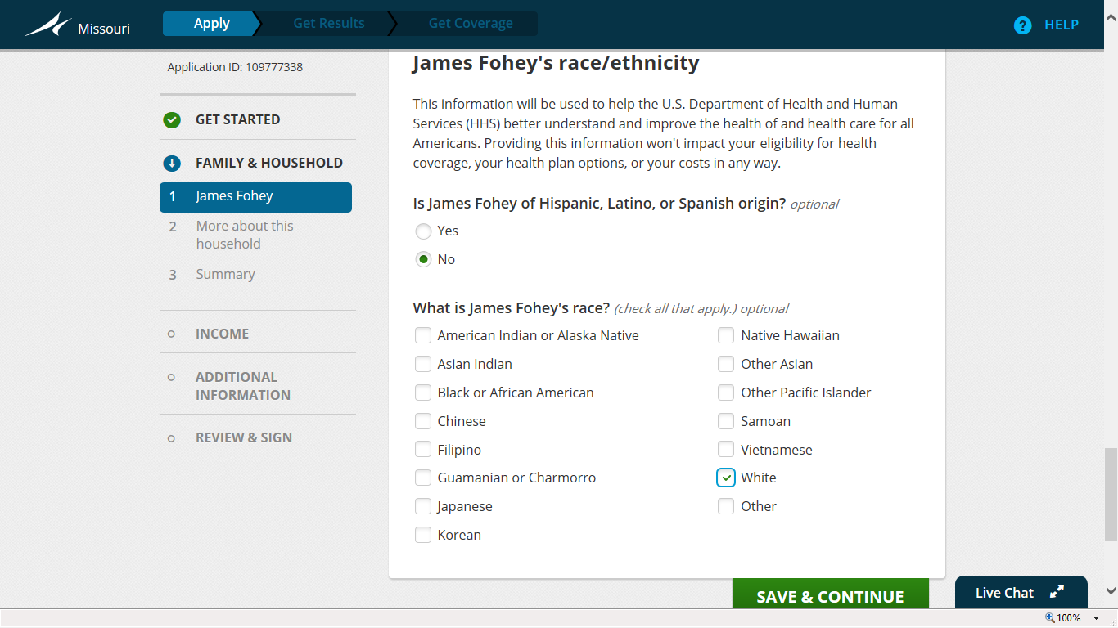
Select the most appropriate choice if comfortable

Slide 28
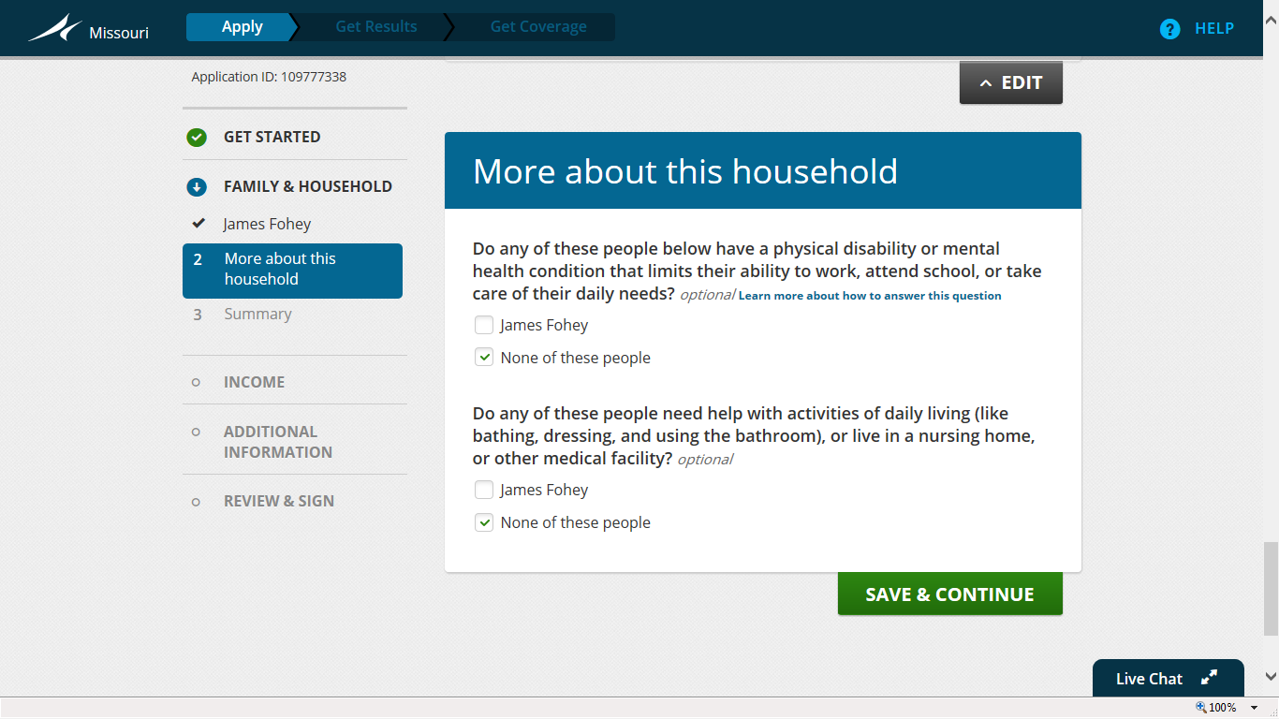
Answer “yes” if receiving SSD
If an individual qualifies for Social Security Disability (SSD), indicate that the individual has a physical disability or mental health condition.

Slide 29
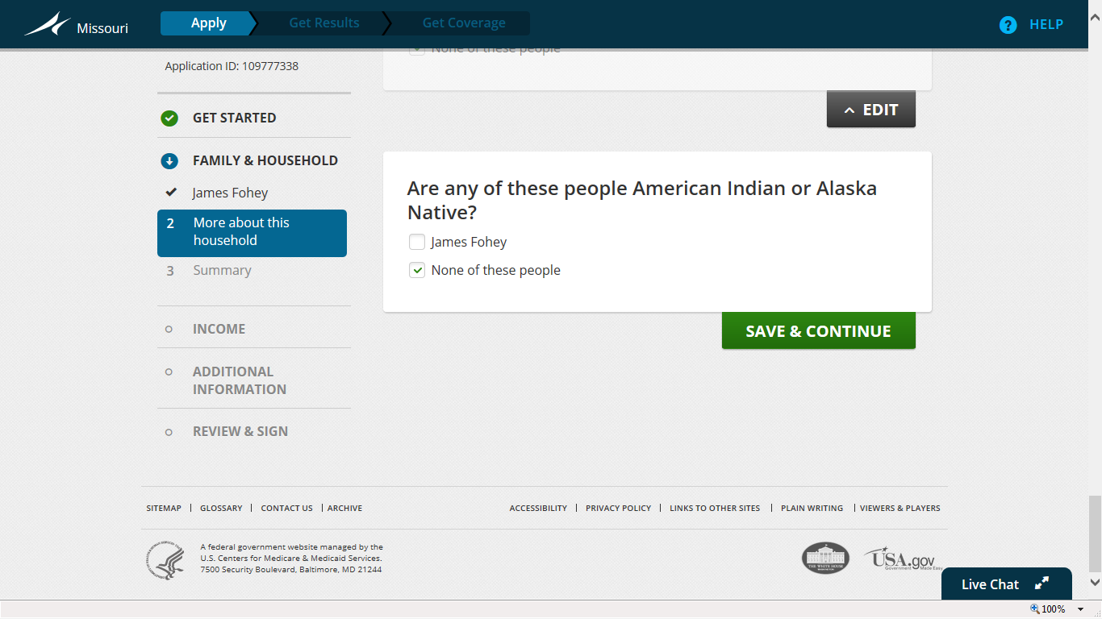
If “yes”, special health services and rules apply. See HealthCare.gov or your Certified Application Counselor for more details.

Slide 30
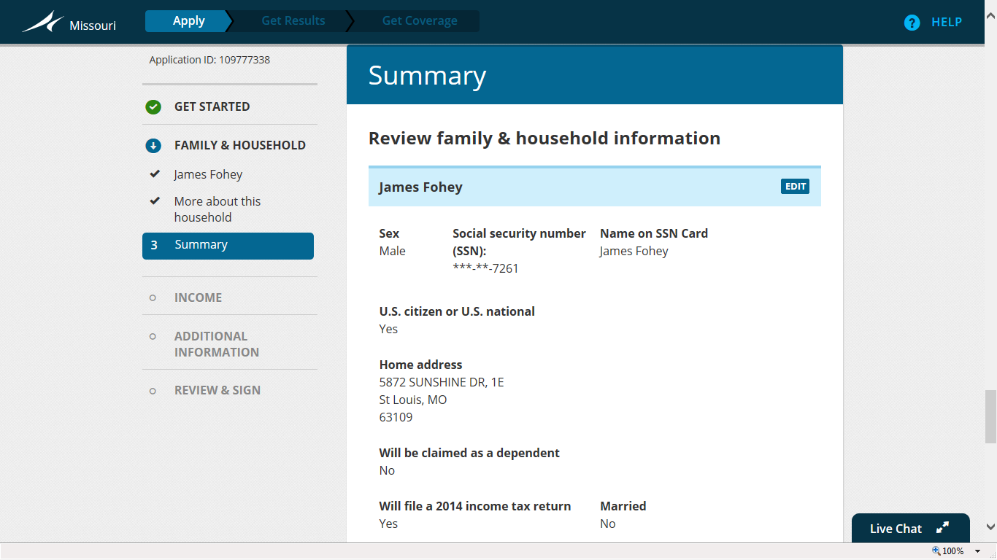
Review information before moving forward. Once this information has been set, it will be difficult to change.

Slide 31
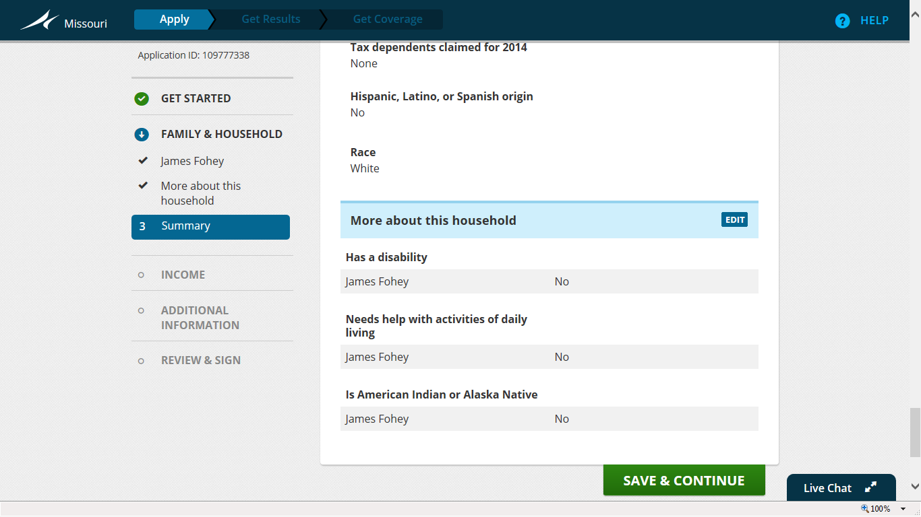
If information requires change, click the “edit” button before moving forward to the “Income” section of the application.

Slide 32
Table of Contents
Step One: Creating a Marketplace Account
Step Two: Starting a Marketplace Application
Step Three: Entering Household Information
Step Four: Entering Income Information *next
Step Five: Entering Additional Information
Step Six: Reviewing and Signing
Step Seven: Reviewing Eligibility Notice
Step Eight: Comparing and Choosing a Health Plan
Step Nine: Comparing and Choosing a Dental Plan
Step Ten: Making a Premium Payment
Other: Navigating Your Profile and Application
When to Contact Cover Lemay: Unique Situations

Slide 33
Entering Income Information
Step Four:

Slide 34
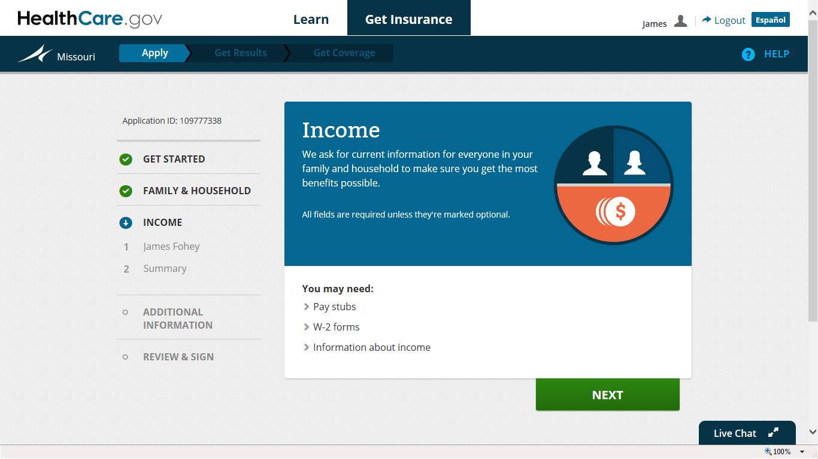
“Income” section of application will begin at the conclusion of the “Family & Household” information section.

Slide 35
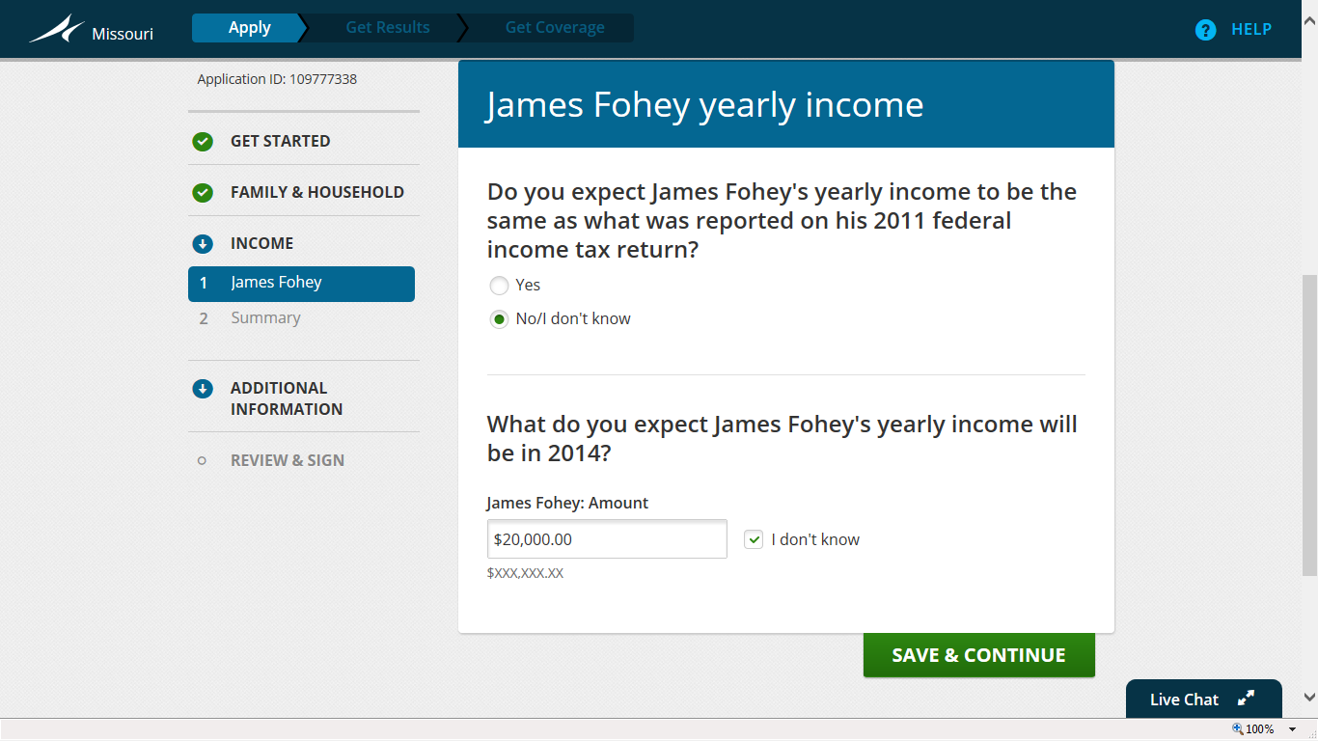
Not sure? Please call Cover Lemay to ensure you are completing this section correctly.
Provide a good faith estimate of income for 2014 before taxes which should include: SSD (but not SSI), employment, unemployment benefits, capital gains, money received from rent, and alimony. If self employed or own small business, provide net estimate. Please call Cover Lemay if you have ANY questions about what to include in this section.

Slide 36
Table of Contents
Step One: Creating a Marketplace Account
Step Two: Starting a Marketplace Application
Step Three: Entering Household Information
Step Four: Entering Income Information
Step Five: Entering Additional Information *next
Step Six: Reviewing and Signing
Step Seven: Reviewing Eligibility Notice
Step Eight: Comparing and Choosing a Health Plan
Step Nine: Comparing and Choosing a Dental Plan
Step Ten: Making a Premium Payment
Other: Navigating Your Profile and Application
When to Contact Cover Lemay: Unique Situations

Slide 37
Entering Additional Information
Step Five:

Slide 38
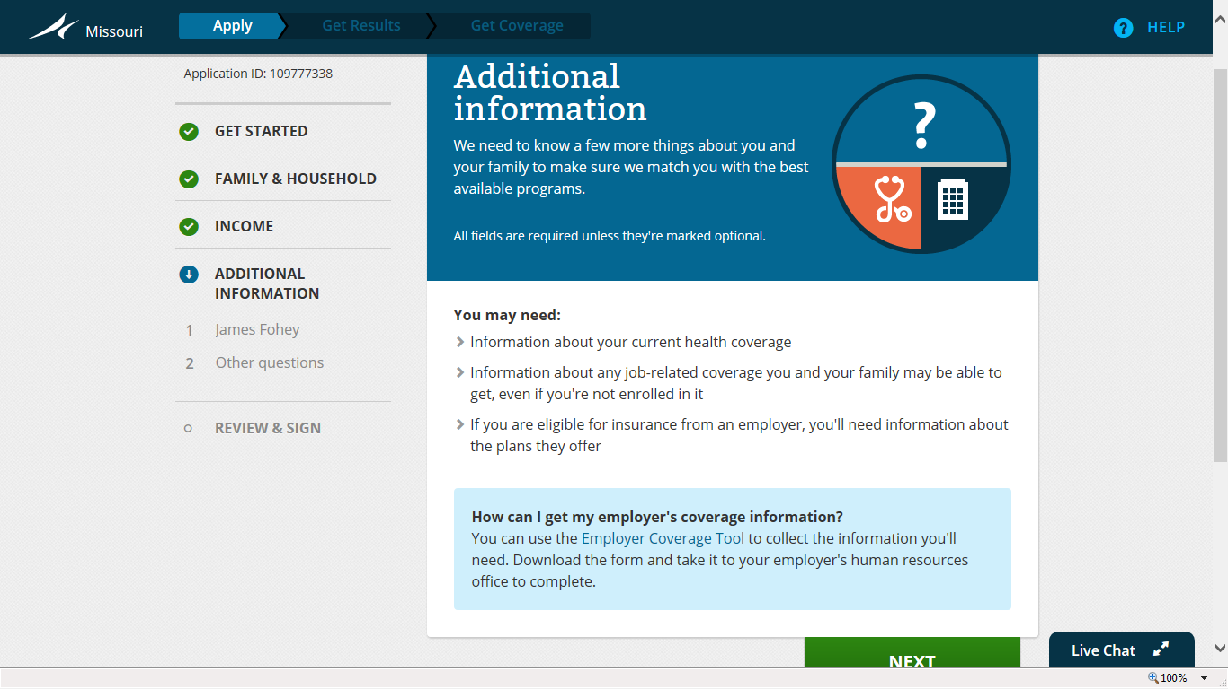
Complete the form if insurance is available through the employer. If the employer plan covers other family members, then the additional members do not qualify for subsidies. If the employer insurance is deemed unaffordable or not a Qualified Health Plan, individuals will be eligible to participate and for subsidies in the Affordable Care Act Health Care Marketplace.

Slide 39
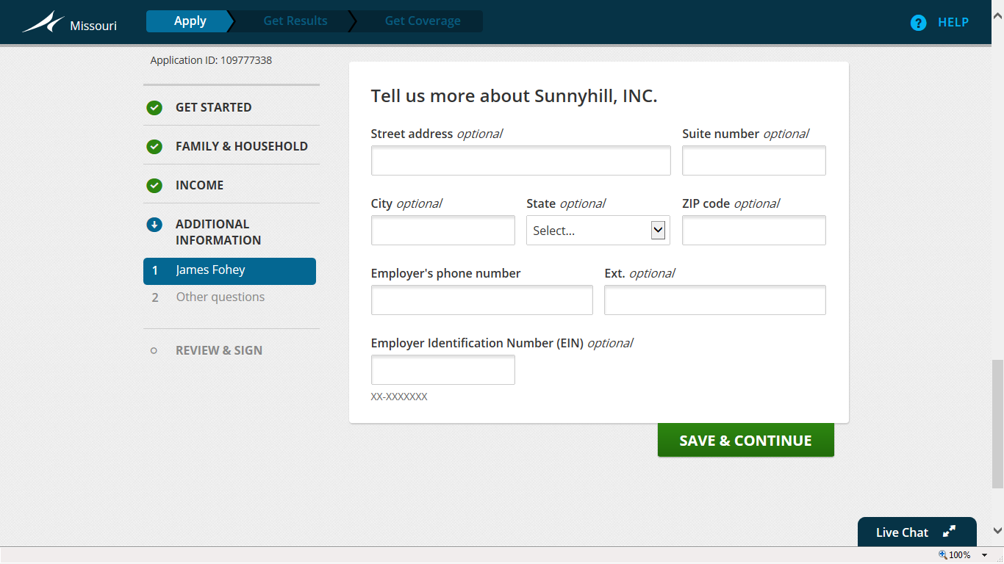
Provide as much information as possible, however, phone number is the only required field.

Slide 40
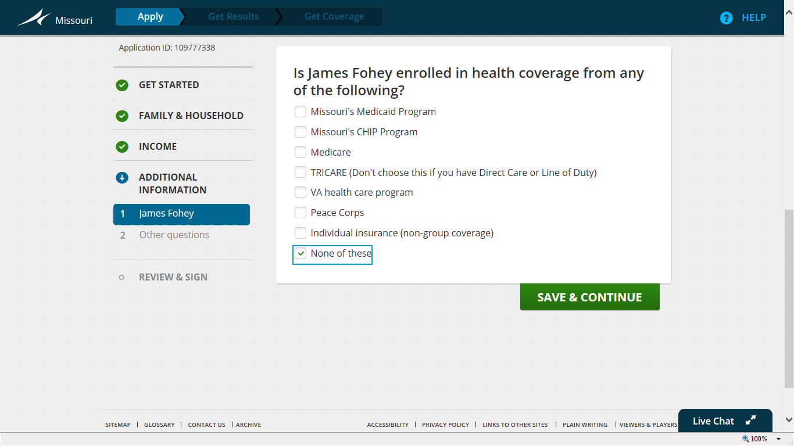
Provide this information if applicable.

Slide 41
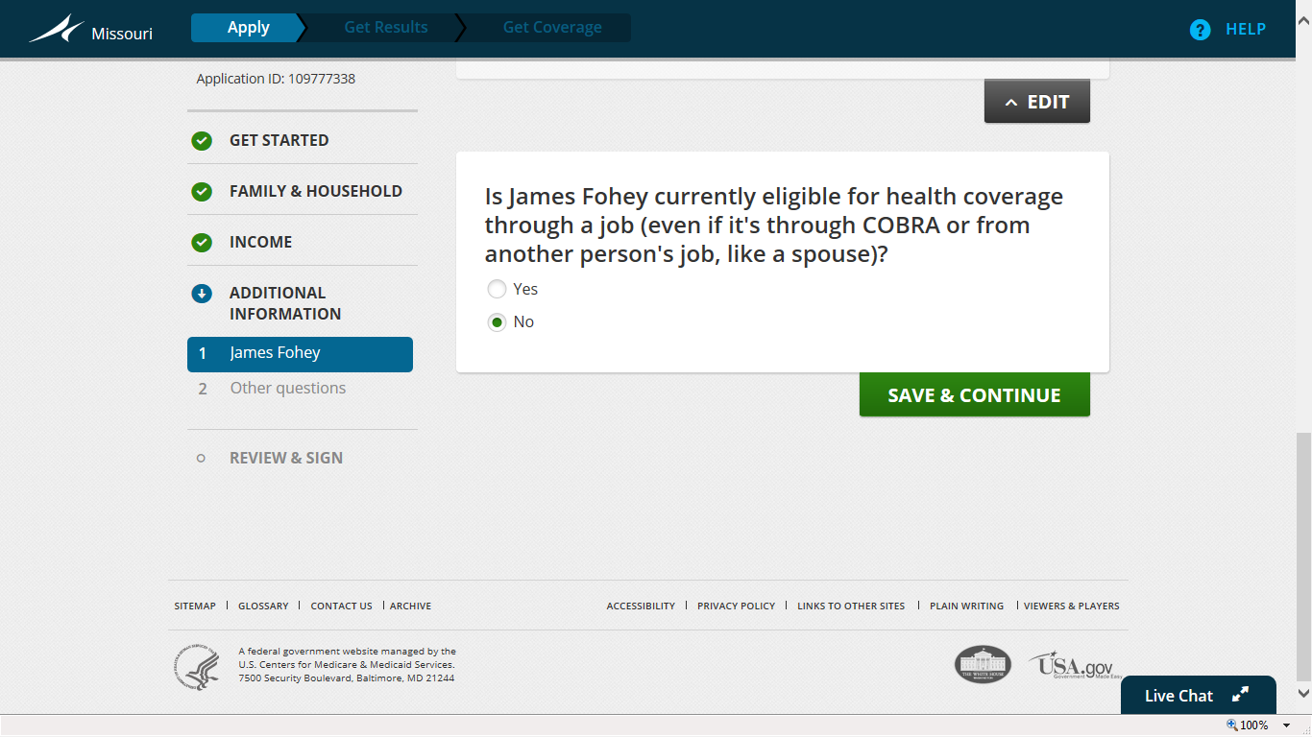
This question is asking if affordable family health insurance is currently available in any manner. If so, state “yes” and input the current plan information including policy number and end date.

Slide 42
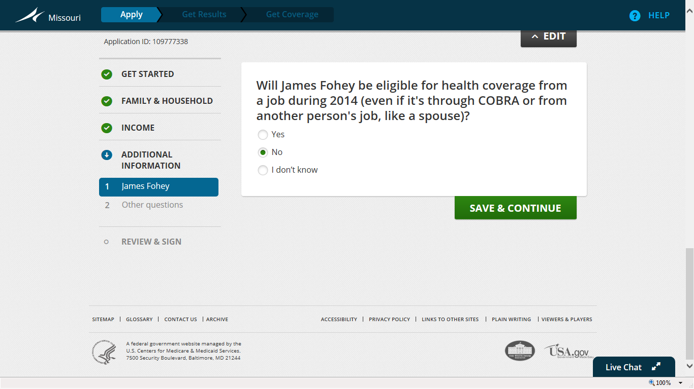
State “yes” if you are certain you will have coverage. Otherwise, state “no” even if you are unsure to continue through the application process. You always have the option to update your account later to reflect if you are eligible for coverage through your employer.
State whether coverage is available in 2014.

Slide 43
Table of Contents
Step One: Creating a Marketplace Account
Step Two: Starting a Marketplace Application
Step Three: Entering Household Information
Step Four: Entering Income Information
Step Five: Entering Additional Information
Step Six: Reviewing and Signing *next
Step Seven: Reviewing Eligibility Notice
Step Eight: Comparing and Choosing a Health Plan
Step Nine: Comparing and Choosing a Dental Plan
Step Ten: Making a Premium Payment
Other: Navigating Your Profile and Application
When to Contact Cover Lemay: Unique Situations

Slide 44
Reviewing and Signing
Step Six:

Slide 45
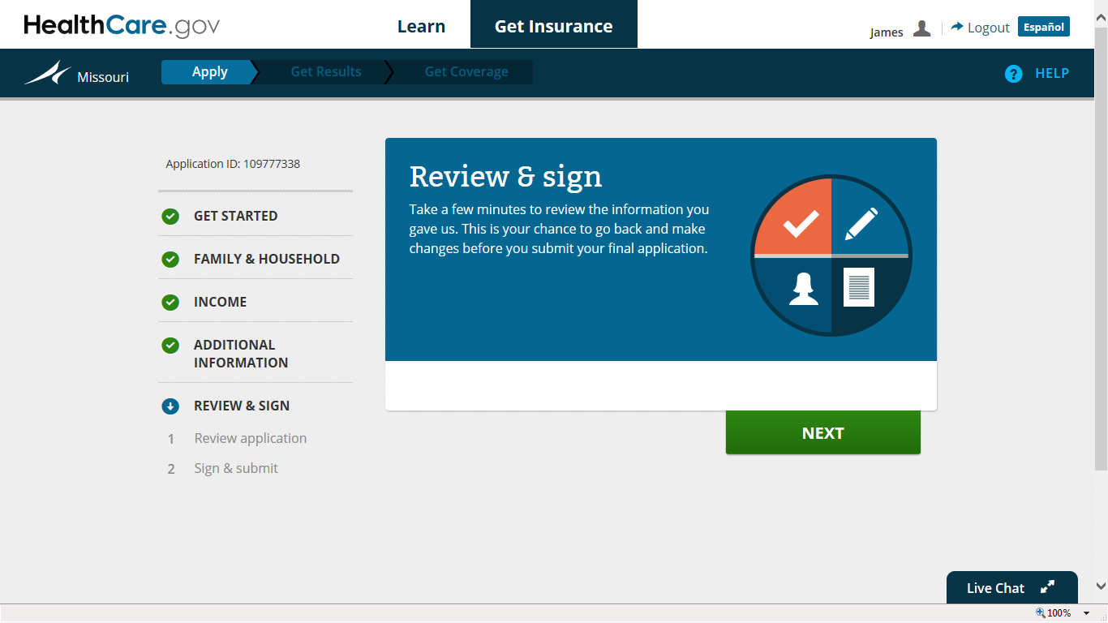
Congratulations on almost completing the application! The next step is to review the entire application and electronically sign.

Slide 46
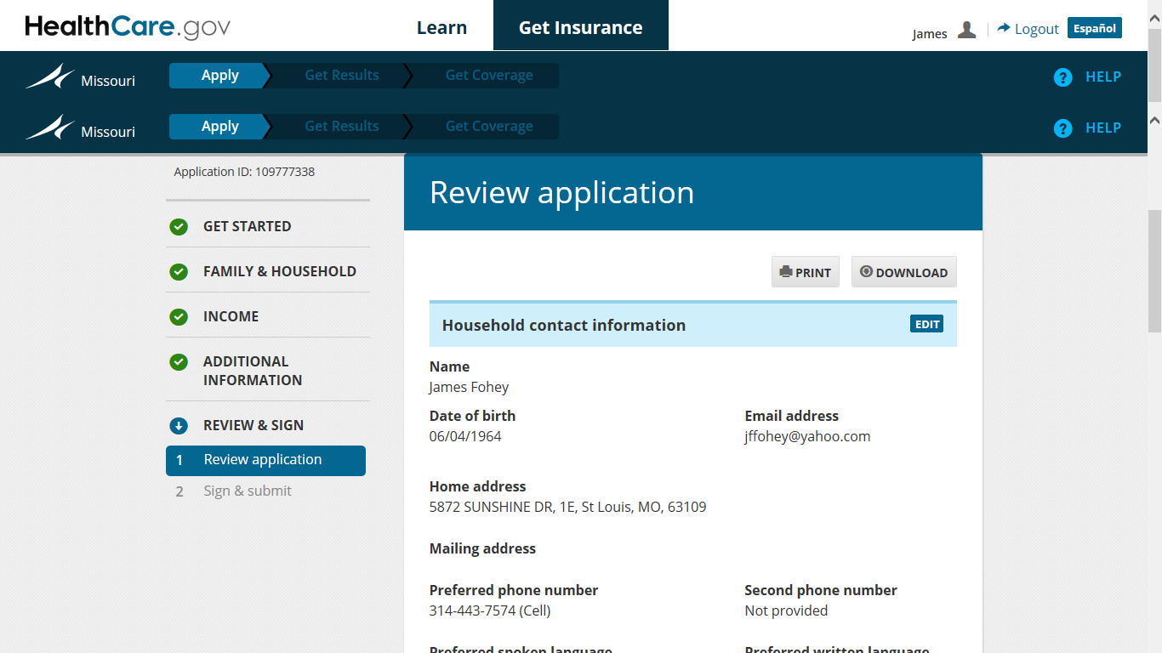
Please review for accuracy. Remember, once the application is submitted, the only way to change information is to submit a request to the Advanced Resolution Center which may take several weeks to resolve. The other option is to delete the application and start over.

Slide 47
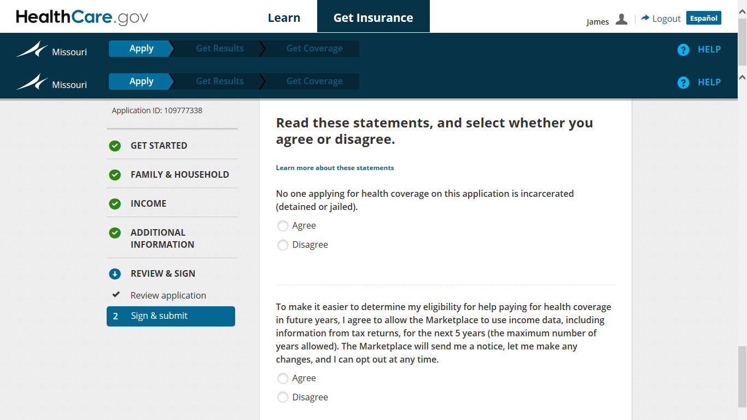
If you are not currently incarcerated, choose “Yes” as your answer.
Choosing “yes” will make it easier for renewals and changes to your account in the future. Keep in mind you will have to submit your income information in future years to qualify for Marketplace assistance (premium tax credits and cost sharing reductions).
Choose the appropriate answer for each statement.

Slide 48
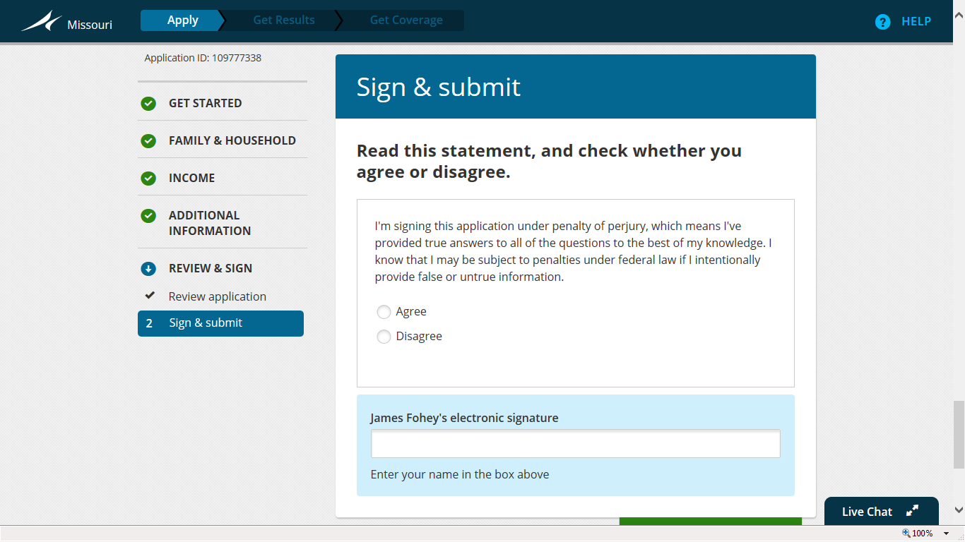
Electronically sign after reading the statement.

Slide 49
Table of Contents
Step One: Creating a Marketplace Account
Step Two: Starting a Marketplace Application
Step Three: Entering Household Information
Step Four: Entering Income Information
Step Five: Entering Additional Information
Step Six: Reviewing and Signing
Step Seven: Reviewing Eligibility Notice *next
Step Eight: Comparing and Choosing a Health Plan
Step Nine: Comparing and Choosing a Dental Plan
Step Ten: Making a Premium Payment
Other: Navigating Your Profile and Application
When to Contact Cover Lemay: Unique Situations

Slide 50
Reviewing Eligibility Notice
Step Seven:

Slide 51
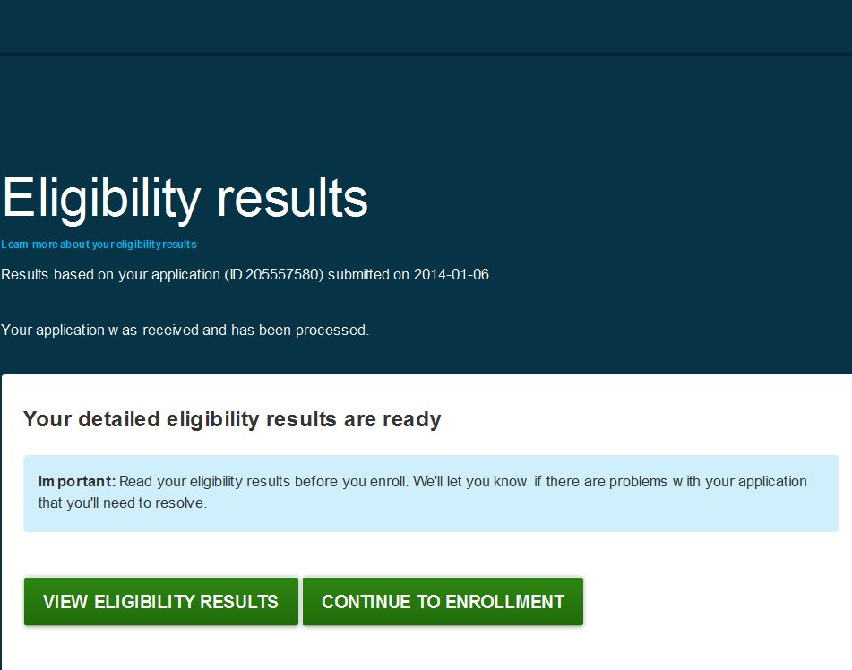
You will see this screen if your application has been successfully submitted and received. Click “View Eligibility Results” before choosing “Continue to Enrollment”.

Slide 52
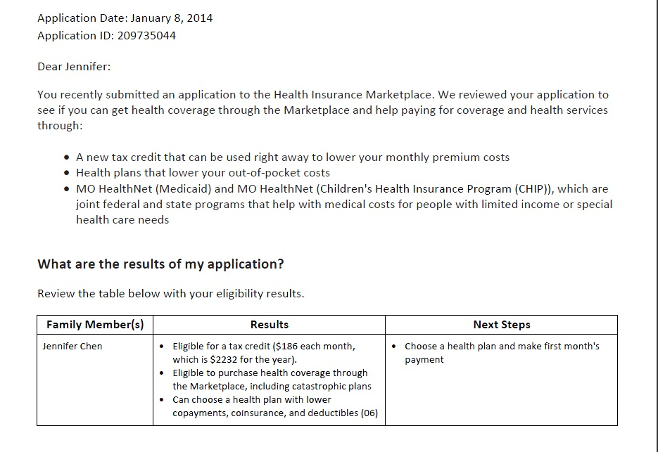
States per individual eligibility to participate in the Marketplace and any subsidies available.
After submitting the application, click the “View Eligibility Results” button and download the PDF file. The file will state your application ID and results below. If additional information is required to complete your application, specific instructions will be provided.

Slide 53
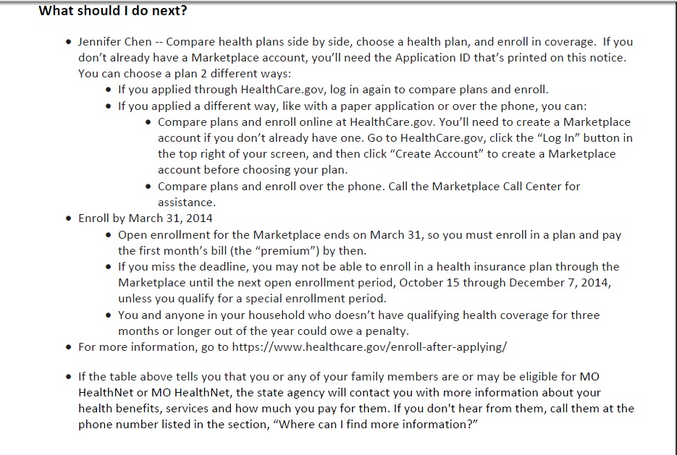
If you are required to submit additional documents to verify identity, income, or other information, it will be stated here with instructions on how to mail or upload the information online. Otherwise, the next step is to choose a health plan by clicking “Continue to Enrollment” in your Marketplace account.

Slide 54
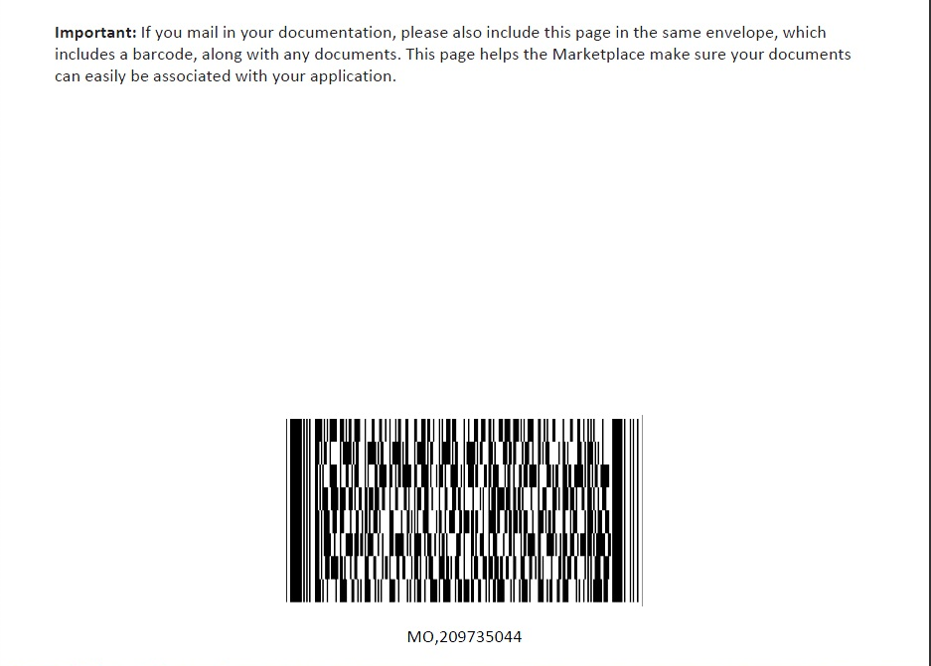
Print this page when mailing anything; your application ID will appear below the barcode.
If you are required to submit additional documentation and plan to mail in the information, you must include the following: 1) First page with the application ID number. 2) Any pages that state eligibility of applicants. 3) Any pages that state your next steps and required documentation to complete application. 4) This barcode.

Slide 55
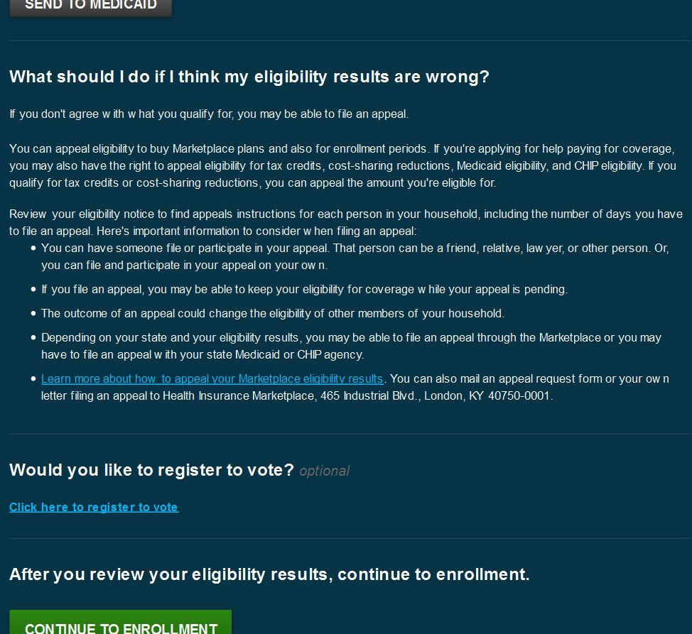
If anything appears incorrect, contact Cover Lemay at (314) 691-7469, www.CoverLemay.com, or CoverLemay@gmail.com for a Certified Application Counselor to assist you with the process.

Slide 56
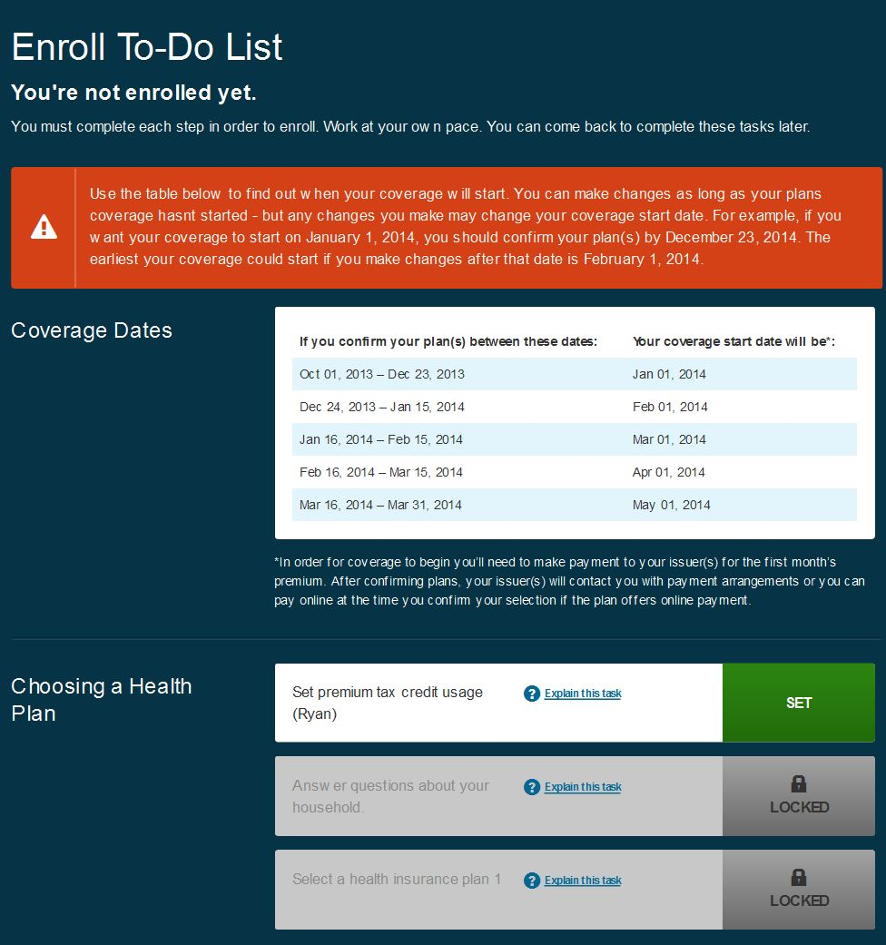
This is the screen that appears after choosing “Continue to Enrollment”.
Check for action items to complete
Review this chart for enrollment deadlines and effective coverage
Start with the box that says “Set” and is green to continue with enrollment
These additional boxes will become available after completing “Set premium tax credit usage”

Slide 57
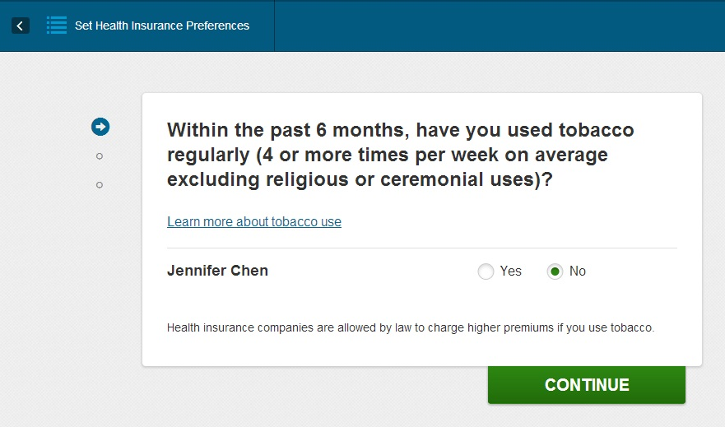
Answer this question prior to viewing your plans and premium costs. The Affordable Care Act protects consumers by only allowing insurance companies to change premium costs based on age, geographic location, and tobacco usage. You cannot be denied health insurance coverage based on pre-existing conditions. Your insurance can be revoked if there is proof that you did not answer this question truthfully.

Slide 58
Table of Contents
Step One: Creating a Marketplace Account
Step Two: Starting a Marketplace Application
Step Three: Entering Household Information
Step Four: Entering Income Information
Step Five: Entering Additional Information
Step Six: Reviewing and Signing
Step Seven: Reviewing Eligibility Notice
Step Eight: Comparing and Choosing a Health Plan *next
Step Nine: Comparing and Choosing a Dental Plan
Step Ten: Making a Premium Payment
Other: Navigating Your Profile and Application
When to Contact Cover Lemay: Unique Situations

Slide 59
Comparing and Choosing a Health Plan
Step Eight:

Slide 60
Review the requirements for all Qualified Health Plans and basic information about comparing and choosing plans in the Health Care Marketplace.

Slide 61
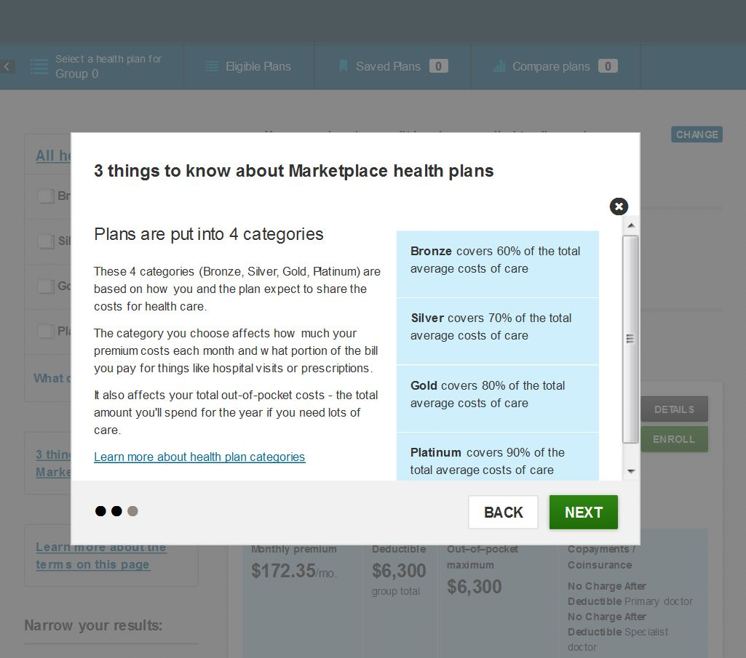
Review the levels of health insurance coverage in the Health Care Marketplace. Note: Missouri does not offer Platinum plans as of 1/1/14.

Slide 62
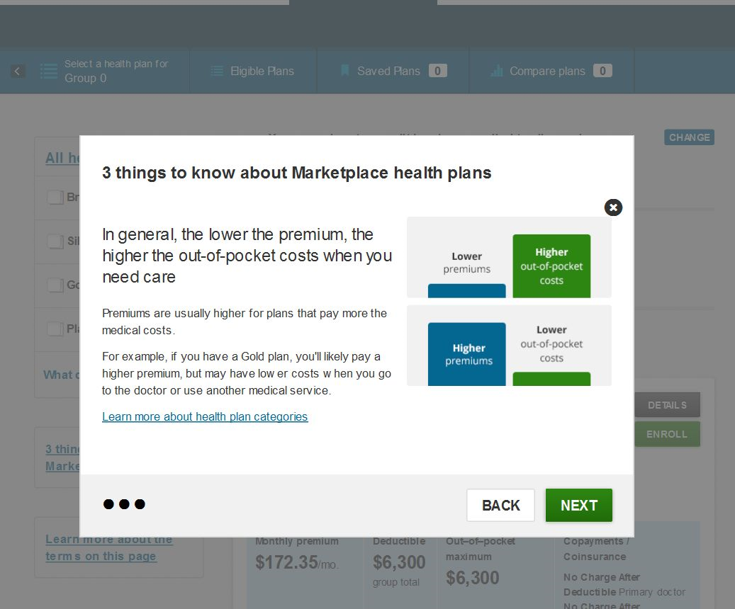
Review the relationship between premiums and out of pocket costs.

Slide 63
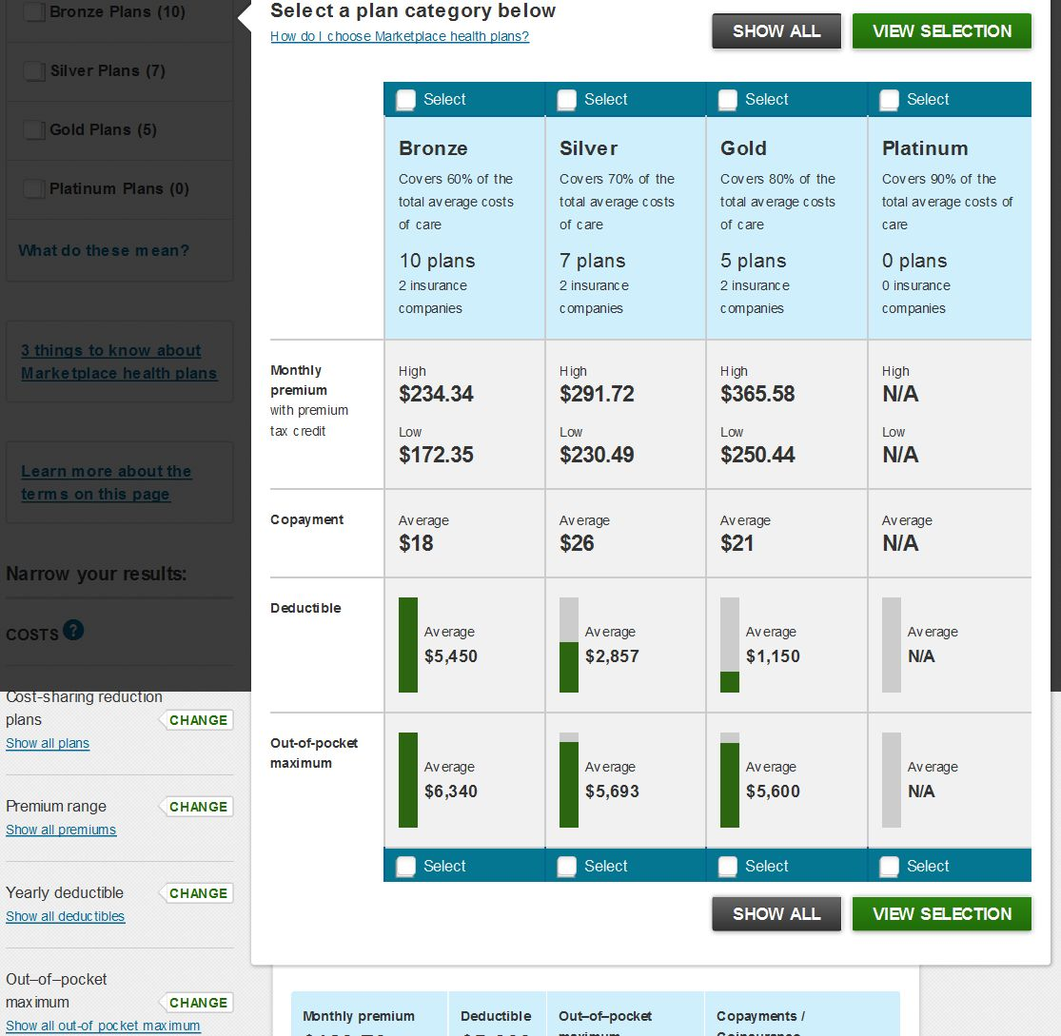
Select what types of plan categories you would like to view or choose “Show All”. You can also change your filters after this screen.
Remember, these costs reflect the costs you are responsible for (total premium cost – premium advanced tax credits = premium cost displayed on screen). Costs also reflect cost sharing reductions (you must choose at least Silver level plan for cost sharing reductions).

Slide 64
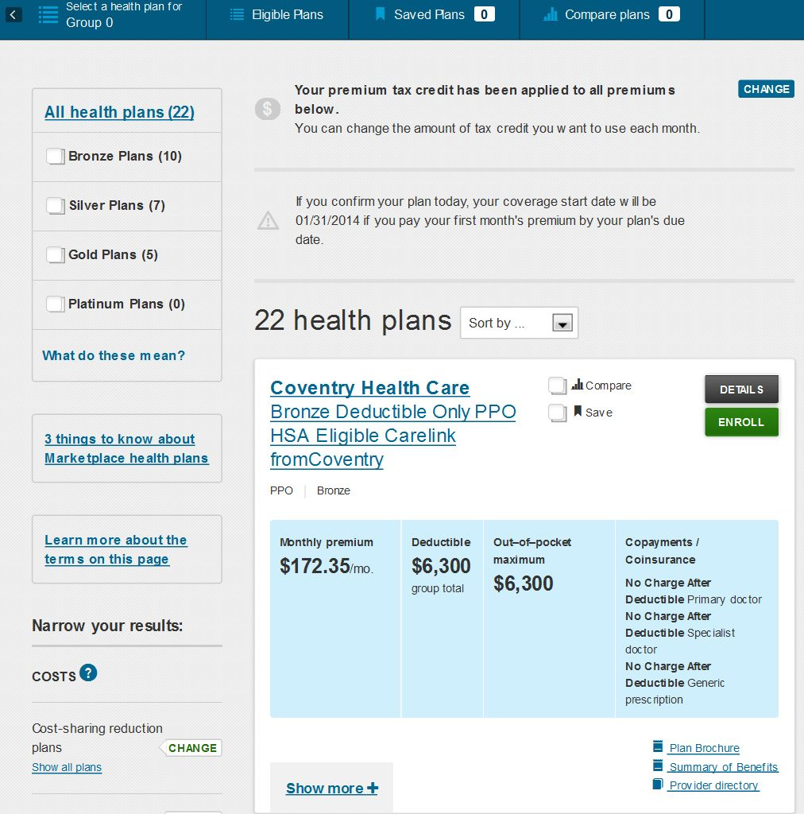
You may change the amount of premium tax credit applied per month here.
Note the deadlines for enrollment and service start.
Sort by premium costs, out of pocket maximums, plan names, etc.
Use these options to narrow down your plans to review.
Find out more specifics about your plan including drug costs, hospital stays, in-network providers
This reflects your responsibilities (premium tax credits and cost sharing reductions have been applied)

Slide 65
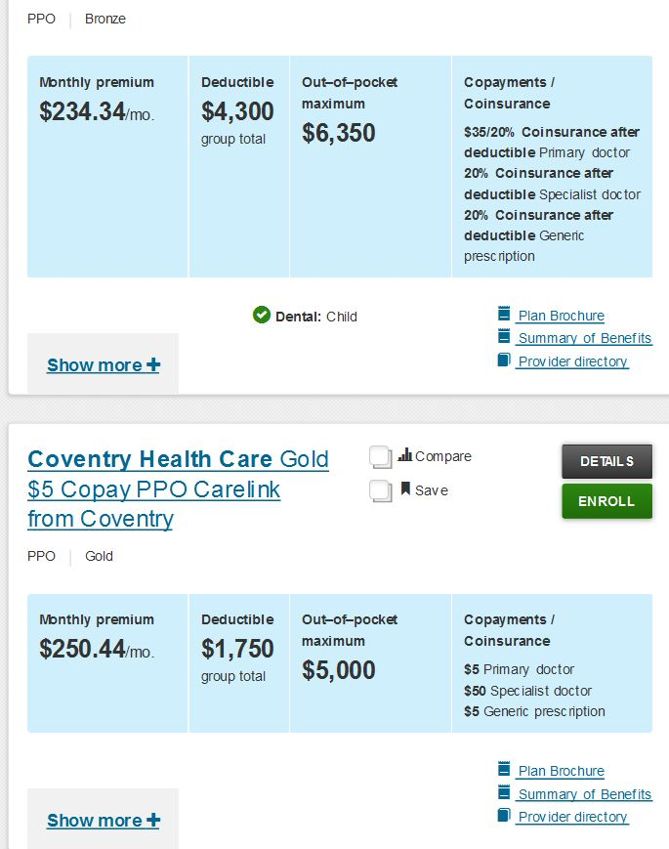
Review plan options for monthly premium costs, deductibles, out of pocket maximums, costs to see primary doctors and specialists, and costs for prescriptions before enrolling.
Note: Coventry and Blue Cross Blue Shield are the only participating insurance companies as of 1/1/14. Each plan covers physicians at certain hospitals. Be sure to confirm with the insurance company if you need to continue with certain providers.
Contact Cover Lemay if you have questions.
Choose “Compare” to view multiple plans side by side. Choose “Save” if you have narrowed down to a few plans and would like to see them again when you log into your profile next time without searching.

Slide 66
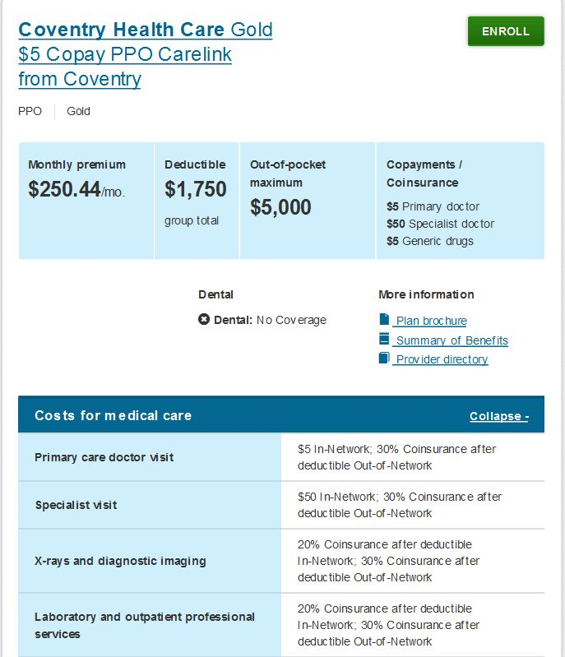
Example of “Plan Details” screen. Review the “Costs for medical care” chart.
Again, costs will reflect your responsibility (premium tax credits and cost sharing reductions have already been applied).
Dental coverage is required to be offered within or as a separate plan for children only. Adult dental is not covered in these health plans. If you would like to review adult dental plans, this will become an option only if you enroll in a health care plan first.

Slide 67
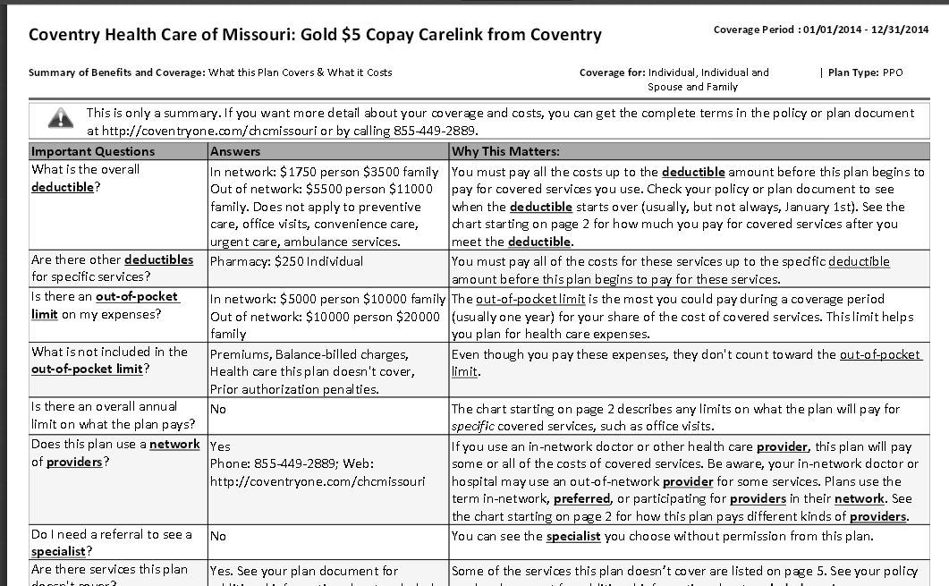
Example of “Plan Brochure”. The link to this file is found under the plan name on your comparing plans screen. Note: the costs reflected here are the original costs (without premium tax credits or cost sharing reductions). The costs reflected on your Marketplace account may be different. You are responsible for the costs displayed in your Marketplace account only.

Slide 68
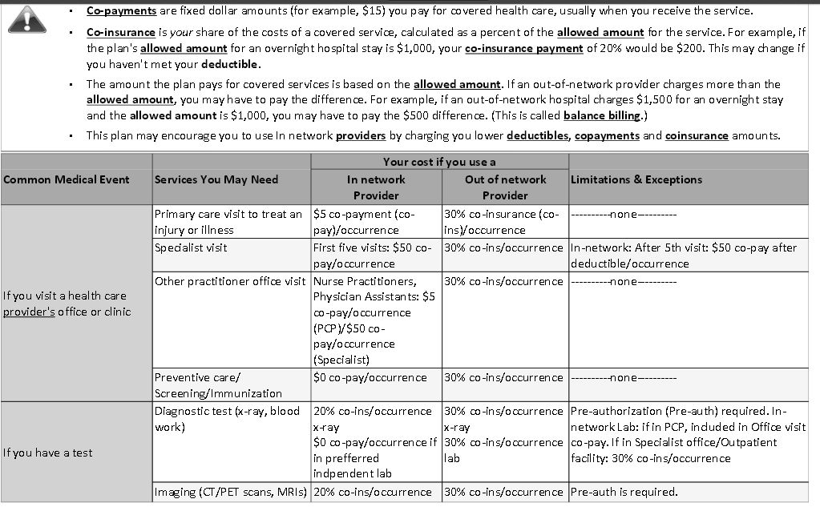
Additional information found the in “Plan Brochure” in more detail than the summary tables found on HealthCare.gov. This information is provided directly by the insurance company. If you have questions about your benefits, please contact the insurance company directly.

Slide 69
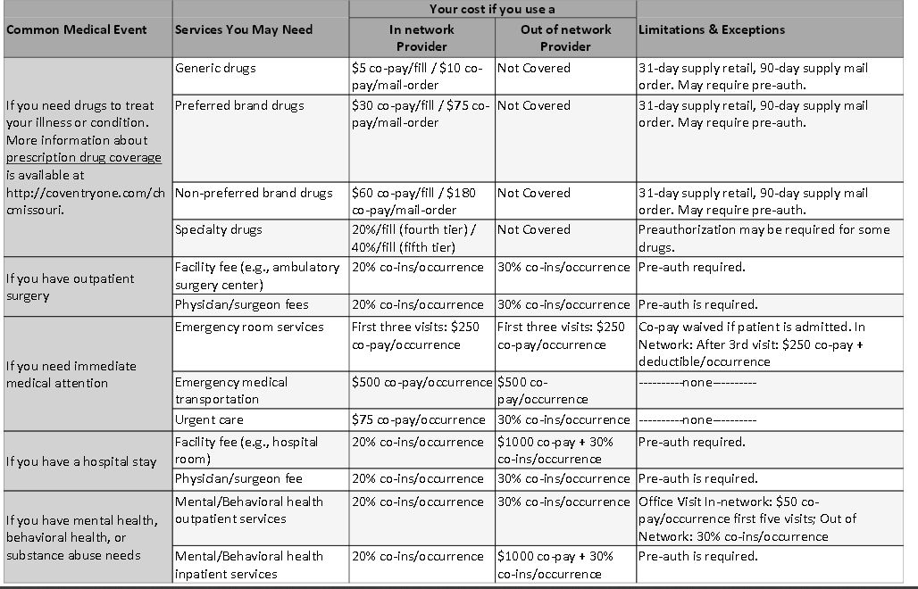
Examples of fees in a specific “Plan Brochure”. Cover Lemay suggests comparing costs by using this information to compare between plans.

Slide 70
Table of Contents
Step One: Creating a Marketplace Account
Step Two: Starting a Marketplace Application
Step Three: Entering Household Information
Step Four: Entering Income Information
Step Five: Entering Additional Information
Step Six: Reviewing and Signing
Step Seven: Reviewing Eligibility Notice
Step Eight: Comparing and Choosing a Health Plan
Step Nine: Comparing and Choosing a Dental Plan *next
Step Ten: Making a Premium Payment
Other: Navigating Your Profile and Application
When to Contact Cover Lemay: Unique Situations

Slide 71
Comparing and Choosing a Dental Plan
Step Nine:

Slide 72
Click the “Set” button to move forward with dental plan preferences
For children: The Affordable Care Act mandates that dental insurance must be available through a health plan or available to be purchased separately. Parents may choose whether or not to purchase a separate children’s dental insurance plan without penalty. Most health insurance plans include children’s dental insurance.
For adults: Dental insurance is not usually included in the health plan and must be selected as a stand alone plan.
For all: Dental insurance in the Marketplace is only available if an individual first enrolls in a health plan.

Slide 73
Set whether or not you are interested in enrolling in a dental plan. You can choose “Yes” and view the plans (with any leftover premium tax credit from the health plans applied to the dental plans). You may return to the main screen at any point to change your preferences to “No”.

Slide 74
Click “Change” if you previously set your dental preferences NOT “Set”
Return to this screen to change your dental plan preferences if necessary. You may also change your health insurance plan.

Slide 75
Click “Set” to move forward to finalizing your insurance plans and to make your first premium payment.
After choosing a dental plan or choosing not to enroll in a dental plan, you will return to this main screen. Click the “Set” button to review and confirm your health and/or dental insurance plan coverage.

Slide 76
After finalizing your plan, you will need to review the following statements.
Continued on next screen.

Slide 77
Sign electronically by typing your name as it appears on your Social Security card.
Review the remaining statements and choose “Agree” to move forward. Type your name to sign electronically.

Slide 78
Table of Contents
Step One: Creating a Marketplace Account
Step Two: Starting a Marketplace Application
Step Three: Entering Household Information
Step Four: Entering Income Information
Step Five: Entering Additional Information
Step Six: Reviewing and Signing
Step Seven: Reviewing Eligibility Notice
Step Eight: Comparing and Choosing a Health Plan
Step Nine: Comparing and Choosing a Dental Plan
Step Ten: Making a Premium Payment *next
Other: Navigating Your Profile and Application
When to Contact Cover Lemay: Unique Situations

Slide 79
Making a Premium Payment
Step Ten:

Slide 80
Making a Premium Payment
The easiest method is online, through the Marketplace immediately following confirmation of your enrollment
You may also make payments in the following methods depending on what is available through your specific insurance company:
Online through the insurance company’s website
Over the phone with the insurance company
Mailing a check to the insurance company
Accepted methods of premium payments:
Automatic debit/bank draft (can be set up for monthly billing)
Credit card (can be set up for monthly billing)
Check

Slide 81
Table of Contents
Step One: Creating a Marketplace Account
Step Two: Starting a Marketplace Application
Step Three: Entering Household Information
Step Four: Entering Income Information
Step Five: Entering Additional Information
Step Six: Reviewing and Signing
Step Seven: Reviewing Eligibility Notice
Step Eight: Comparing and Choosing a Health Plan
Step Nine: Comparing and Choosing a Dental Plan
Step Ten: Making a Premium Payment
Other: Navigating Your Profile and Application *next
When to Contact Cover Lemay: Unique Situations

Slide 82
Navigating Your Profile and Application
After Signing and Submitting or Continuing an Application

Slide 83
Click the profile figure to choose “My Applications and Coverage” to view this screen
Return to this screen if you need to resume enrollment, review complete enrollment, review eligibility status, report a life change, or update your preferences.

Slide 84
If enrollment into a health plan has not been completed, the screen will state there are currently no plans. If enrollment has been completed, you will be able to see the exact plan, premium amounts, and plan details.

Slide 85
Choose this option on the menu to review.
You may return to view your eligibility results at any point during the process. When you click the green button, the results will download in PDF format. If you have pending appeals, you may also view the status here.

Slide 86
This will be available in an online format shortly. See your CAC or search HealthCare.gov for the paper form in the meantime.
You must update the Marketplace on any qualifying life changes as stated above within 30 days of the change occurring. As of 1/1/14, this option is only available in paper form.

Slide 87
If you need to update your personal contact information or how you would like the Marketplace to contact you, change it in your profile under “Communication Preferences”. Make sure this is up to date as you will receive important notices about your coverage.

Slide 88
You may receive notices from HealthCare.gov regarding your account. Make sure to keep your account preferences updated including email and phone number for contact.

Slide 89
If you would like to give an authorized representative access to your application, you must call the Marketplace at 1-800-318-2596 to provide the contact information of the authorized individual. You currently cannot give permission through the application or in your profile as of 1/1/14. You may revoke access at any point by calling Marketplace Assistance to update your preferences.

Slide 90
Click “Continue Application” if you had to log out previously or were unable to provide required information before
Use this panel to update your account. Note: “Application details” is where you can upload supporting documents if necessary.
If you need to return to your account, you will see this screen. Use the left hand panel to navigate. If you have already enrolled in a plan, “My plans & programs” will display the insurance plan name, premium amounts, and plan start date. If your application is not complete, the above screen will display to allow you to continue. You may also remove your application if needed.

Slide 91
Remove application if there are unresolvable issues or incorrect information
Click here for details about current application status and program/plan enrollment
Review current application status, application ID, and remove the application if necessary. The left panel also provides links to additional information.

Slide 92
Table of Contents
Step One: Creating a Marketplace Account
Step Two: Starting a Marketplace Application
Step Three: Entering Household Information
Step Four: Entering Income Information
Step Five: Entering Additional Information
Step Six: Reviewing and Signing
Step Seven: Reviewing Eligibility Notice
Step Eight: Comparing and Choosing a Health Plan
Step Nine: Comparing and Choosing a Dental Plan
Step Ten: Making a Premium Payment
Other: Navigating Your Profile and Application
When to Contact Cover Lemay: Unique Situations *next

Slide 93
Unique Situations
When to contact Cover Lemay for assistance

Slide 94
Contact Cover Lemay if:
Your eligibility statement requests you to upload or submit additional required documents
You believe your eligibility results are incorrect and would like to appeal
You did not receive eligibility results, have difficulty locating them, or have questions
You need to request an exemption
You need to report a life change event
You input incorrect information in the application and need to start over

Slide 95
Cover Lemay can provide education and enrollment assistance for the Affordable Care Act Marketplace
Cover Lemay
www.CoverLemay.com
(314) 691-7469
CoverLemay@gmail.com

Slide 96
Table of Contents
Step One: Creating a Marketplace Account
Step Two: Starting a Marketplace Application
Step Three: Entering Household Information
Step Four: Entering Income Information
Step Five: Entering Additional Information
Step Six: Reviewing and Signing
Step Seven: Reviewing Eligibility Notice
Step Eight: Comparing and Choosing a Health Plan
Step Nine: Comparing and Choosing a Dental Plan
Step Ten: Making a Premium Payment
Other: Navigating Your Profile and Application
When to Contact Cover Lemay: Unique Situations
-End-

