Slide 1
Health Care Coverage for Immigrant Families: Challenges & Opportunities
Betzabel Estudillo
Health Policy Coordinator
California Immigrant Policy

Slide 2
Founded in 1996, CIPC is a non-partisan, non-profit statewide organization that seeks to inform public debate and policy decisions on issues affecting the state’s immigrants and their families in order to improve the quality of life for all Californians. CIPC engages in policy advocacy, and also provides technical assistance, training and education on immigrant issues.

Slide 3
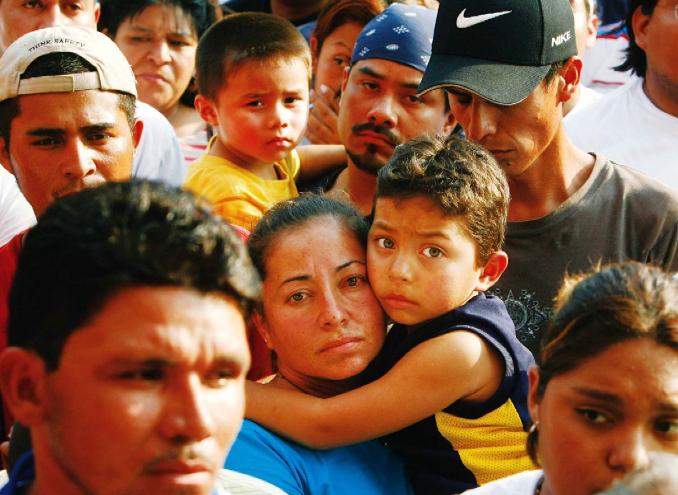
Immigrants in the U.S.
41 million immigrants nationwide
11 million undocumented immigrants nationwide
~ 10 million immigrants in CA
~ 919,000 immigrants in AZ
Deportation Raids
More than 2 million deportations
under the Obama Administration
Central American refugee deportations
Fear and mistrust in immigrant
communities
Source: U.S Census, 2013

Slide 4
What does healthcare access look like for immigrants?

Slide 5
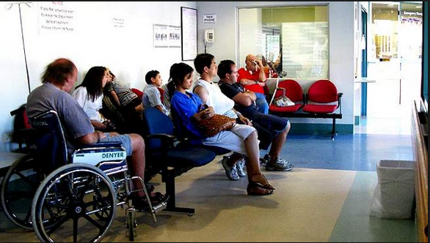
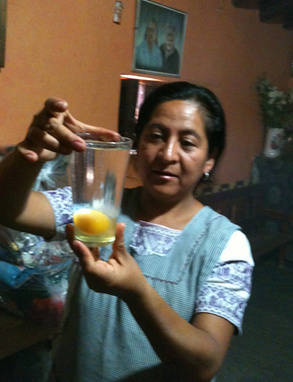

Slide 6
Implementation of the ACA in California
CA has been shifting to a health care system that meets the 'quadruple aim’: reducing costs, providing better care, and reducing disparities
State Marketplace – Covered California
Expansion of Medicaid (Medi-Cal)– Beginning January 1, 2014, all low-income childless adults including qualified immigrants and PRUCOL are eligible for full-scope Medi-Cal, if they meet the income requirement.
Notes:
Working from the federal standards and going beyond, California has chosen to operate its own exchange (Covered California) to expand and streamline its Medi-Cal program, fine tuning the exchange marketplace and setting standards for employer coverage.
Covered CA is an "active purchaser" with the ability to negotiate the best value for California consumers and with strong conflict-of-interest provisions so that the health industry isn't on both sides of the bargaining table.
Enrollment in California’s health insurance program for low-income individuals, Medi-Cal, grew by 35% between 2013 and 2014 under the Affordable Care Act (ACA).
California has been a Leader in Medicaid Enrollment under the ACA

Slide 7
Immigrants and the ACA
Eligibility
All lawfully present immigrants are eligible for the ACA and financial assistance (Deferred Action for Childhood Arrivals recipients are not eligible)
Undocumented immigrants are not eligible to purchase coverage through our state’s exchange Covered CA or receive comprehensive coverage through full scope Medi-Cal
Challenges
Mixed status families – confusion about eligibility, fear, lack of information.
Complexity of U.S. healthcare system
Undocumented people and DACA recipients were wrongfully charged a tax penalty for not having health insurance

Slide 8
DACA Demographics
What is DACA?
UC Berkeley Labor Center/UCLA Center for Health Policy Research Report Study (February 2014)
154,000 Californians granted deferred action under DACA (December 2013)
Estimated that up to 125,000 would be eligible for Medi-Cal
Many DACA recipients in CA will likely remain uninsured because they do not qualify for or will enroll in Medi-Cal or will lack access to affordable private coverage
Current Data:
DACA Recipients in CA: 362, 017 (September 2015)
DACA Recipients in AZ: 42,009 (September, 2015)
Notes:
An estimated 937,000 individuals nationally were eligible for the DACA program when it began in 2012
To date, roughly 665,000 people have received DACA.
California has more individuals eligible for the DACA program than any other state
Estimated that up to 125,000 (81%) are eligible for Medi-Cal ( high estimate since DACA recipients may be able to secure job that provide health coverage)
Nationwide Survey (NILC/Center for American Progress/Tom K. Wong)- A number of early surveys show that DACA has improved the lives of its recipients, and economic impact analyses have found that wages rise as recipients gain work authorization, get jobs that better match their skills and training, and invest more in higher education.

Slide 9
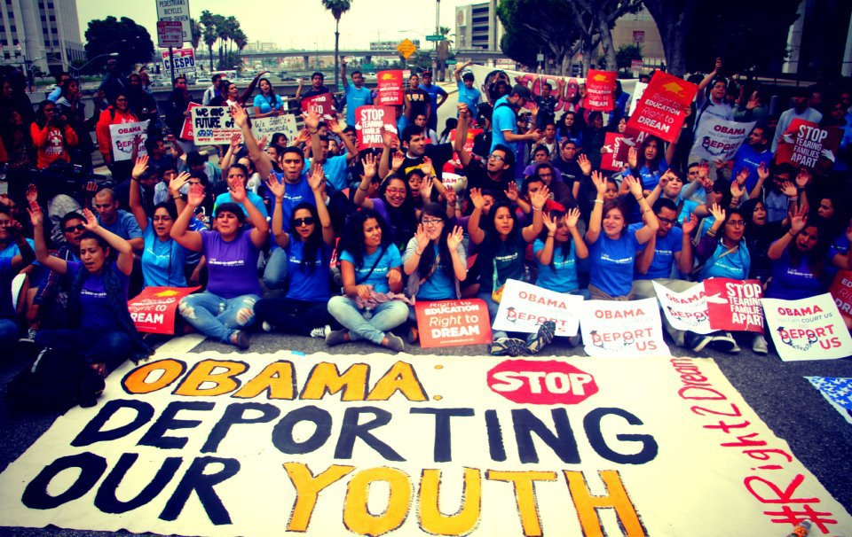
Taking the ACA out of DACA
President Obama’s announcement to exclude DACA individuals from the Affordable Care Act (ACA)
U.S. Department of Health and Human Services (HHS) specifically excluded DACA recipients from eligibility for health insurance through federal Medicaid and the Marketplaces (with or without subsidies)
Not subject to the individual
mandate
Photo Credit: Pocho-One Photography
Notes:
Although the USCIS considers individuals granted DACA to be lawfully present in the U.S.,10 the U.S. Department of Health and Human Services (HHS) specifically excluded them from eligibility for health insurance through federal Medicaid and the Marketplaces, with or without subsidies
As a result of being excluded from the HHS definition of “lawfully present,” they are explicitly exempt from the ACA’s requirement to have insurance

Slide 10
DACA & Medi-Cal
Medi-Cal Expansion— Starting January 1, 2014, all low-income childless adults including qualified immigrants and PRUCOL are eligible for full-scope Medi-Cal, if they meet the income requirement.
DACA individuals are eligible for full-scope Medi-Cal, if they meet the income requirement.
How is this true?
In California DACA status is considered Permanently Residing in the U.S. under the Color of Law (PRUCOL) and are eligible for state-funded full-scope Medi-Cal benefits
Notes:
DACA recipients and undocumented people are excluded from purchasing health coverage and receiving tax credits through the Affordable Care Act. Therefore, they cannot buy and are not mandated to have health insurance through California’s marketplace, Covered California
California immigrants with DACA status are considered “Permanently Residing under the Color of Law” or PRUCOL, a category that is used by government benefit programs in California such as Medi-Cal.

Slide 11
Challenges & Opportunities
DACA recipients unaware they may be potentially eligible for full-scope Medi-Cal
DACA recipients see healthcare as a privilege- culture shift in healthcare access
County eligibility workers unaware of DACA status and eligibility for Medi-Cal, or have provided incorrect information
DACA recipients concerns with applying due to fear of deportation (for extended undoc family members), public charge, and that it may hurt their chances of adjusting their status in the future
Opportunity to work with immigrant youth, advocates, immigrant rights organizations, and the Department of Health Care Services (DHCS)
Key step towards ensuring that all Californians have access to healthcare

Slide 12
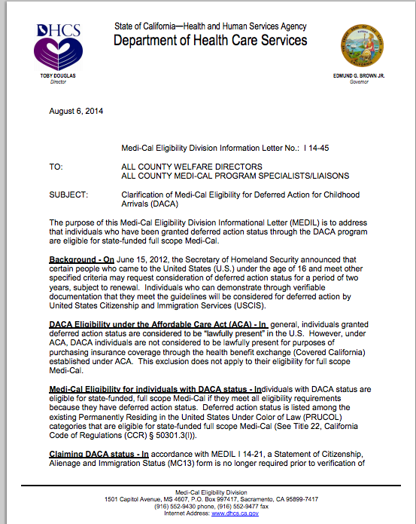
Medi-Cal Eligibility Division Information Letter No.: I 14-45
Notes:
Discuss the purpose of the MEDIL
Some Medi-Cal workers may not be aware that DACA recipients are eligible for Medi-Cal and may turn them away or discourage them from applying. If that happens, there is a state memo “MEDIL” that explains to the Medi-Cal worker that they are eligible for full-scope as a DACA recipient.
They can print out the MEDIL document and bring it with them when they apply in person.

Slide 13
Covered CA & CA Immigrants
An estimated 1.2 million, or 46%, of the 2.6 million Californians eligible for federal premium subsidies are Latino.
Low Latino enrollment – During OE1 20% of those enrolled identified as Latina/o enrollment
Challenges
Fear of deportation for undocumented family members
Public charge
Eligibility confusion
Lack of cultural and linguistic competency
The Marketing, Outreach, and Enrollment Assistance Advisory (Latino & Immigrant sub group) was formed in response to the low enrollment numbers of Latinos and to address the challenges and need of immigrant families

Slide 14
Covered CA & CA Immigrants
Opportunities for increasing enrollment
Partnership with legislative and community leaders and immigrant rights/grassroots organizations
Partnership with ethnic media for coverage on immigrant issues
Covered CA Immigration Fact Sheets developed and translated in all 13 threshold languages
Targeted messaging for mixed-status families letting them that their information is safe, secure, and confidential
Outreach efforts: press conferences, media briefings, ads/commercials that resonates with immigrant families

Slide 16
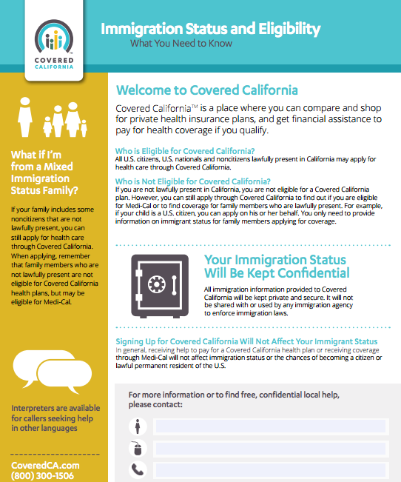

Slide 17
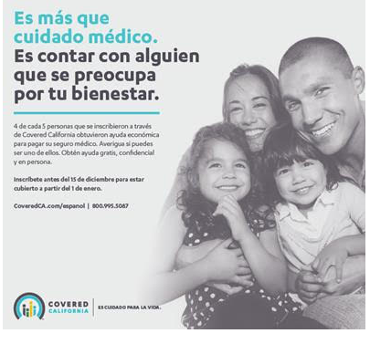

Slide 18
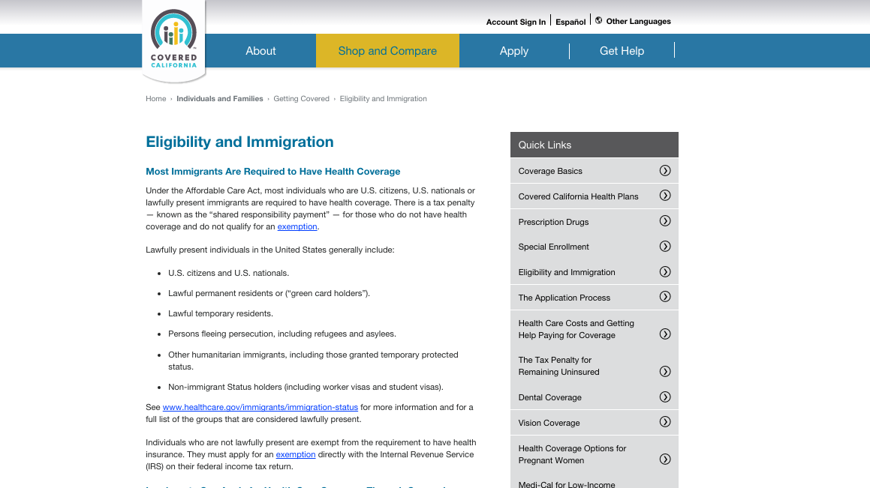

Slide 19
Strategic Communications for Immigrant Health
Building an inclusive narrative on immigrant health
Effective messaging that resonates with mixed-status families
Value-Based Messaging: We are all healthier when everyone is covered, CA is stronger when everyone has access to healthcare
Highlighting our vision of the ACA! – With Covered CA we can get help families stay healthy and set a powerful model for the nation

Slide 20
Words Matter

Slide 21
Questions?

Slide 22
Betzabel Estudillo
California Immigrant Policy Center
Los Angeles I Oakland I Sacramento
bestudillo@caimmigrant.org

