Slide 1
ABC’s of the Premium Tax Credit
Internal Revenue Service
Revised August 21, 2015

Slide 2
The information contained in this presentation is current as of August 21, 2015:
Visit IRS.gov for tax forms and instructions
For the latest information about tax provisions of the Affordable Care Act, visit IRS.gov/ACA.

Slide 3
Agenda
Background
Basics of the premium tax credit
Eligibility
How to file
Reconciling advance payments
Common errors
Resources

Slide 4
Health Insurance Marketplace
Provides information at HealthCare.gov or state Marketplace website
Enrolls individuals in health coverage
Offers financial assistance
Issues Form 1095-A, Health Insurance Marketplace Statement

Slide 5
Basics of the PTC
Refundable tax credit
Must buy Marketplace coverage
Must file Form 8962 to claim the PTC and reconcile any advance payments

Slide 6
PTC Eligibility
Must meet all of the following requirements:
Income between 100-400% of Federal Poverty Line
Taxpayer, spouse, or dependent must enroll in Marketplace coverage for a month that the enrollee is not eligible for coverage through employer or government plan
Cannot be claimed as a dependent by another person
Not file as Married Filing Separately
Note: Some exceptions apply

Slide 7
2015 Income Limits are based on 2014 FPL
One Individual:
$11,670 (100% FPL) - $46,680 (400% FPL)
Family of Two:
$15,730 (100% FPL) - $62,920 (400% FPL)
Family of Four:
$23,850 (100% FPL) - $95,400 (400% FPL)

Slide 8
Advance Payments of PTC (APTC)
Determined by Marketplace based on estimated household income and family size
Paid directly to insurance company on the taxpayer’s behalf
MUST file tax return to reconcile

Slide 9
How to claim the PTC
Based on actual annual household income and family size reported on the tax return
Claimed on tax return using Form 8962
Reconciles APTC
Results in either a refundable credit or repayment of excess advance payments

Slide 10
Information Statements
Marketplace - Form 1095-A,
Health Insurance Marketplace Statement
Insurers - Form 1095-B, Health Coverage
Large Employers – Form 1095-C, Employer-Provided Health Insurance Coverage and Offer

Slide 11
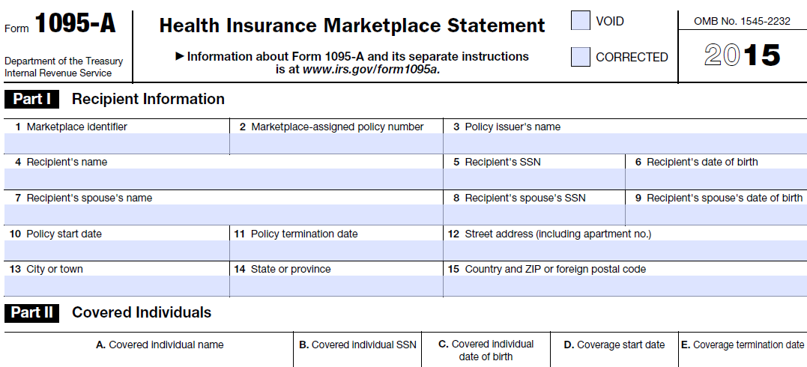
Form 1095-A

Slide 12
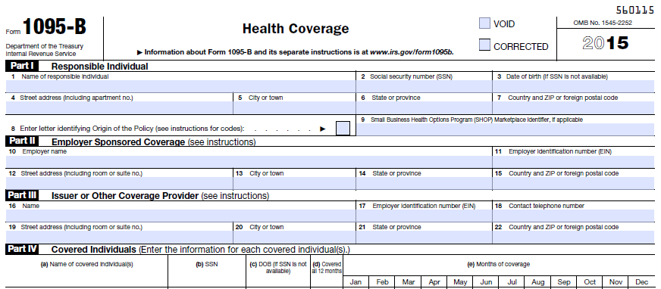
Form 1095-B

Slide 13
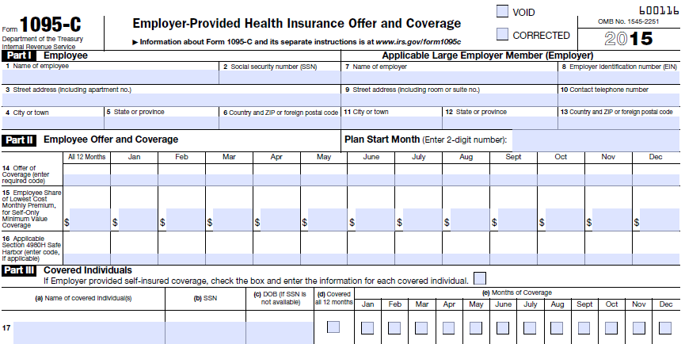
Form 1095-C

Slide 14
Forms needed to claim PTC
Form 1095-A from Marketplace
• Form 8962 to claim and reconcile PTC/APTC
File Form 8962 with 1040, 1040A or 1040NR

Slide 15
Form 8962 - Premium Tax Credit
File Form 8962 with tax return to :
claim the premium tax credit and
reconcile APTC

Slide 16
Return Preparer Interview Best Practices
Did your client receive Form 1095-A from Marketplace?
APTC
Verify coverage months and who is covered
Multiple policies issued
Were there changes in circumstances during the year?
Married/divorced
Eligible for government or employer sponsored coverage
Months without coverage

Slide 17
2014 Filing Season Recap
Reconciling APTC
Penalty relief for 2014
Reporting changes in circumstances
Corrected Forms 1095-A

Slide 18
Common Errors
Claimed PTC but failed to attach Form 8962
Did not reconcile APTC
Form 8962, Part 2, Lines 11 or 12-23 (Column F)
Form 1095-A data not correctly reported
Form 8962, Part 2, Lines 11 or 12-23 (Columns A and B)
Transposed digits

Slide 19
Common Errors
Miscalculated Monthly PTC Allowed
Form 8962, Part 2, Lines 11 or 12-23 (Column E)
Miscalculated Repayment Amount of Excess APTC
Form 8962, Part 3, Lines 28 & 29

Slide 20
2015: What You Need to Know
Forms 1095-A and 8962
Report changes in circumstance to the Marketplace if receiving APTC
2016 Marketplace enrollment
Nov 1, 2015 to January 31, 2016
Special Enrollment Periods

Slide 21
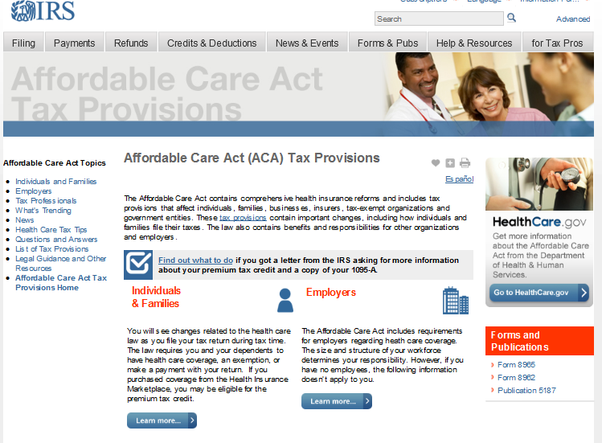
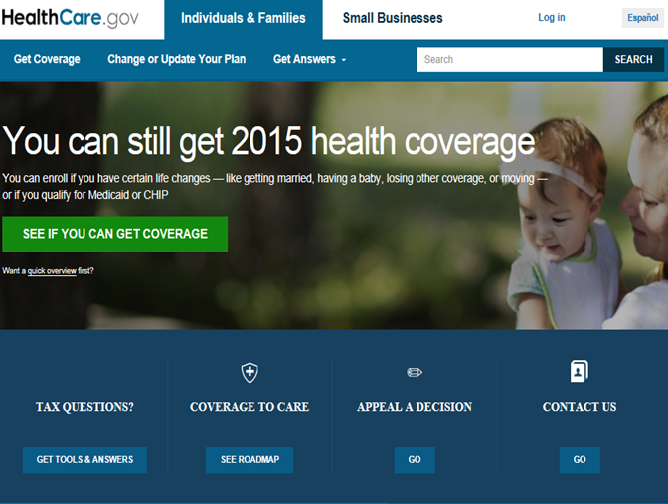
Resources
Publication 974 – Premium Tax Credit
Instructions and Form 8962, Premium Tax Credit

