Slide 1
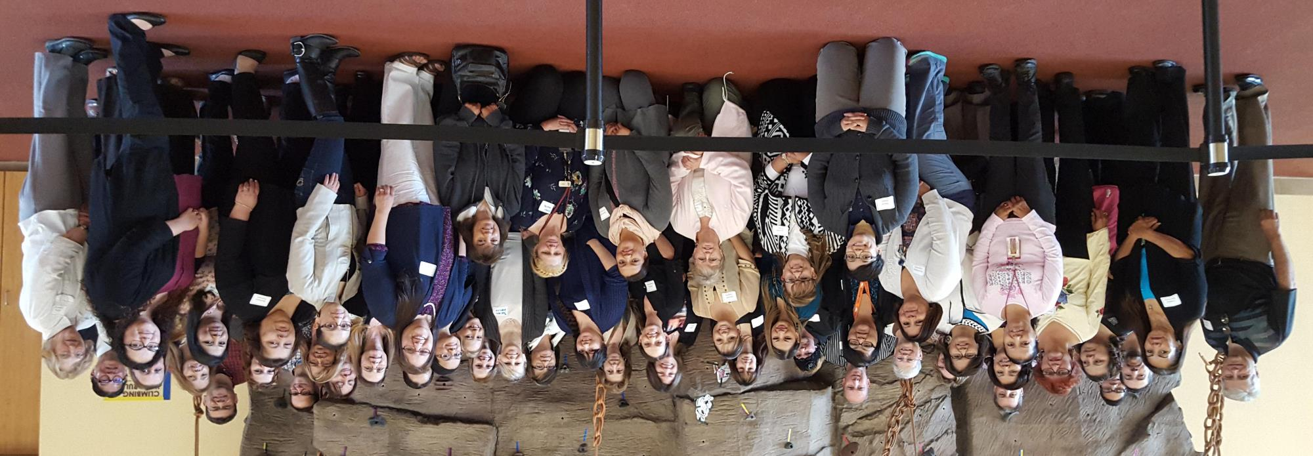

Outreach Planning in a COVID Environment
Assister Training Flagstaff, 2015

Slide 2
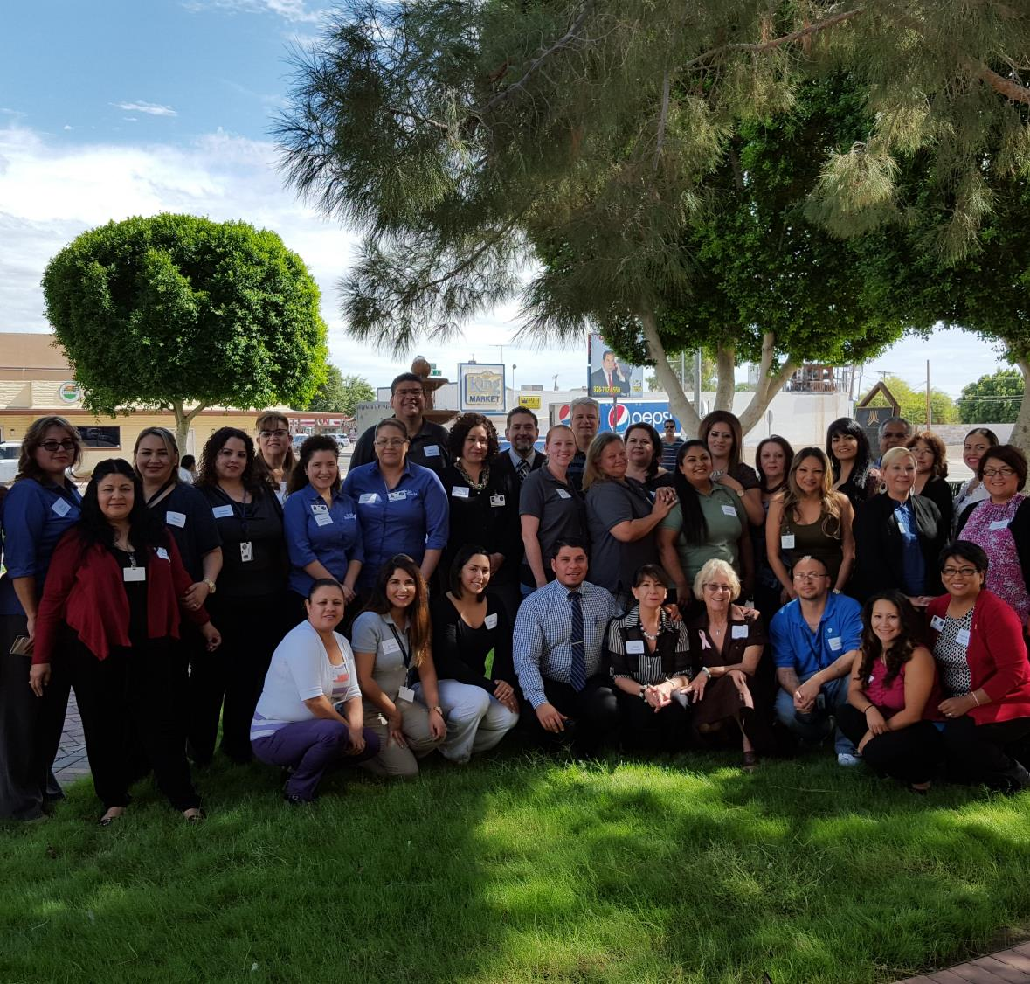
What We Will Cover
Where are the Uninsured?
Outreach Planning & COVID
Developing Your Outreach Plan
Yuma 2015

Slide 3
Building Blocks For Success
Outreach Plan Goal
Where Do They Live, Work, Play & Pray
AEA
Data-informed Messaging
Assets and Circles of Influence
Target
Method to Deliver Message
CTA

Slide 4

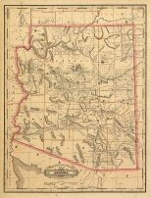
Mapping Links

Slide 5
AEA – Building Block
1
Awareness
2
Education
3
Application
“Awareness precedes a perceived need to understand, which precedes the action of applying.”
Notes:
DAVID - WORKSHEET

Slide 6
Awareness vs. Educating
AWARENESS – KEEPS ISSUE
TOP-OF-MIND
EDUCATE – REQUIRES CHANGE
IN BEHAVIOR
Short
Interesting
Effective
On-going
What
How
Impact
Call to Action
What is your aim?
Notes:
DAVID

Slide 7
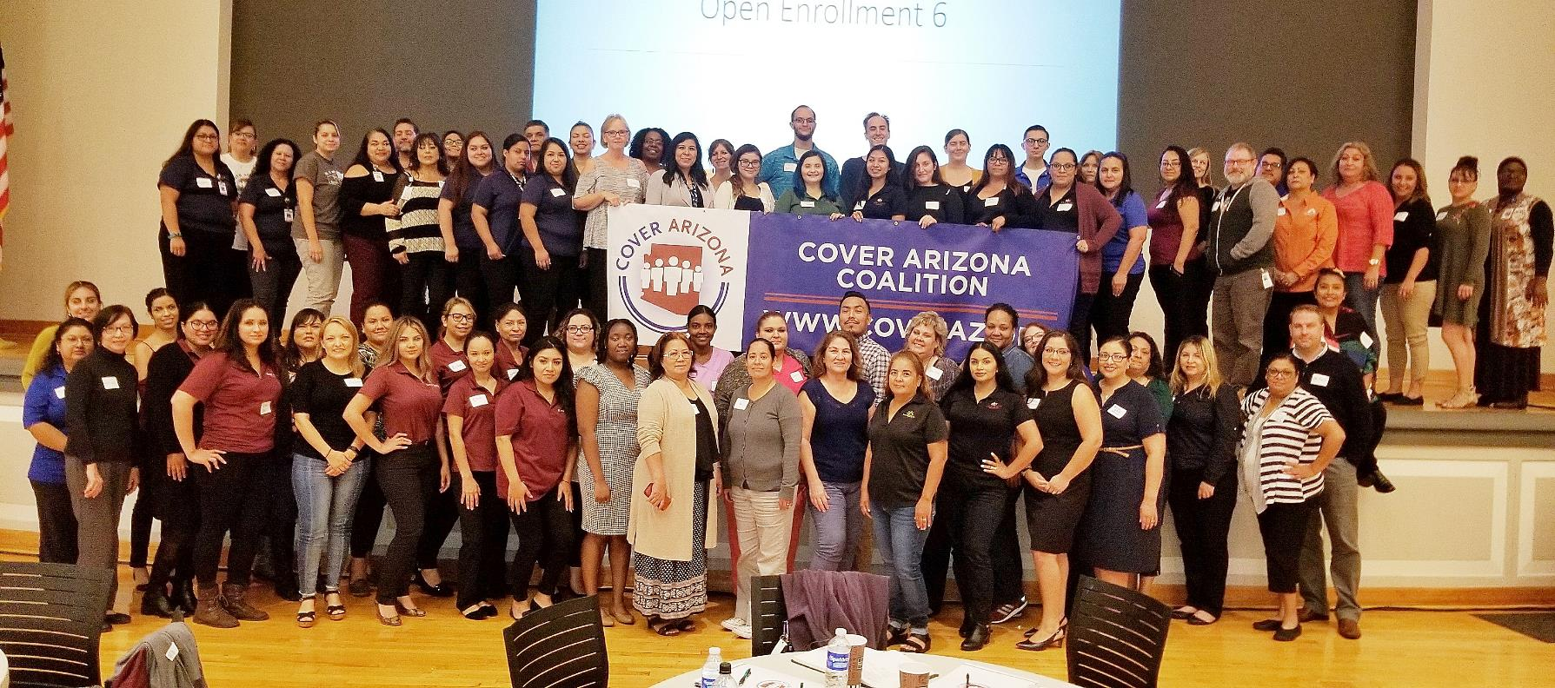
Phoenix 2018

Slide 8

How well does your community understand their coverage options?
Quick Poll --- polling instructions

Slide 9



Building Block:
Call to Action (CTA)
In marketing, a call to action (CTA) is an instruction to the audience to provoke an immediate response, usually using an imperative verb such as "call now to find out more" or "visit a store today".
Not Your Story or Message
See Handout
Notes:
DAVID - WORKSHEET

Slide 10

Everyone everywhere is not a marketing plan.

Slide 11

Don’t Spray & Pray!
“If you don’t know who they are, you won’t know where to look, or if you found them”.
Somebody

Slide 12

Building Block:
Who Are Your Primary Targets?
Describe your target audience characteristics:
Gender Identity
Age Range
Single, Couple, Kids?
Where Do They Live
Ethnic or Cultural
Other Identity Factors

Slide 13
Write Your Descriptions, Top Three Targets
Descriptors | Your Description
Gender Identity
Age Range
Single or Couple
Kids at Home
Where Do They Live
Ethnic or Cultural Characteristics
Other Identity Factors
See your handout

Slide 14
Example
Primary Target Audience:
Latinas (female) between ages
22 and 48
Children living at home
Living in or near Casa Grande
and Maricopa
Low to moderate income

Slide 15

Building Block:
Where Are They
See your handout
Where do they live?
What are the area schools?
Where do they shop for food?
What clubs or groups do they join?
Where do they worship?
Which radio stations most likely listening to?
Most likely publications or websites to use?

Slide 16
Building Block:
Where Are They
See your handout
Schools
  Admin
  Communications staff
  Nurse (Health Aide)
  McKinney Vento staff
  Coaches
Common Backgrounds
  Food stores
  Cultural centers
  Types of business
  ESL classes

Slide 17
Building Block:
Organizations that serve your targets
Food Pantries
Food Banks
Food
Housing Help
CAP Office
?
Utility
Homeless Shelters
Low Income Housing

Slide 18


Creative Outreach Example

Slide 19


Creative Outreach Example
Mom’s Groups

Slide 20

Instructions:
15 minutes.
Use the handout to describe you top two targets audiences.
#1

Slide 21
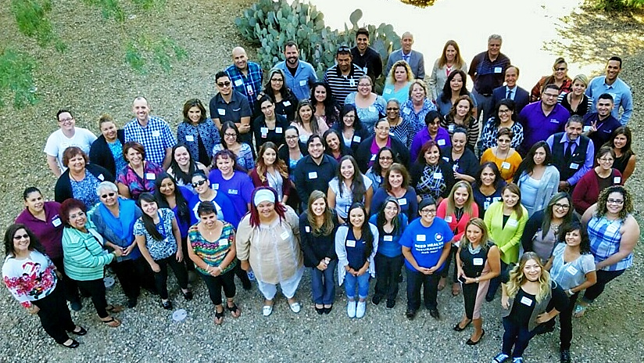
Tucson 2016

Slide 22
It Takes Time to Decide
Immediate Yes/No
Medium Time for Yes/No
Multiple levels and longer time for Yes/No
School Districts, Hospitals,
Big Businesses
Larger Businesses
Business Owner
Time to Decide

Slide 23
Circles of Influence
Who can you reach and influence?
Daily or Weekly
Monthly
Few Times a Year
Internal
Notes:
CHERYL -WORKSHEET

Slide 24

Who can help – Internal Audience
Staff
  Front Desk
  Those who answer
  the phone
  Billing office
  Others
Patients
Friends
Donors
Board
Others???
Notes:
CHERYL

Slide 25
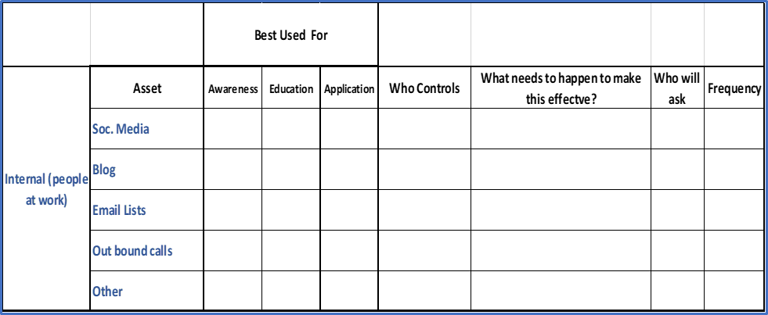
Internal and External Assets
A-E-A
Who do you need to talk to?
Notes:
DAVID -WORKSHEET

Slide 26
Building Blocks
Outreach Plan Goal
Where Do They Live, Work, Play & Pray
AEA
Data-informed Messaging
Assets and Circles of Influence
Target
Method to Deliver Message
CTA

Slide 27

Data-based Messaging

Slide 28
Where did people get their insurance before COVID?
Background

Slide 29
Background
AZ 2018 to 2019 one half of one percent increase
Approximately 40% or 324,000 uninsured Arizonans earn under 200% FPL

Slide 30
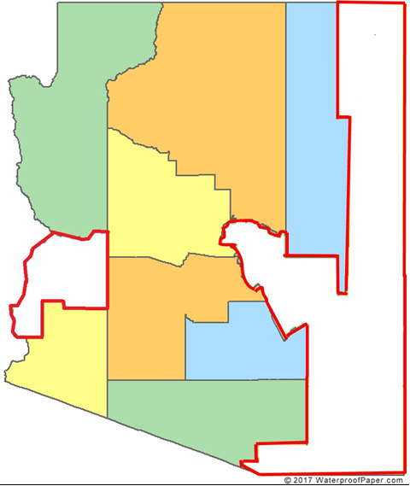
324,000 is more than the combined populations of Greenlee, La Paz, Graham, Santa Cruz, Gila and Apache Counties.

Slide 31



Recent Research
Background
Nearly one in five (18%) consumers who looked for coverage or actively
renewed their coverage, or about seven million people, received consumer
assistance in the past year. Most who enrolled in coverage with help said
assistance made a difference; 40% think it is unlikely they would have found
coverage without help.
Another 12% of target consumers—nearly five million people—tried to find help but did not get it, suggesting there is a shortage of consumer assistance. Among target consumers who were not helped in the past year, two-thirds said they would likely seek consumer assistance if it were available.
Consumer Assistance in Health Insurance: Evidence of Impact and Unmet Need – Methods – 9511 | KFF

Slide 32

Recent Research
Background
Roughly one in four marketplace enrollees who were helped by a broker or commercial health plan representative said they were offered a non-ACA compliant policy as an alternative or supplement to a marketplace policy. Brokers and commercial health plan representatives rarely help with Medicaid enrollment.
Assistance in Health Insurance: Evidence of Impact and Unmet Need – Methods – 9511 | KFF
“Roughly one-quarter may be doing such a bad job that they’re engaging in deceptive marketing practices”.
Eight of 31 Non-ACA Health Agents Flunk GAO Honesty Test, Allison Bell | September 17, 2020 at 02:46 PM, ThinkAdvisor

Slide 33
AHCCCS and Marketplace Consumers Have Different Issues
Background

Slide 34
Uninsured
Background
Cost still poses a major barrier to coverage
for the uninsured. In 2018, 45% of uninsured nonelderly adults said they were uninsured because the cost is too high, making it the most common reason cited for being uninsured.
Individuals with income below 200% of the Federal Poverty Level (FPL) are at the highest risk of being uninsured. In total, more than eight in ten of the uninsured were in families with incomes below 400% of poverty in 2018.
Many uninsured don’t know financial help is available!

Slide 35
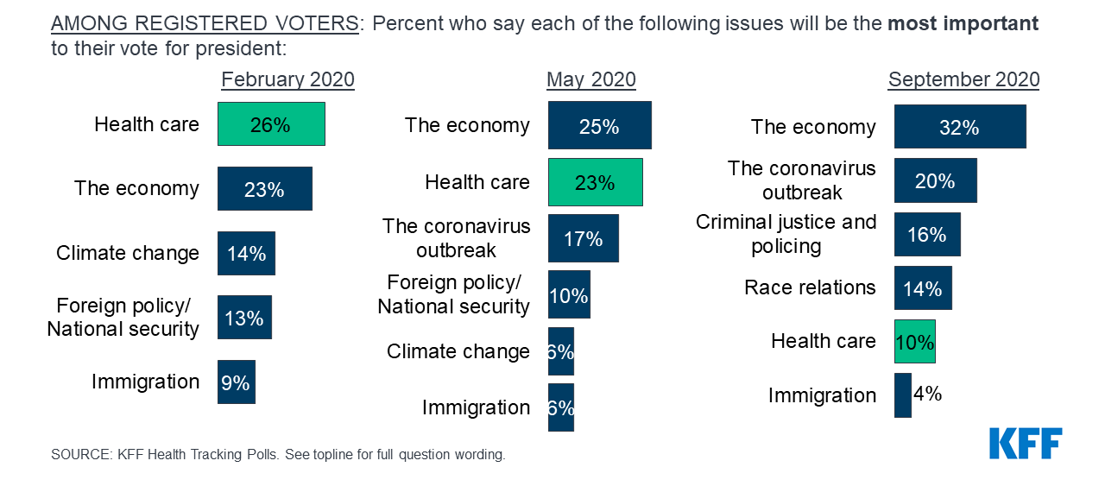
What are voters (consumers) thinking?
COVID-19 and Healthcare 30%

Slide 36
3.3 Million Lost Coverage
Between late April and mid-July, approximately 3.3 million individuals lost employer sponsored health plan coverage.
Additionally, 1.6 million—or nearly half of those who lost employer-sponsored insurance—were Hispanic individuals.
The number of uninsured individuals increased by around two million.
Robert Wood Johnson Foundation, Sept 17, 2020

Slide 37
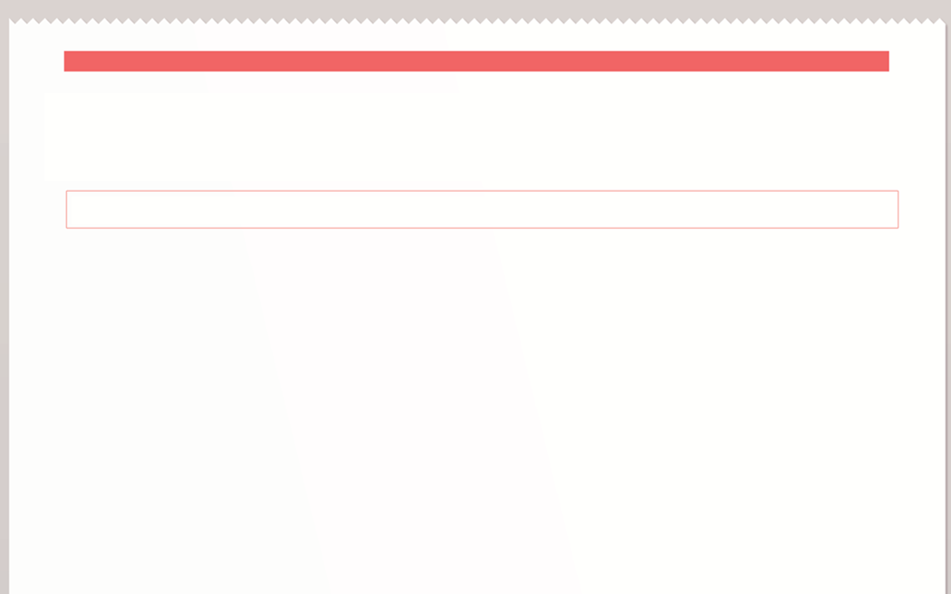


Messaging
THE DAILY NEWS
www.dailynews.com
THE WORLD’S FAVOURITE NEWSPAPER
- Since 1879
Health Insurance Is Affordable
When writing, picture your target audience
Uninsured?
Financial help is available; no-cost coverage for a family of three earning up to $28,000
Unsure how to apply - no-cost help
is available here
Most uninsured families qualify for no-cost and very low-cost coverage
Bilingual, no-cost help is available here
?

Slide 38

Remember This?
40% of uninsured earn under 200% FPL!

Slide 39
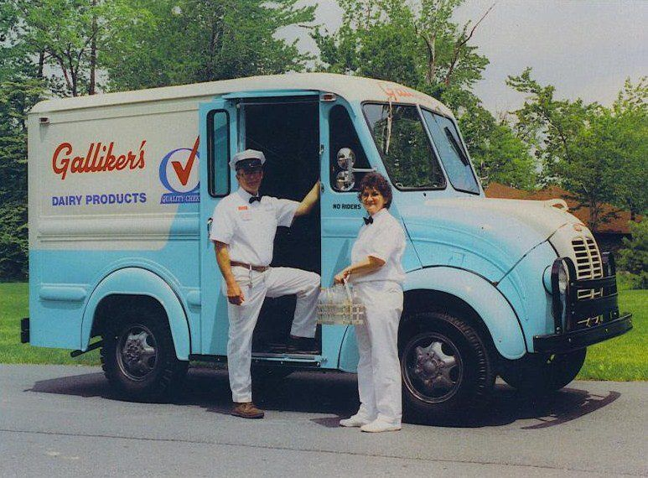
Delivering Your Message

Slide 40
Delivering Your Message
1:1 - high effectiveness, small reach
Live presentations - medium effectiveness, medium reach
Media, social media, email blasts, newsletters – low effectiveness, big reach
Effectiveness
Numbers of People Reached

Slide 41
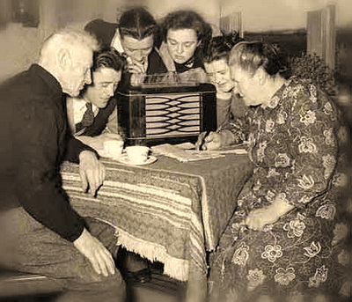
How Will You Deliver Your Message to Your Targeted Uninsured in Your Community?
Local Media
Social Media
Organizations with an Email list or Social Media Following
1:1 meetings/calls to schools, businesses and places of worship

Slide 42
Instructions
15 minutes
Use handouts
Discuss and write what your targets need to hear and how you can deliver that message.
#2

Slide 43

DEMOGRAPHICS
Gender identity
Age
Ethnicity & Culture
Language
WHERE
Live
Work
Shop
Attend school
Play
Pray
MESSAGE
AEA
CTA
Not too much or too little
What they need to hear, least needed to take action
METHOD of DELIVERY
Partners – who serve your targets
One on one
Presentations
Social Media
Articles
Mass Media
In-reach

Slide 44

REMEMBER
More than 300,000 (40%) of uninsured Arizonans earn less than 200% FPL

Slide 45

Tools
Communications Calendar
Theme weeks
Keep posts “fresh”
Tie into other news
Before & after Thanksgiving
Notes:
STAN

Slide 46
Tools
Communications Calendar: Example
Oct 15 – 31:
“Get Ready for Open Enrollment”
Nov 1 – 15:
“Most pay less X $”
Nov 16 – 30:
“Comprehensive Coverage”
Dec 1-15:
“The End Is Near”
Notes:
STAN

Slide 47

What Communication Help Is Needed?
Theme Weeks Suggestions
Articles
Memes
Talking Points
Posters
Flyers
Quick Poll – What do you need?

Slide 48







Cover AZ’s Role
Contact statewide and national media (aircover)
Provide letters to the editor and article templates and ideas for your use
Provide meme and post
Suggest themes for different periods
Assist you with your questions

Slide 49

Community Catalyst
https://drive.google.com/drive/folders/1XdQi210XQIl0Qtsgbs0B-kCwqrDsdp_l
Outreach materials (graphics, messaging, etc) covering COVID-19, health insurance literacy, Marketplace open & special enrollment periods.
Connecting Kids to Coverage National Campaign
https://www.insurekidsnow.gov/outreach-tool-library/index.html
Official CMS outreach materials for healthcare coverage and access, specifically for children. Can request some images to be customized for your organization.
From Coverage to Care
https://www.cms.gov/About-CMS/Agency-Information/OMH/equity-initiatives/from-coverage-to-care
Official CMS outreach materials for healthcare coverage and access. Can order physical copies to be shipped to your organization.

Slide 50

Get America Covered
https://www.getamericacovered.org/take-action
Messaging and graphics
Out2Enroll
https://drive.google.com/drive/u/0/folders/1tDt4Ji2uuulWja8zcD2ybwNocmi_29zi
Themed weeks, messaging, and graphics
Young Invincibles
https://drive.google.com/drive/folders/1FEcXH8cquS5-xMGNlS1LsXXDtZzI4TPn
Themed weeks, messaging, and graphics

Slide 51

Session 3
AZ Marketplace Insurance Companies
Oct 14
2 – 4 PM

Slide 52
Thank You
Questions or Need Assistance
Allen Gjersvig, alleng@aachc.org
Marcus Johnson mjohnson@vitalysthealth.org
Call 800.377.3536 or go to CoverAZ.org

